Slide 1
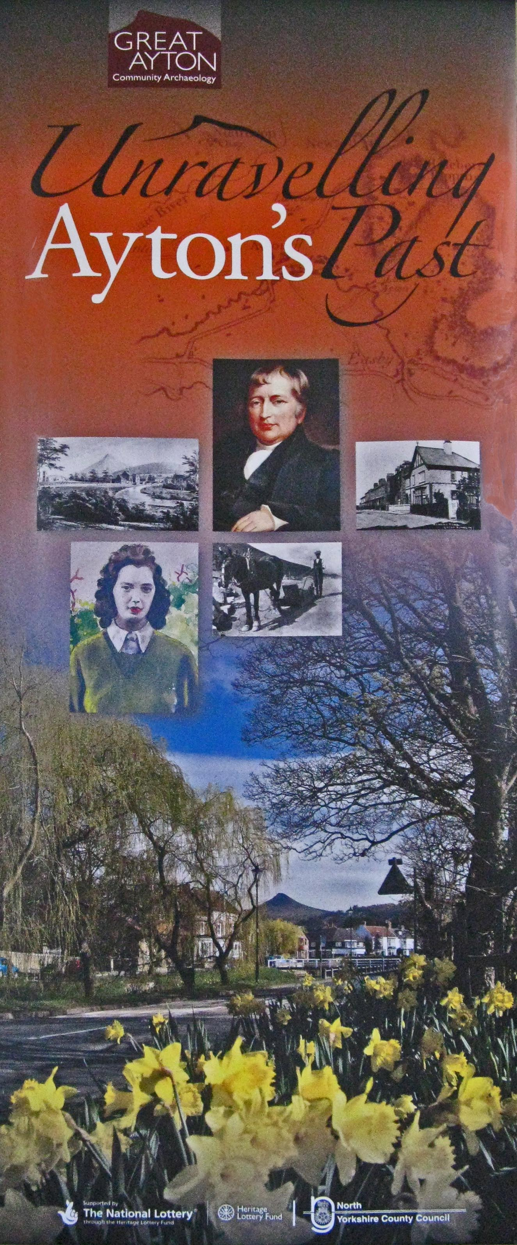
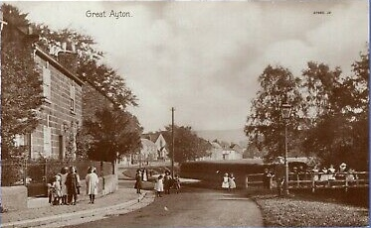
Our Village 1911
A Snapshot in Time - The Census

Slide 2
Why a census?
Reasons for a national count
Methodology
Notes:
The first national census since the ‘Domesday Book’ in 1086 took place on 10th March 1801 or as near as possible to that date.
This was prompted by concerns that the population was outgrowing the ability of the country to feed itself. (UK was in the midst of French Revolutionary Wars; plus perceived population growth with the beginnings of the Industrial Revolution)
.
Details recorded for each parish, township, or place were:
• Number of inhabited houses, occupied by how many families
• Number of uninhabited houses
• How many persons, how many male, how many female
• How many persons are chiefly employed in agriculture; how many in trade, manufactures, or handicraft; and how many in neither
• How many baptisms and burials in the years 1700 to 1800, distinguishing males from females
• How many marriages in each year from 1754 to the end of 1800
Details of individuals and their names were not recorded in the official Census returns.
The act laid down that "written Answers are to be returned by the Rector, Vicar, Curate, or Officiating Minister, and Overseers of the Poor, or (in Default thereof) by some substantial Householder, of every Parish, Township, and Place ... in England; and by the Schoolmasters or other Persons to be appointed ... for every Parish in Scotland;
This was all organised on a local basis with no centralised control.
The following 3 censuses 1811,1821 and 1831, asked the same questions and followed the same methodology.
The 1841 Census is considered to be the first modern census, with details of individuals recorded but ages, for those over 15, were rounded to the nearest multiple of ‘5’
The questions asked during the census reflected the concerns of the time. The 1851 Census was used to identify the extent of the drift from rural to urban centres reflecting the increase in industrial activity.
Between 1801 and 1851 the population of England, Wales and Scotland had doubled from 10 million to 20 million. At the same time emigration, particularly to the USA, had increased to 1000 people per day. Questions were asked if the population would continue to increase at the same rate given the level of emigration.

Slide 3
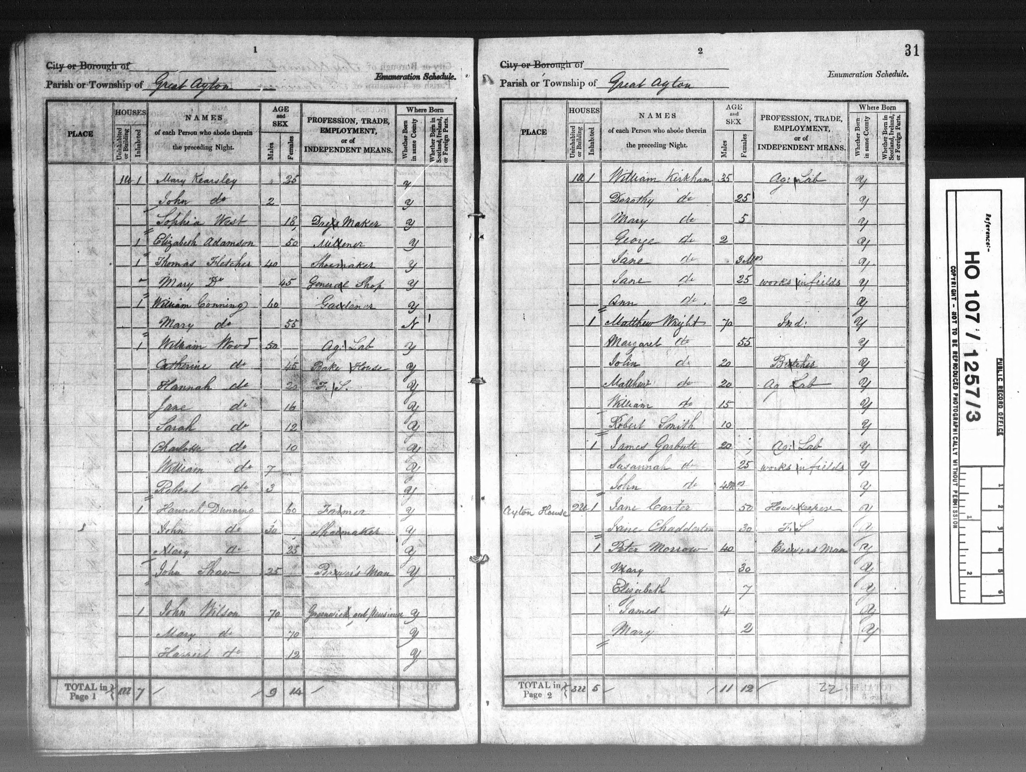
Example 1841 Census Return

Slide 4
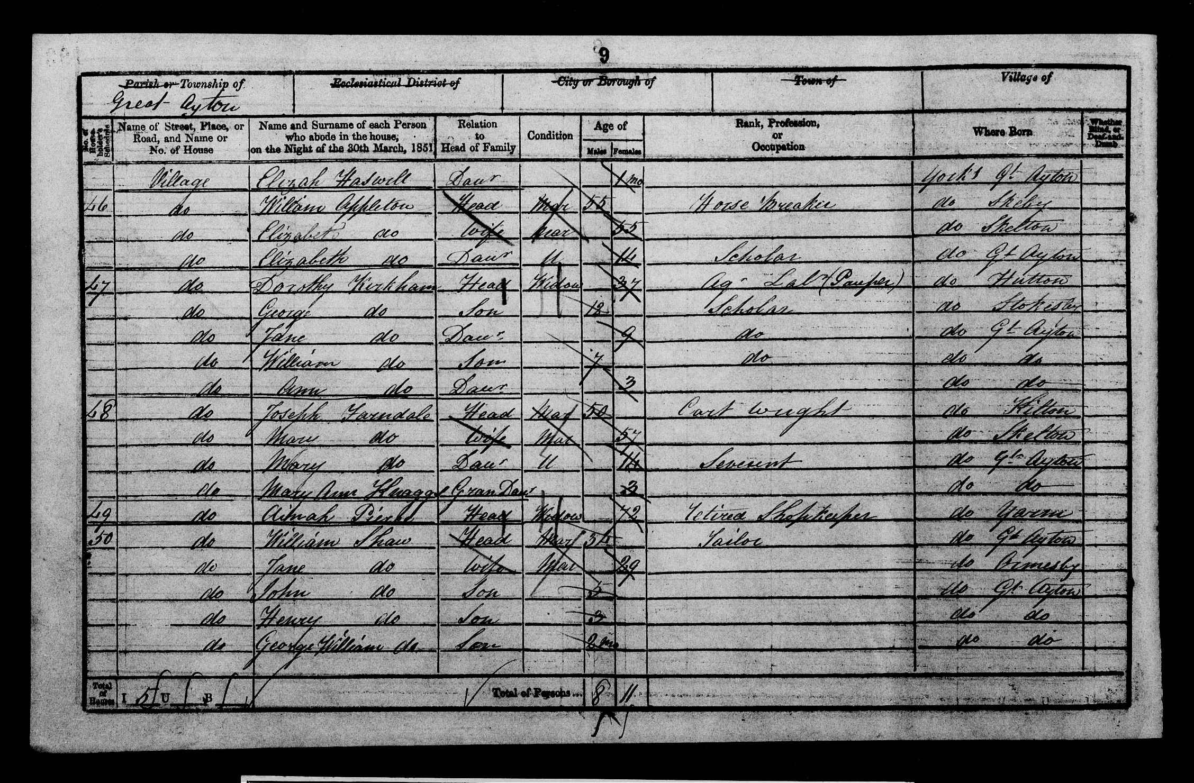
Example 1851 census Return

Slide 5
The 1911 Census
Background to the 1911 Census

Slide 6
The Census in Great Ayton
The Census Routes
The Enumerators
The Results

Slide 7
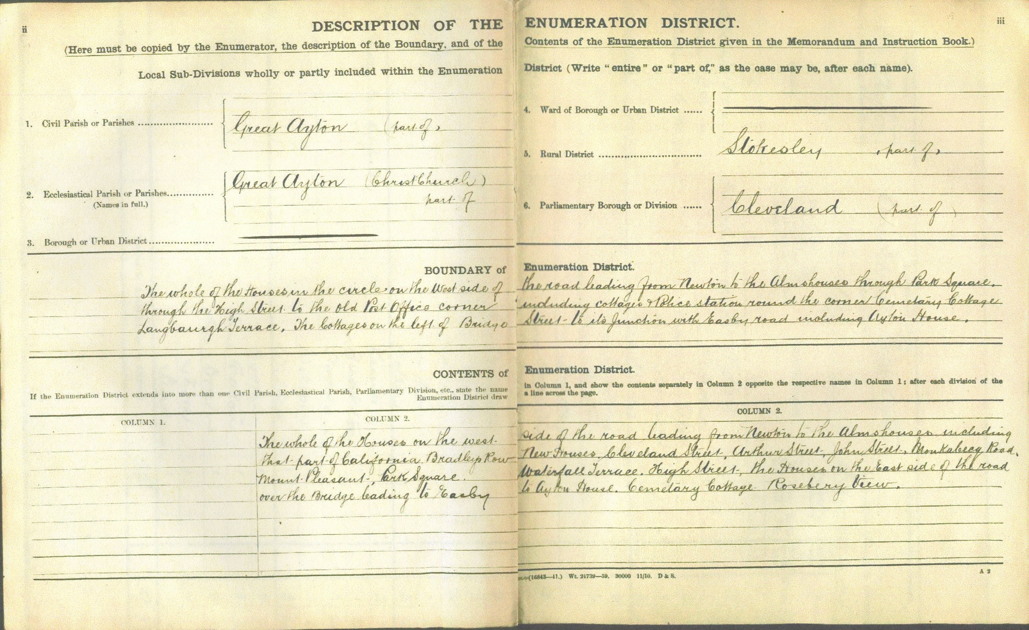
Example of route instructions

Slide 8
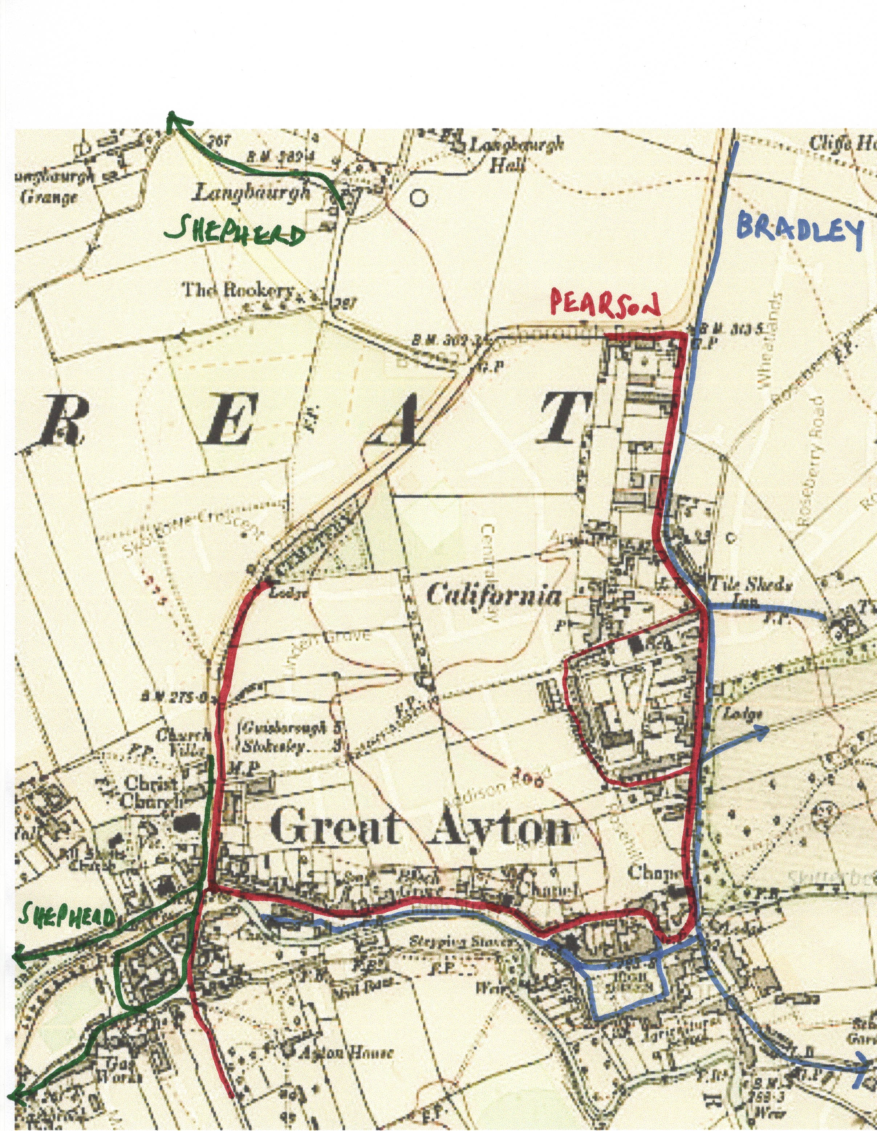
The Census Routes

Slide 9
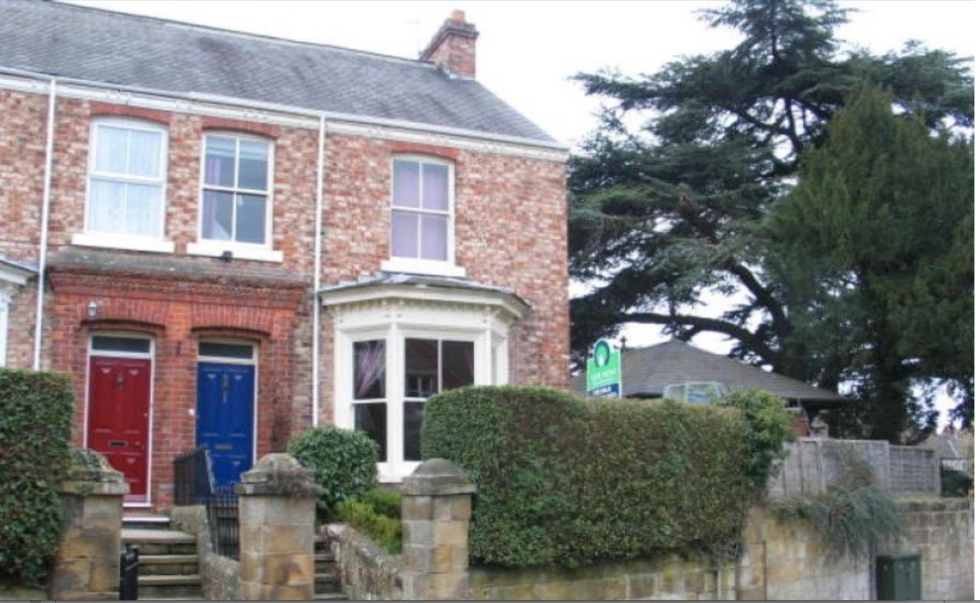
Raby Cottage, Station Road

Slide 10
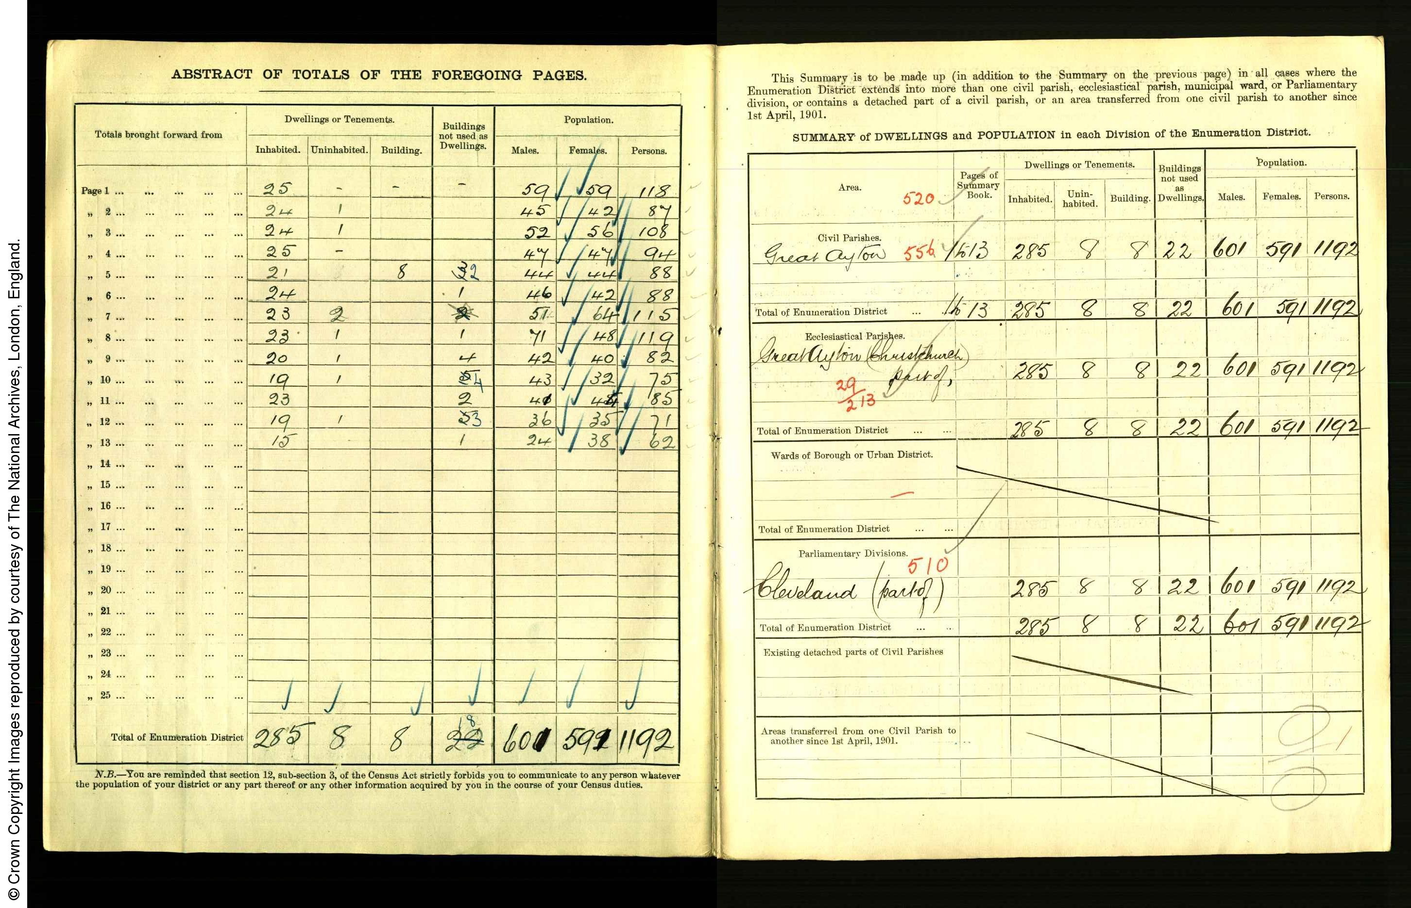

Slide 11
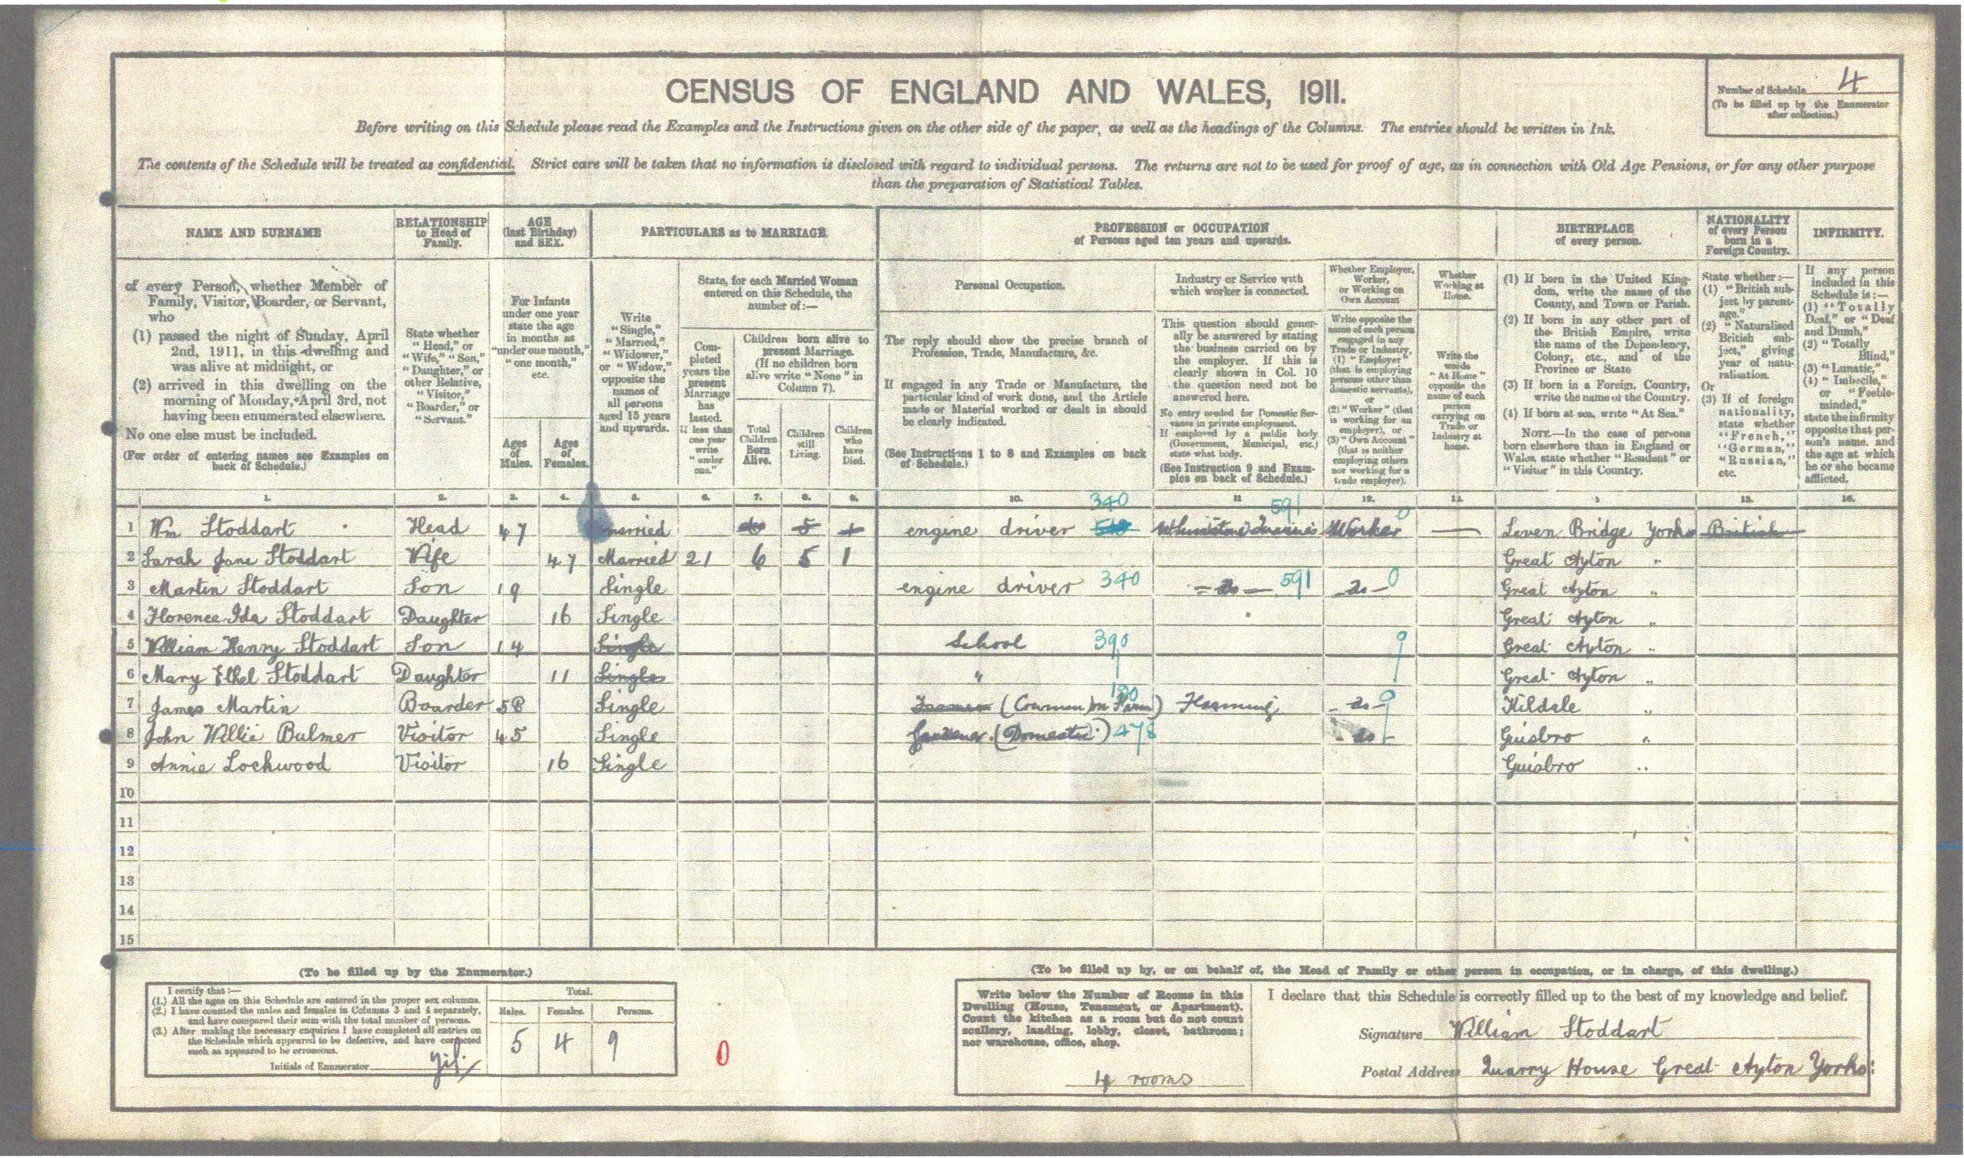

Slide 12
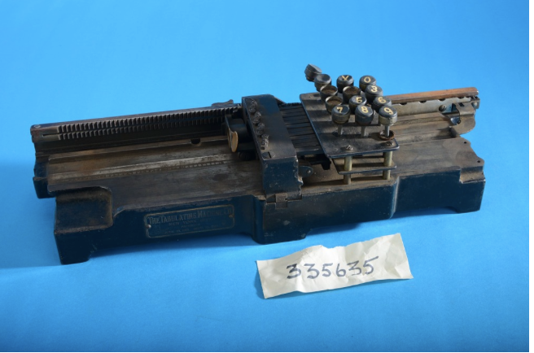
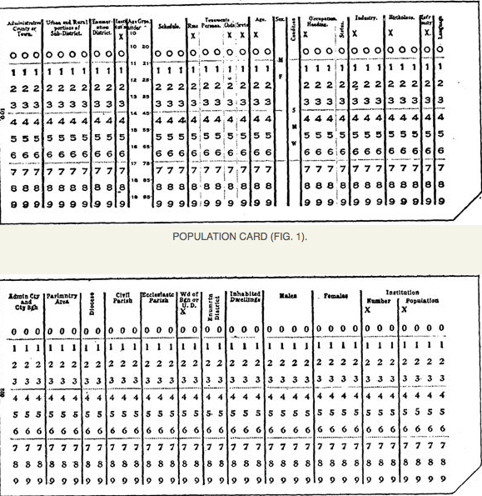
A Hollerith Punch
Card Machine
Examples of Punch Cards

Slide 13
Great Ayton Census 1911 Totals
Enumerator | Inhabited Dwellings | Uninhabited Dwellings | Dwellings being Built | Buildings not used as Dwellings | Males | Females | Total No. of Persons | Average No. of People per Dwelling
Pearson | 285 | 8 | 8 | 18 | 601 | 591 | 1192 | 4.2
Bradley | 107 | 21 | 0 | 14 | 225 | 258 | 483 | 4.5
Shepherd | 103 | 8 | 7 | 10 | 245 | 259 | 504 | 4.9
 | 495 | 37 | 15 | 42 | 1071 | 1108 | 2179 | 4.4
Friends School |  |  |  |  | 70 | 70 | 140
Total |  |  |  |  | 1141 | 1178 | 2319

Slide 14
Table 1
Year | Great Ayton Population | Percentage Increase | Year | UK Population | Percentage Increase
1801 | 865 | 100% | 1801 | 10,000,000 | 100%
1811 |  |  | 1811
1821 |  |  | 1821
1831 |  |  | 1831
1841 |  |  | 1841
1851 | 1405 | 162% | 1851 | 20,000,000 | 200%
1861 | 1712 | 198% | 1861 | 23,000,000 | 230%
1871 | 2163 | 250% | 1871 | 26,000,000 | 260%
1881 | 1772 | 205% | 1881 | 30,000,000 | 300%
1891 | 1997 | 231% | 1891 | 33,000,000 | 330%
1901 | 1674 | 194% | 1901 | 37,000,000 | 370%
1911 | 2319 | 268% | 1911 | 41,000,000 | 410%

Slide 16
Some figures from the 1911 Census
854 people of all ages ( 37%) were born in Great Ayton, but only 365 (16%) were over the age of 21
18% - 424 people were born outside of Yorkshire
Of 920 people (40%) recorded as being in employment, 117 (5%) were in agriculture; 324 (14%) worked in Ironstone or Whinstone extraction and 479 (21%) in other occupations

Slide 17
Age Analysis - 826 aged <15 (36%)
    603 aged 16-30 (26%)
Number of men (aged 16-75) employed in Mining and Quarrying was 324 of a total of 706 (46% of adult male working population)
Only 28 people aged 75-90 (1.2%) (16 women + 12 men)

