Slide 1
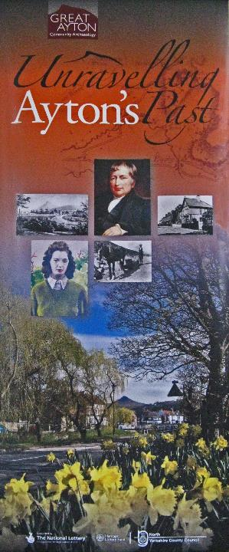
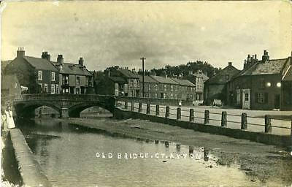
Great Ayton in 1911
People & Places

Slide 2
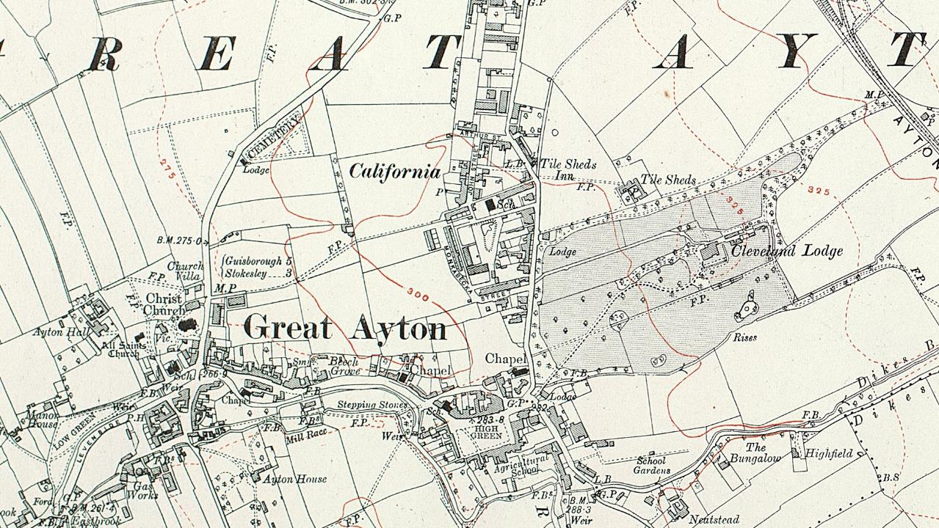

Slide 3
Old Postcard written and posted in 1910 (Just after stone bridge completed)

Slide 4
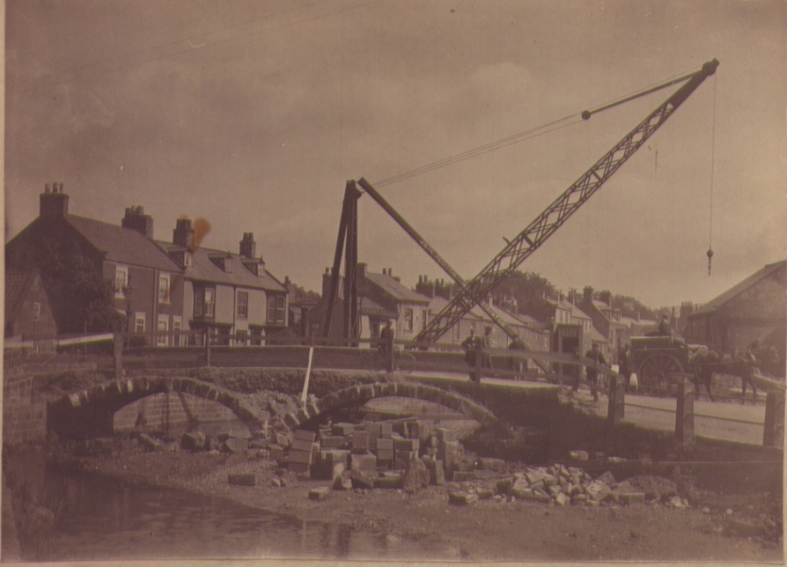
Old stone bridge being removed and reconstructed

Slide 6
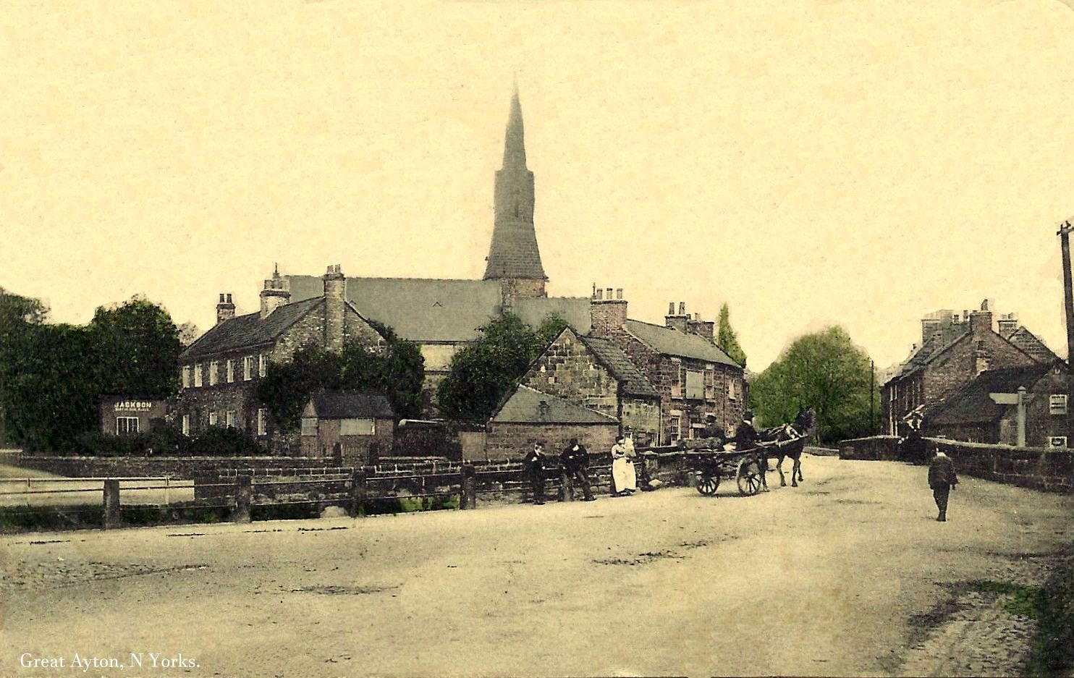

Slide 7
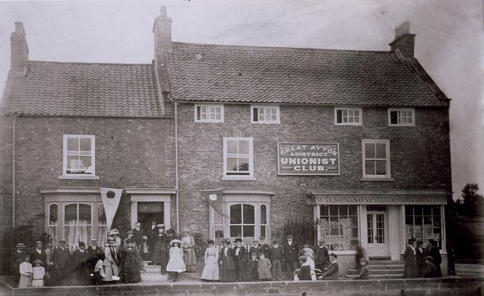
Old Church Lane
Watson & Sons Painters and Decorators occupied the right ground floor, right first floor right and the rooms on the second floor- seven rooms in total.
William Watson was born in York, became a house painter (like his father, Robert) and married Kate Turner early in 1875. They lived for a while in Norton (where son Ernest was born) before the family moved to Church Street, Great Ayton prior to the 1891 census.
The local Unionist Club occupied the left hand half of the building – the photo is believed to have been taken on the official opening of the Club by Waynman Dixon in 1910
First Name | Last Name | Relationship | Marital status | Sex | Age | Birth Year | Occupation | Birth Place
William | Watson | Head | Married | Male | 58 | 1853 | House Painter | York
Kate | Watson | Wife | Married | Female | 54 | 1857 |  | Farnham Surrey
Ernest | Watson | Son | Single | Male | 32 | 1879 | House Painter | Norton Durham
Gertrude | Watson | Daughter | Single | Female | 24 | 1887 |  | Great Ayton
Lily | Watson | Daughter | Single | Female | 20 | 1891 |  | Great Ayton

Slide 8
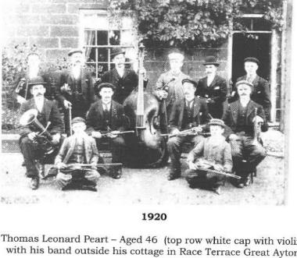
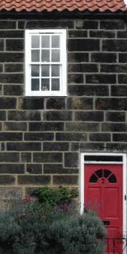
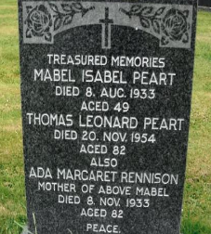
2 Race Terrace was lived in by the Peart family for over 120 years 1881-2005. In 1911 Thomas and Mabel Peart had one child and one had died.
They went on to have four more children: Gwendoline (born 1912), Levis (born 1914), Ion Lissie (born 1917) and Elsie (born 1920). Thomas Leonard’s occupation was a ’Carrier’ in 1911
Levis was a musician as well as a plumber/electrician working in the village and Gwen a dressmaker who was also a musician playing the piano.
Peart Family
2 Race Terrace
First Name | Surname | Birth Date | Age | Place of Birth | Occupation
Thomas Leonard | Peart | 1874 | 37 | Great Ayton | Carrier
Mabel | Peart (Formerly Rennison) | 1884 | 27 | Gainford Durham
Joseph L | Peart | 1910 | 1 | Great Ayton

Slide 9
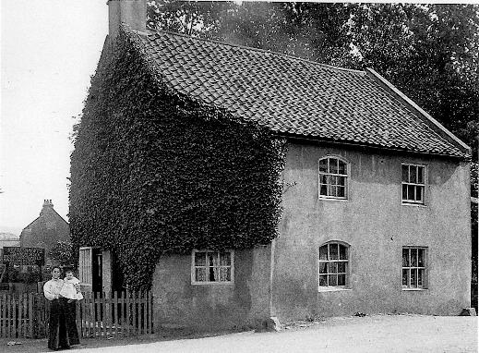
Ivy Cottage, Mill Terrace
At the end of Mill Terrace the mill race passed under part of Ivy Cottage.
Many stable-like features---remains of stalls, a stable slatted window, a stable door in two halves, and above was an upper room which had a hayloft style door opening from it some 12ft. above Mill Terrace.
Notice board reveals it was being used for selling light refreshments –“Tea made to order; Biscuits; Sparkling drinks, etc”.
Ivy Cottage was demolished in the 1950’s for road widening
Surname | First name | Relationship | Age | Date of birth | Birthplace | Occupation
Featherstone | Robert | Head | 35 | 1876 | Hinderwell | Miner(ironstone)
Featherstone | Martha Annie | Wife | 36 | 1875 | Marske
Featherstone | George | Son | 9 | 1902 | Lingdale
Featherstone | Wilfred | Son | 6 | 1905 | Lingdale
Featherstone | Lawrence Dixon | Son | 4 | 1907 | Lingdale
Featherstone | Ouida Doreen | Daughter | 2 | 1909 | Lingdale
Featherstone | Robert | Son | 3 months | 1911 | Great Ayton

Slide 10
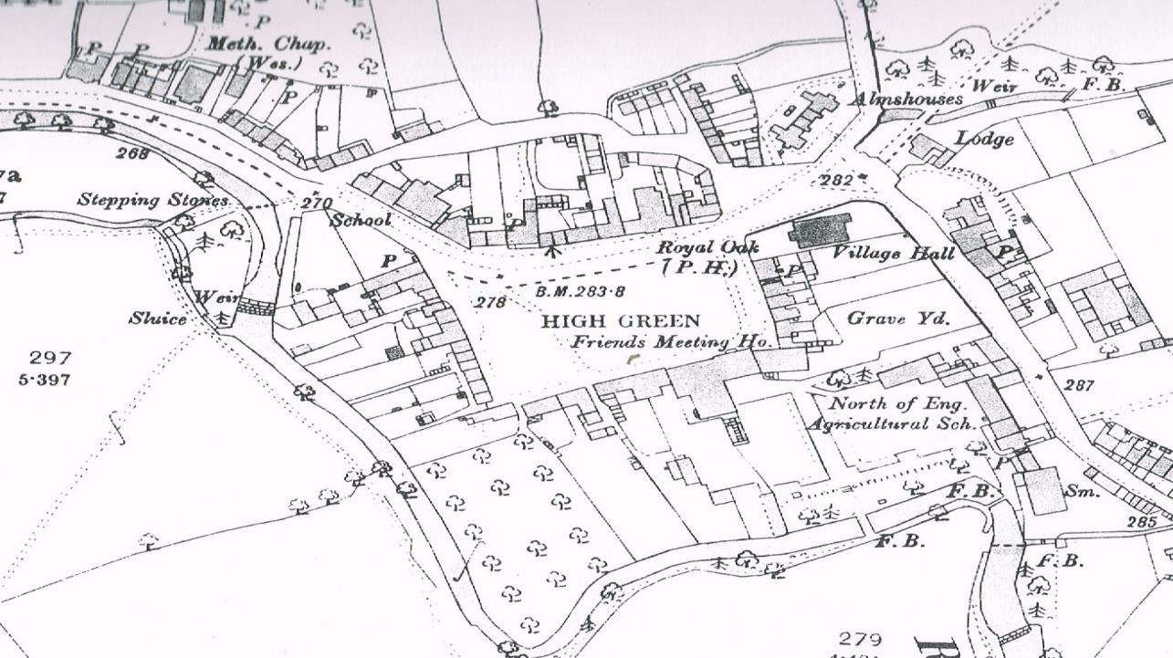

Slide 12
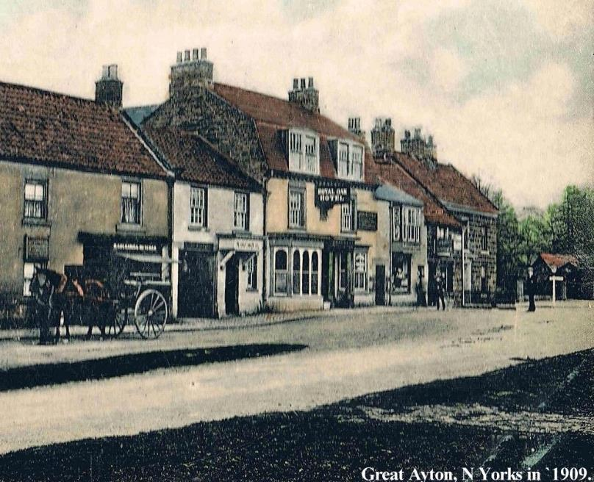

Slide 13
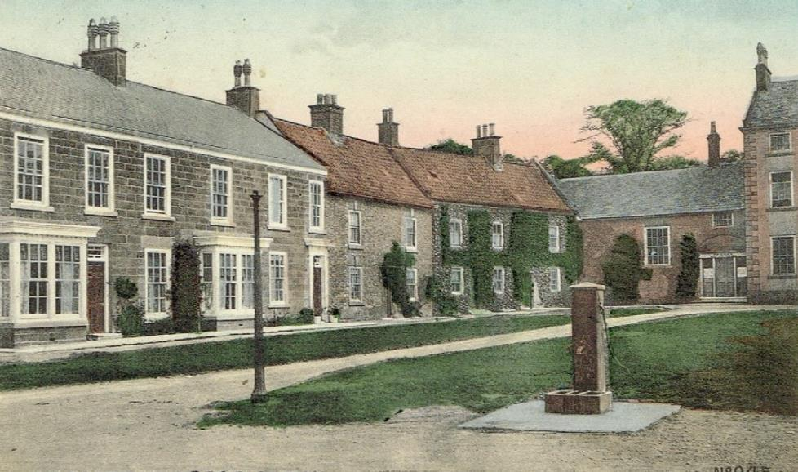
Is this the remains of a gas lamp or an old “stink pipe”?

Slide 14
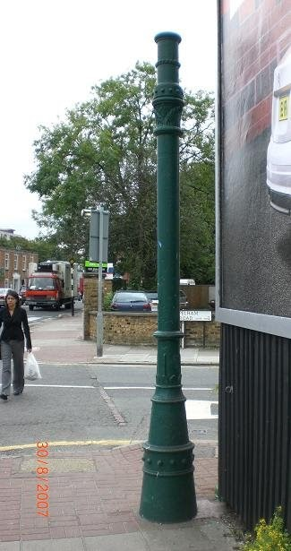
Stink pipe in London Street

Slide 15
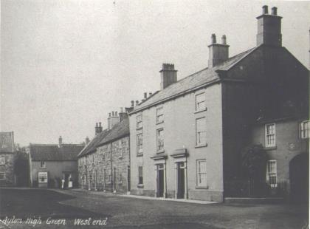
West End High Green
Four cottages to left of 3-storey houses occupied by the descendents of John and Mary Anne Stevens who relocated from Chilmark in Wiltshire to Great Ayton in the 1890’s.
first cottage was occupied in 1911 by the Suggitt family. Edith Suggitt aged 35 was a daughter of John and Mary Stevens.
In the next four roomed cottage are Edith’s brother William Stevens with his wife Eleanor Hill and their daughter Mary Eleanor
The next cottage was occupied by single brother Frank Stevens, a whinstone miner, who is recorded as the sole occupant.
In the last cottage in the row are living John Stevens with his wife Elizabeth and daughter Sadie. John was the son of James Stevens.
First Name | Surname |  | Status | Age | Date of Birth | Occupation | Place of birth
John | Suggitt | Head | Married | 36 | 1875 | Carter General | Skelton Yorkshire
Edith | Suggitt | Wife | Married | 35 | 1876 |  | Chilmark Wiltshire
Frank | Suggitt | Son | Single | 14 | 1897 |  | Great Ayton
Ernest | Suggitt | Son | Single | 5 | 1906 |  | Great Ayton
William | Stevens | Head | Married | 48 | 1863 | Ironstone Miner | Chilmark Wiltshire
Eleanor Hill | Stevens | Wife | Married | 51 | 1860 |  | Stockton on Tees
Mary Eleanor | Stevens | Daughter | Single | 11 | 1900 |  | Great Ayton
John | Stevens | Head | Married | 33 | 1878 | Miner Below Ground | Great Ayton
Elizabeth | Stevens | Wife | Married | 26 | 1885 |  | Yorks Armley
Sadie | Stevens | Daughter |  | 0 | 1911 |  | Great Ayton

Slide 16
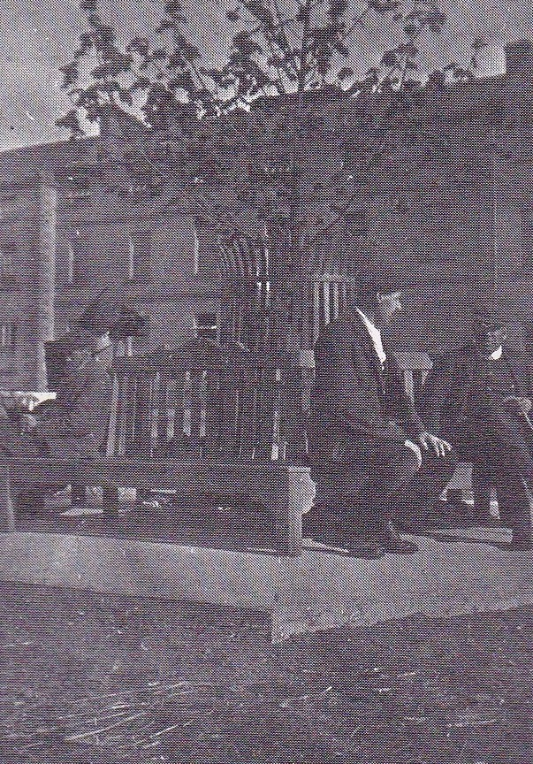
Worthington Pearson and Watson Johnstone on new Coronation Seat (1912)

Slide 17
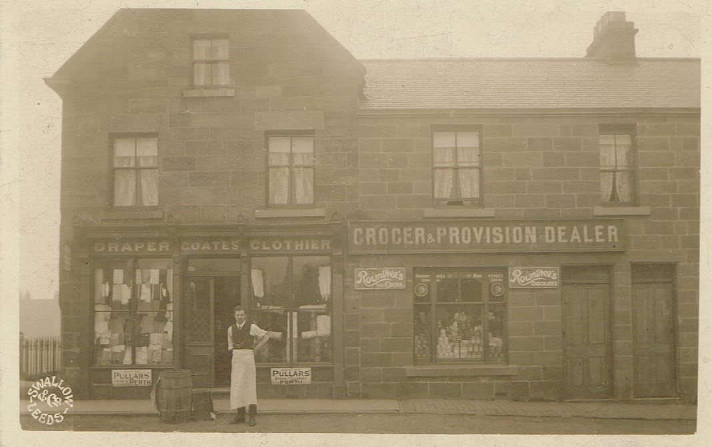
Coates Draper and Grocery Store (now chemist)

Slide 18
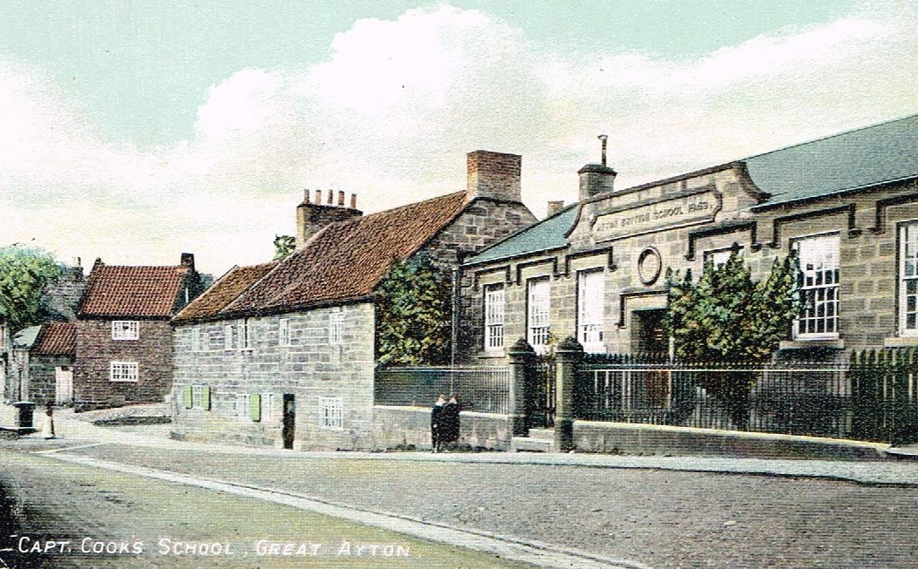
The British School
Sign now in back wall of car park
Founded in 1842 to provide FREE non-sectarian education to boys & girls, financed by public subscription.
Thomas Richardson donated four Stockton & Darlington railway shares which brought in enough income to pay the running costs & salaries.
The school closed in 1968 and became the county library in 1971, In 2012 the building became a community library, owned and operated as Great Ayton Discovery Centre

Slide 19
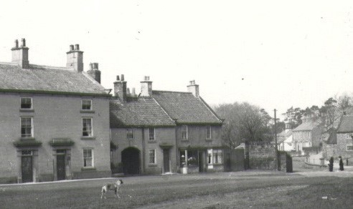
Doctors Surgery, High Green
The old Doctors Surgery where access was gained through the arch
Charles Stuart was born in Chirnside, Berwickshire on 20 March 1858 and attended Edinburgh University where he gained his qualification of Doctor of Medicine M.D.
Also living in the house in 1911 were two of his sisters Jessie and Mary.
He was a much loved family doctor for 39 years and died in 1923 aged 65. He and sister Jessie are commemorated in a stained-glass window in Christ Church
First Name | Last Name | Relationship | Marital status | Sex | Age | Birth Year | Occupation | Birth Place
Charles | Stuart | Head | Single | Male | 53 | 1858 | Medical Practitioner | Chirnside Berwickshire
Jessie Logan | Stuart | Sister | Single | Female | 50 | 1861 | Housekeeper | Chirnside Berwickshire
Mary Erskine Carmichael | Stuart | Sister | Single | Female | 36 | 1875 | Companion | Chirnside Berwickshire
Robert | Murray | Assistant | Single | Male | 23 | 1888 | Medical Practioner | Hobkirk Roxburghshire
Emily Josehine | Durkin | Servant | Single | Female | 21 | 1890 | Housemaid | St. Johns Middlesbrough

Slide 20
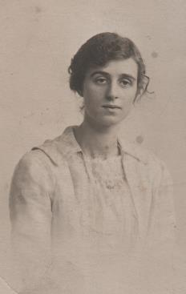
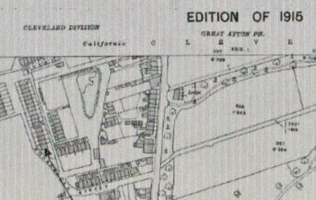
The Bulmer family lived in Monkabecq Road Great Ayton also known as 1, The Gables. The house had five rooms.
Daisy Olive was one of 10 children most of whom had left home by the time of the 1911 Census.
Daisy Olive Bulmer 1898 – 1959
Three years later Daisy Olive, at the age of 16, was married to Harry Bennison.
They went on to have 5 children :-
Kenneth (born 1915), Alan (born 1916), Stanley (born 1918) Joan (born 1921), Harry (born 1925)
Daisy Olive Bennison aged about 19
Name and Surname | Relationship | Age | Status | Occupation | Birthplace
Richard Bulmer | Head | 56 | Married | General Labourer | Stokesley, Yorks
Matilda Bulmer | Wife | 53 | Married |  | North Cave
Sidney Bulmer | Son | 22 | Single |  | Great Ayton
Minnie Bulmer | Daughter | 24 | Single |  | Great Ayton
Daisy Olive Bulmer | Daughter | 13 |  |  | Great Ayton
1 The Gables

Slide 21
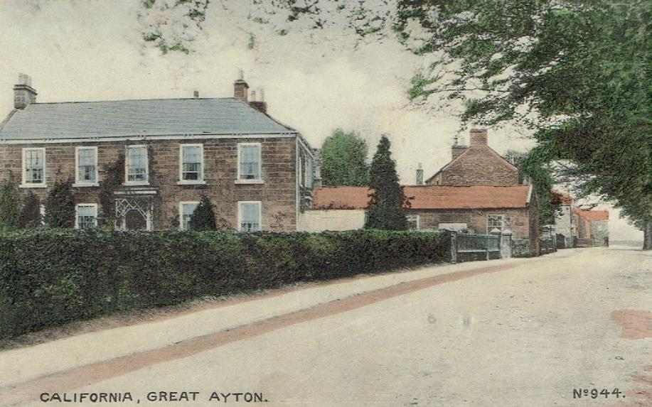

Slide 22
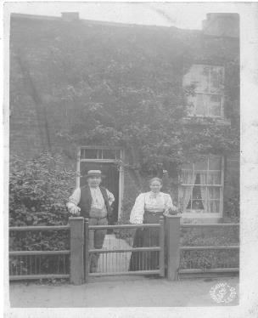
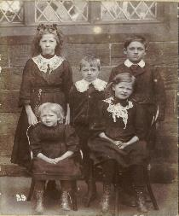
Mount Pleasant
(65 Newton Road)
Photograph taken at Marwood School in 1911
Top left is Cecilia Smith (aged 11) other children are all Cecilia’s nieces and nephews
Name | Relationship | Age | Occupation | Birth Place | County
Thomas Smith | Head | 55 | Ironstone miner | Rosedale | Yorks
Sarah Jane Smith | Wife | 51 | Domestic duties | Levisham | Yorks
Leila Smith | Daughter | 14 |  | Fylingdale | Yorks
Cecelia H M Smith | Daughter | 11 | Scholar | Fylingdale | Yorks
James V T Smith | Grandson | 10 | Scholar | Rosedale | Yorks
Victor Alexander Thomas Smith
and his wife Sarah Jane Smith
Originally a farmer at Fylingdale, Thomas moved to Grosmont to become an ironstone miner then to Loftus and finally to Great Ayton in 1910.

Slide 23
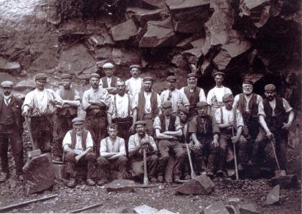
Biggins Family – Arthur Street
Thomas Biggins was born in Thirsk in 1847 and married Elizabeth Langley on 4 February 1871 in Stokesley, working as a Jet Miner. He moved to California in Great Ayton, living in Arthur Street and working as a Whinstone Miner.
He was still working as a Quarryman in 1911 aged 63
Thomas was now a widower ( as his wife Elizabeth had died in September 1901). They had thirteen children together nine surviving to 1911.Thomas died in 1932 aged 85 years.
1911 Census
Surname | Forename | Relationship | Date of Birth | Age | Place of birth | Occupation
Biggins | Thomas | Father (Widower) | 1848 | 63 | Thirsk | Quarryman | Whinstone
Biggins | William | Son | 1891 | 20 | Great Ayton | Farmers Labourer
Biggins | Alice | Daughter | 1893 | 18 | Great Ayton

Slide 24
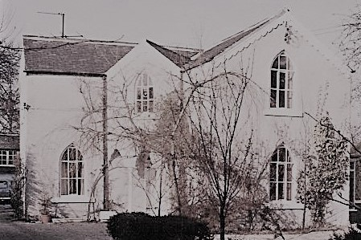
The Recess
Originally called “The Bard’s Recess”, it was built in 1862 by John Wright, a well-known poet of the time, and designed to look like an open book. The “gothic” windows were said to remind him of Guisborough Priory. When built The Recess enjoyed a fine rural location in the area which was to be known as California
First name(s) | Last name | Relationship | Marital status | Sex | Age | Birth year | Birth place | Occupation
James | Bragg | Head | Married | M | 59 | 1852 | Barnard Castle, Co Durham | No occupation
Hannah | Bragg | Wife | Married | F | 61 | 1850 | Goldsborough, Yorkshire | -
Ethel Ann | Bragg | Daughter | Single | F | 22 | 1889 | Middlesbrough | -
Robert | Barlie | Boarder | Single | M | 23 | 1888 | Dundee | Clerk, Whinstone Quarry
Thomas | Clark | Boarder | Married | M | 57 | 1854 | Austwick, Yorkshire | Quarry Manager, Whinstone Quarry Employer

Slide 25
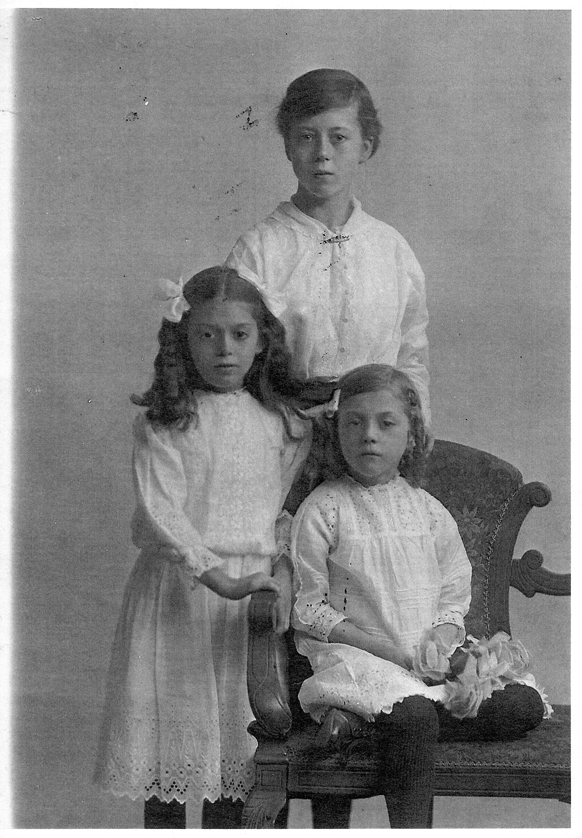

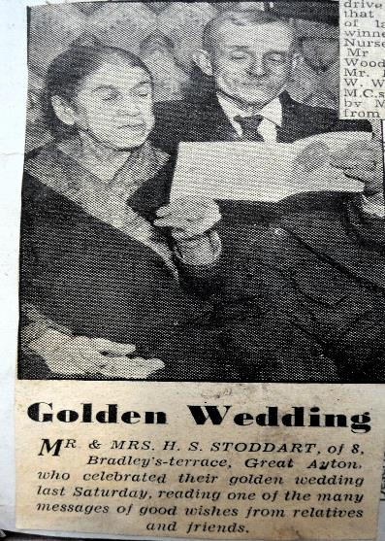
8 Bradleys Terrace
Phoebe Ann’s father had moved his family up to Cornforth Co.Durham from Staffordshire when she was 10years old.
She married John Stockdale and they had 4 sons.
After John died in an accident in Great Ayton, Phoebe married Herbert Stoddart and they had 3 daughters
Photo taken in 1914 of Mary, Emily and Eva Stoddart
Name | Relationship | Age | Occupation | Where born | County
Herbert Stoddart | Head | 37 | Ironstone miner | Great Ayton | Yorks
Phoebe Ann Stoddart | Wife | 46 | Domestic duties | Tipton | Staffs
Emily Stoddart | Daughter | 10 | Scholar | Great Ayton | Yorks
Mary Elizabeth Stoddart | Daughter | 5 | Scholar | Great Ayton | Yorks
Eva Stoddart | Daughter | 2 |  | Great Ayton | Yorks
John George Stockdale | Stepson | 22 | Ironstone miner | Darlington | Durham
William Stockdale | Stepson | 16 | Ironstone miner | Marton | Yorks

Slide 26

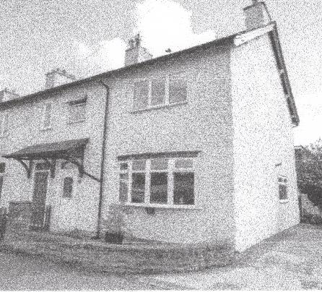
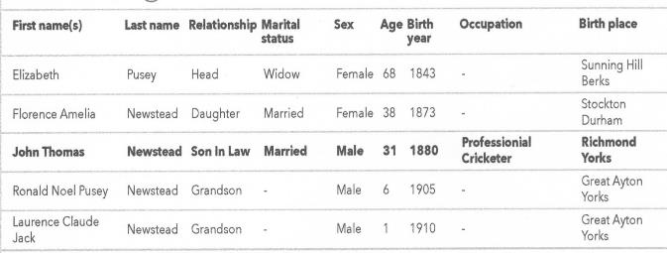
John Newstead,
Langbaurgh Terrace
John Newstead was a professional cricketer who played for Yorkshire between 1903 and 1913. His performance in 1908; 927runs and 140 wickets, which included an extraordinary 7 wickets for 10 runs against Worcestershire, earned him recognition as one of Wisden’s cricketers of the year in 1909 (along with Sir Jack Hobbs!)
He married Florence Amelia Pusey in Great Ayton in 1903. One of their sons, Ronald, also played cricket professionally.

Slide 27
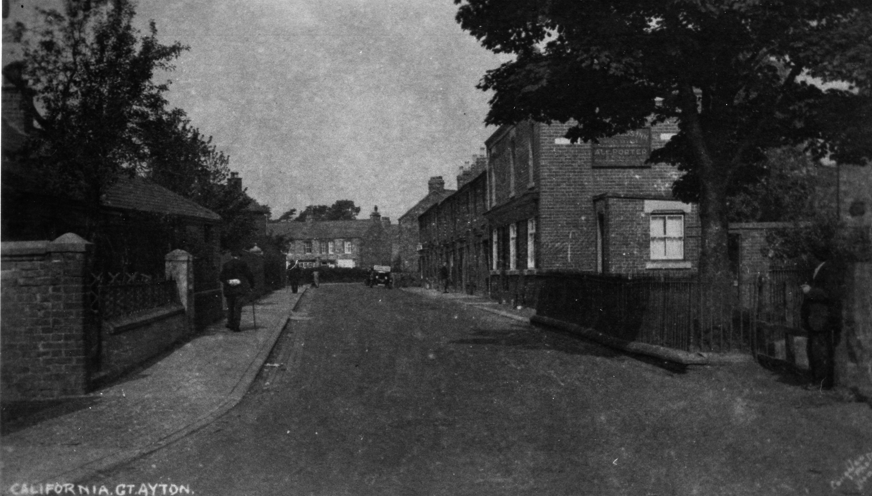
Now we are back to the hustle and bustle of 2020!!
THANK YOU FOR WATCHING!!

