Slide 1
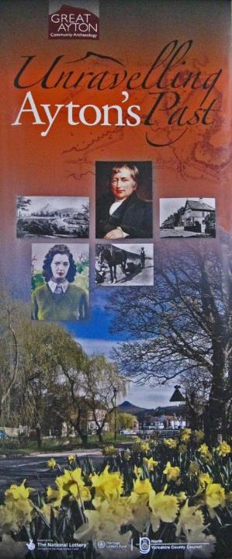
GREAT AYTON HISTORY SOCIETY
Part 1
The lives of
Ernest Lack &
Alfred Harold Kitching
Part 2
What evidence of wartime installations remain in Great Ayton

Slide 2
Research
Great Ayton History Society has researched the lives of all the men from Great Ayton who were killed in WW1.
We are now trying to do the same for WW2 casualties
This presentation is for two of these men
Ernest Lack
Alfred Harold Kitching.
Notes:
Research : Family members can access the military records of the soldier.

Slide 3
Ernest Lack
27.1.1920 - 9.7.1943

Slide 4
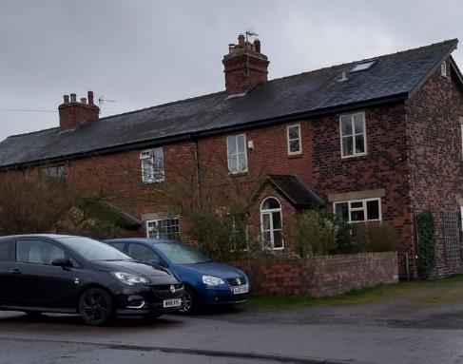
Ernest was born on 27th January 1920 at Station Cottages, Great Ayton, to Ernest Lack and Martha Lack (Nee Bowes).

Slide 5
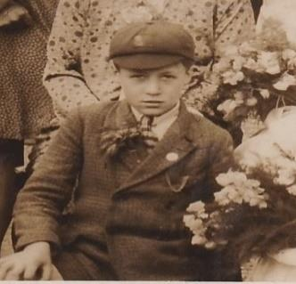
Ernest senior worked as a railway porter, then Assistant Station Master.
Ernest had four sisters, Rose, Gertrude, Olive and Ruby.

Slide 6
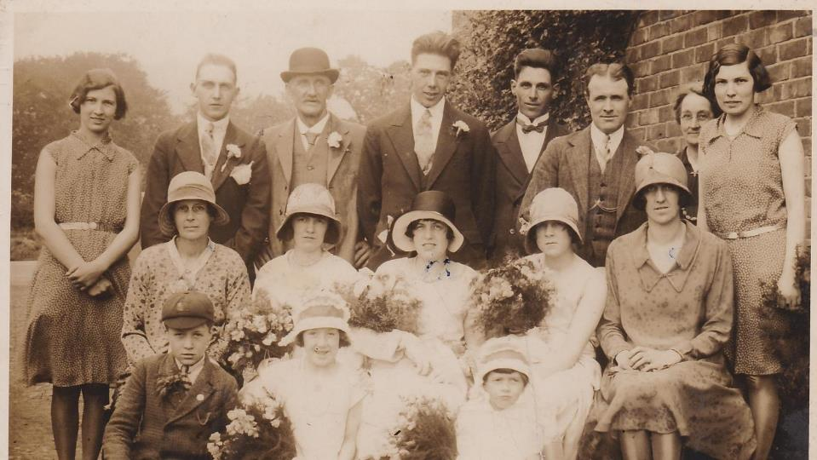
Ernest aged 10
Ernest is front left, at the wedding of his big sister Olive to Wilson Maycroft Tanfield.

Slide 7
Ernest was known to his friends and family as Napsy.
After leaving school, Napsy became a private gardener.
When war was declared, Napsy joined the Territorial Army.

Slide 8
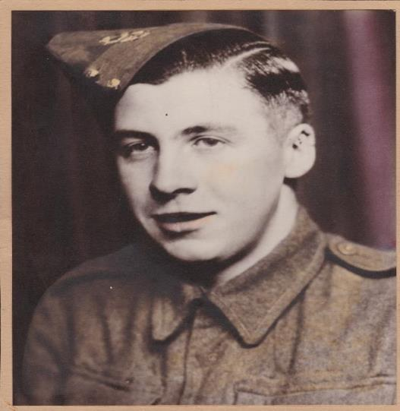
Ernest Lack joined the 1st Battalion of the Border Regiment on 18th April 1940
He passed his medical examination on 21st March 1940, in A1 condition, and joined as a Private.
His service number was: 3602853.
He was initially posted to Crook, Co Durham until 21st June 1940.
He then moved to Leiston in Suffolk where an Air Force base was being constructed.

Slide 9
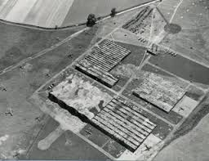
War Service
He later transferred to Panshanger Aerodrome, Welwyn Garden City, when 248 acres of agricultural land was released to the Air Ministry under the terms of the Emergency Powers Act (1939). The Air Ministry gave de Havilland at Hatfield the authority to construct a decoy air craft factory there to divert enemy bombers from their factory 6 miles away. The decoy factory was used from November 1940 and the fields surrounding it were used for flying training.

Slide 10
Next, Napsy served at Crickhowell in Wales. He was confined to barracks for 10 days by his Commanding Officer from 28th February 1941. He was probably based at Cwrt y Gollen ("Hazel Court") which was a British Army training base, 2 miles south-east of Crickhowell.

Slide 11
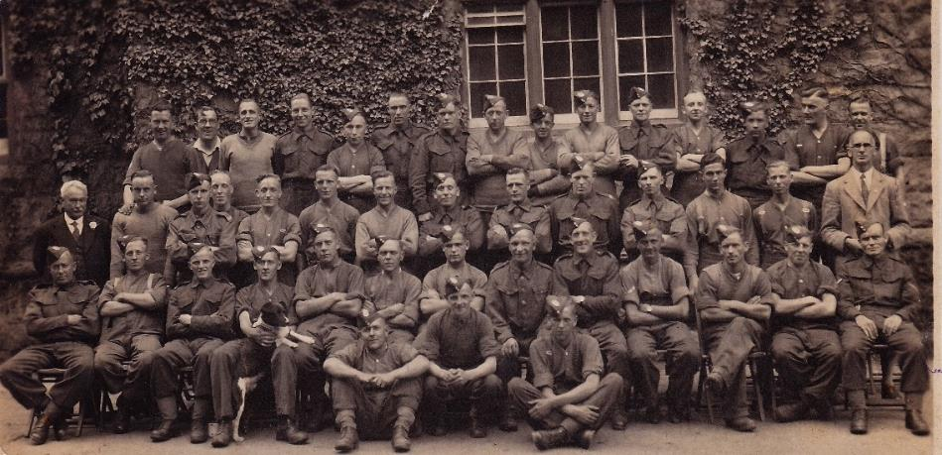
Napsy is on the back row, 5 from the left. Photo taken in Wales 1941.

Slide 12
Naspy was later based in the South of England near Andover. His army records show that he attended a Driver’s Mechanics Course with a civilian establishment in Bournemouth, from 11th May 1942 to 6th June 1942. He passed his Basic Training Test there.

Slide 13
Letter home
Napsy wrote a letter home, while he was based in the South of England. The left-hand side of the letter is missing.

Slide 14
Napsy wrote a letter to his family when he was based near Andover.
Dear . . . . . .
I’m writing a few
and kicking . Well
this time with nothi
around.The nearest
miles away. But
it – but in plain s
doing he would
we can get some p
shows they put o
sometime will s
that will take us to
really had a good
We have had a go at guessing what was written at the start of each line.

Slide 15
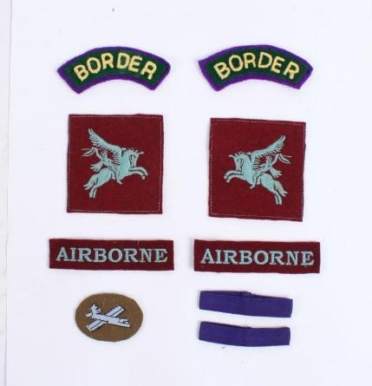
Active Service World War II
The Border Regiment, formed part of the British Expeditionary Force (BEF).
In 1941 the Regiment, and its battalions, took on a new role.
It was selected to undertake airborne assaults by glider and became known as the 1st Air Landing Brigade with the battalion becoming the 1st (Airborne) Battalion the Border Regiment.
It is likely that soldiers were asked if they wished to transfer to the new Brigade and they may have been offered financial incentives to do so.

Slide 16
Napsy was granted a few days home leave in April 1943. He appeared before the Medical Board on 22nd April 1943 and remained in A1 physical condition.
In May 1943, the new 1st Airborne Battalion The Border Regiment moved to North Africa in preparation for operations in Sicily and Italy. Napsy set sail for Tunisia in North Africa on 17th May 1943, arriving in Africa on 26th June 1943.

Slide 17
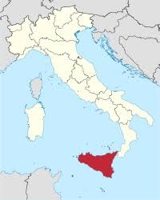
Operation Ladbroke
Shortly after their arrival in North Africa, the Battalion took part in the Allied Invasion of Sicily.
Operation Ladbroke began on 9th July 1943. Unfortunately the 1st Airborne Battalion of the Border Regiment suffered heavy casualties from the outset.

Slide 18
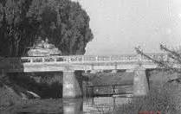

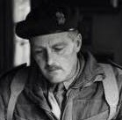
Operation Ladbroke
Operation Ladbroke’s commanding officer was Brigadier Philip Hicks. He commanded a force of 144 gliders, mostly Waco and Horsas. Both types of glider were laden with men and heavy equipment such as tanks and jeeps, needed for the objective to be achieved.
The objective was to establish a large invasion force on the ground near the town of Syracuse, Sicily, then to secure the Ponte Grande Bridge and eventually, take control of the city, with its strategically vital docks, as the start of a full-scale invasion of Sicily.

Slide 19
Operation Ladbroke was part of Operation Husky, the Allied invasion of Sicily. It was the first attempt at a glider landing by the British & Allied forces. Gliders were towed by U.S. planes across the Mediterranean Sea, from North Africa, and then released to land in an area near Syracuse in Sicily. As this was the first mass use of glider troops by the Allied forces, many mistakes were made. Losses were terrible, but the service men involved demonstrated great bravery and heroism. They actually succeeded in their objective of seizing and holding the Ponte Grande Bridge, a story of bravery and resistance against the odds.

Slide 20
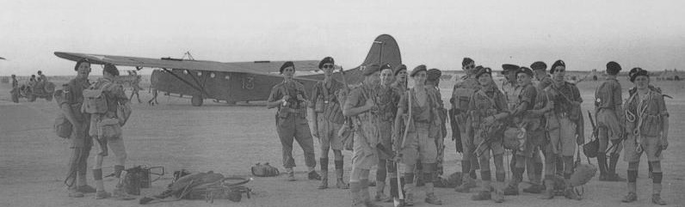
Preparing for Operation Ladbroke
This photo gives us a clue of what went wrong during this operation. It is from the Imperial War Museum Collection and shows half a platoon of the 1st Border Regiment, in front of their Waco glider before take-off on the 9th July 1943. A soldier to the right of centre, is holding an escape axe which he may have used later to save the lives of himself and his comrades if they landed in the sea.

Slide 21
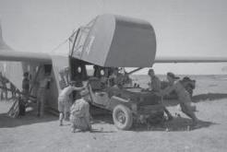
Men loading a jeep onto a glider

Slide 22
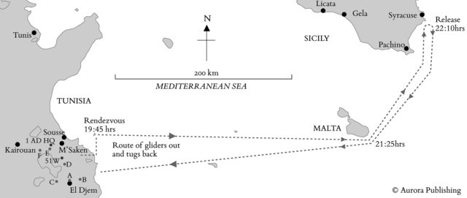

Slide 23
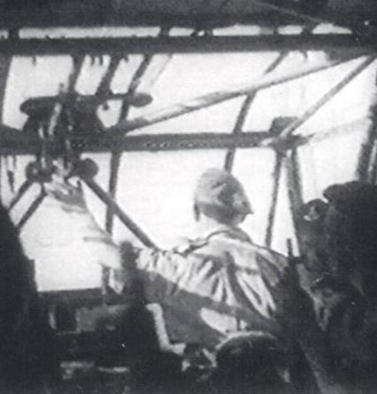
So, what went wrong?
Sadly, most of the gliders did not reach their destination in Sicily.
Of the original force of 144 aircraft, only 56 reached Sicily, with only 12 on or close to their landing zone.
A few planes turned back, but 73 gliders came down into the sea, with the loss of 252 men.
At first it was believed that over 500 men had drowned, but eventually half turned up after being rescued by various ships in the Mediterranean.
Many of the senior commanders of the operation were taken out at this point, including Brigadier Philip Hicks, in command of the 1st Airlanding Brigade. He came down in the sea and had to be rescued later.

Slide 24
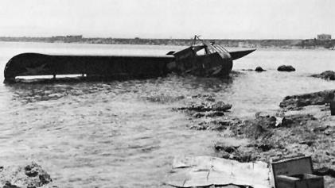
Horsa glider fuselage, crashed in the Mediterranean Sea.
Why did it crash land?
Hicks had been warned that bad weather was forecast, with a possible head wind and restricted vision, but he decided to go ahead with the operation.
Many of the US pilots, flying the planes towing the gliders, were inexperienced.
Italian and German soldiers had prevented Allied Pathfinders from lighting flares to guide the planes in.
Many planes came under fire before or just as they reached the coast. Some were hit and crashed. Some turned back, dropping their tow ropes as they did so, leaving the gliders too far from the shore.

Slide 25
Unfortunately, Ernest (Napsy) Lack was on board one of the gliders that didn’t make it. He drowned on 9th July 1943, when his glider was released too early by a US air force plane. The family have never known the reason why the glider was released early.
Possibly, the plane had come under fire or had mistaken its position.
Or perhaps the weather had taken a turn for the worse, there was definitely cloud covering the moon and a strong head wind.
For whatever reason, the pilot decided to release the glider over the Mediterranean, en route from Tunis, far too far from the target of the Island of Sicily.
Napsy’s family always claimed that he was afraid of water, and it is tragic that his life came to an end in the Mediterranean Sea.

Slide 26
Service and Casualty Form
On his Service and Casualty Form, Napsy is listed as being in North Africa until 9th July 1943.
He was listed as missing, on the 10th July 1943. Then, later that day he is listed as, “Now presumed killed in action.”
His military service had lasted for 3 years and 43 days.

Slide 27
Statement of Service
His Statement of Service Record says, “Presumed killed in action 9.7.43” and “Next of Kin informed 12.5.44.” His father, Ernest Lack, of 2 Railway Cottages, Ayton, Middlesbrough, is listed as the next of kin.
Sadly, the family had had to wait just over 10 months, before Napsy’s death was confirmed.

Slide 28
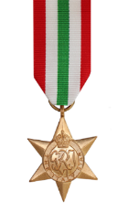
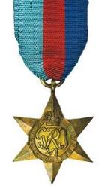
Napsy’s war medals were issued on the 9th December 1949. His father received his son’s 1939/45 Star and Italy Star medals

Slide 29
Never Forgotten
Napsy is mentioned in an article in the local newspaper in 1969, about his parents’ Diamond Wedding Anniversary.

Slide 30
Ernest Lack is commemorated at the Cassino Memorial, panel 7, within the Cassino War Cemetery, 139 km South West of Rome in Italy.
The inscription on the memorial says,“1939 - within this cemetery stand monuments which bear the names of soldiers of the British Commonwealth and Empire who fell in the assaults upon the shores of Sicily and Italy or in later battles to free Italian soil and to whom the fortune of war denied a known and honoured grave.”

Slide 32
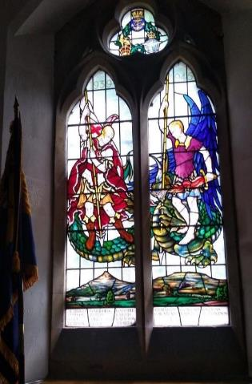
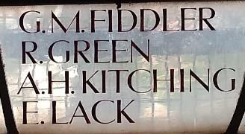
Christ Church window
His name is also on a window at Great Ayton’s Christ Church and the Church War Memorial, along with other casualties from the village, who died during World War 2.

Slide 33
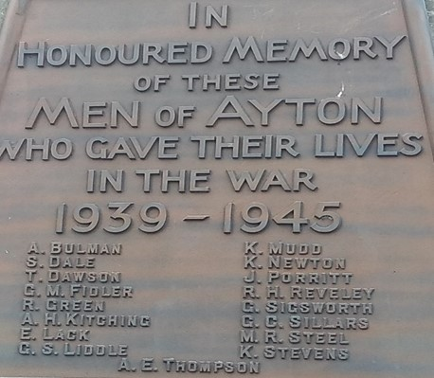

Slide 34
Sources:
History of War.org Operation-Ladbroke.com
Google.co.uk Commonwealth War Graves Commission
Imperial War Museum Archive Wikipedia.org
Ibiblio.org Paradata.org.uk
Welwyn Garden City.org.uk Aurora Publishing
The Amy Personnel Section Descendants of the Lack Family

Slide 35
Alfred Harold Kitching
Alfred Harold Kitching was born in 1919 in Stockton.
He was the only son of :-
Colonel Harold Edward Kitching and Dora Kitching of Ayton Firs Great Ayton.
Colonel Harold Edward Kitching was educated at Uppingham School and Trinity College Cambridge where he obtained rowing blues.
He was commissioned into the 5th Battalion of the Durham Light Infantry in 1914 and served with the 2nd/5th Battalion in Salonica, Greece between 1916 & 1918.

Slide 36
Alfred Harold Kitching
Alfred’s early life and education followed that of his father.
Educated at Elstree and Uppingham schools.
He decided to take up farming as a career and in 1938 entered Wye Agricultural College. In 1939 at the start of the war he had just completed his first year.
He was commissioned as a 2nd Lieutenant in the Durham Light Infantry on January 22nd 1938. He had been a member of Uppingham School’s Officer Training Corps.

Slide 37
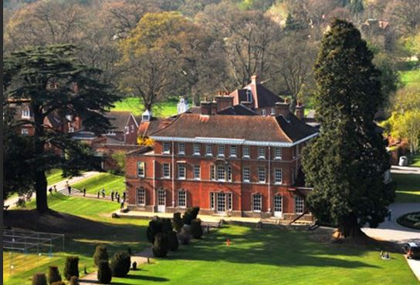
Elstree School Reading

Slide 38
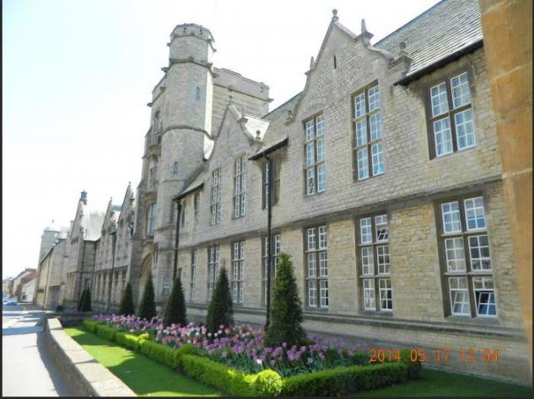
Uppingham School

Slide 39
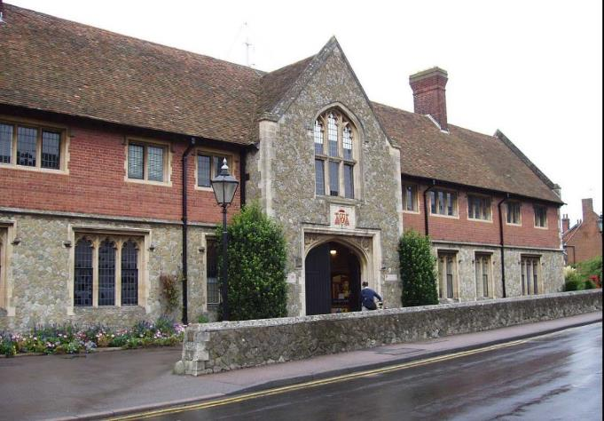
Wye Agricultural College

Slide 40
Alfred Harold Kitching
On June 25th 1942 joined the Army Air Corps Glider Pilots Regiment.

Slide 41
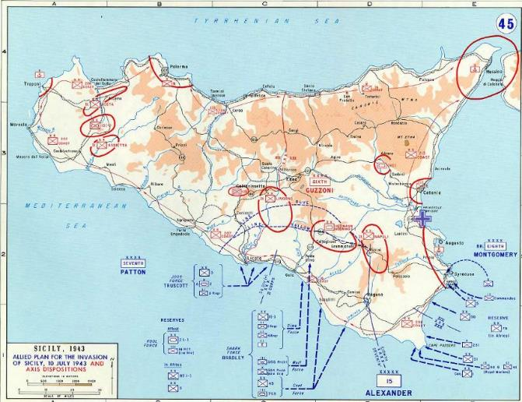
July 9th/10th 1943 Invasion

Slide 42
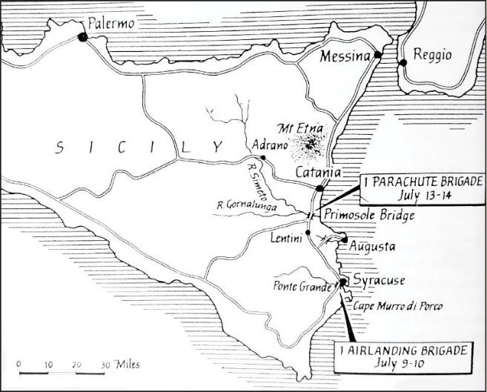
2 Vital Bridges
Notes:
Ernest Lack killed in attack on Ponte Grande Bridge

Slide 43
Airborne Operations
Operation Ladbroke Port Grande Bridge
July 9th/10th
(Ernest Lack killed in this operation)
On July 13th/14th Alfred as part of Operation Fustian is piloting a glider to capture the Primosole Bridge

Slide 44
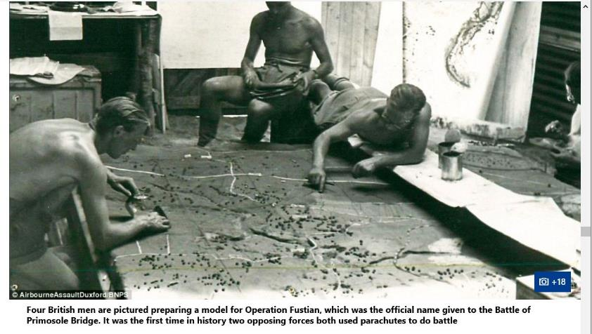
Planning the Attack

Slide 45
July 9th
German reinforcements of the 1st Parachute division drop around the southern side of the Primosole Bridge.
This goes unnoticed by British Intelligence
Notes:
British and German use of paratroops was different. German paratroops to plug gaps in weak spots.

Slide 46
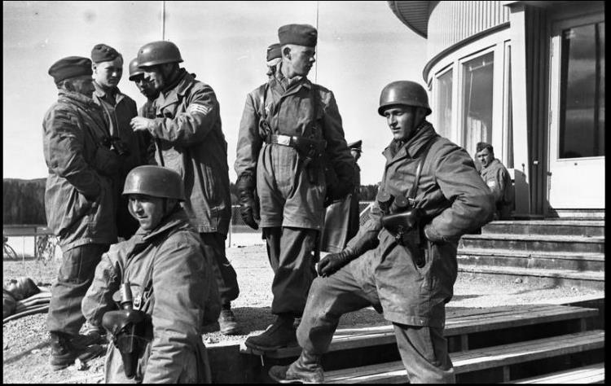
Green Devils

Slide 47
July 13th/14th 1943
1,856 men of the 1st Parachute Brigade took off from North Africa heading for Sicily.
Following the paratroops were aircraft towing 11 Horsa and 8 Waco gliders.
En Route 33 aircraft strayed off course and were engaged by friendly forces.
4 planes were destroyed and 9 were badly damaged and had to return to North Africa.

Slide 48
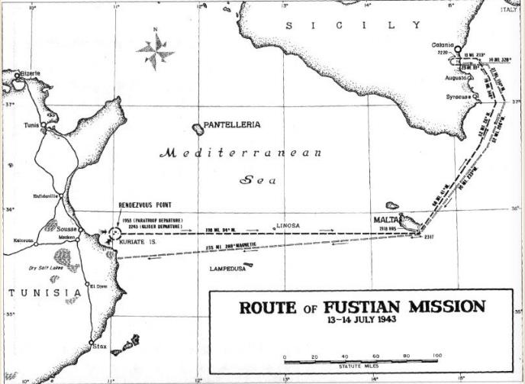
Route to the Bridge
Notes:
Distance in Gliders approx. 200 miles

Slide 49
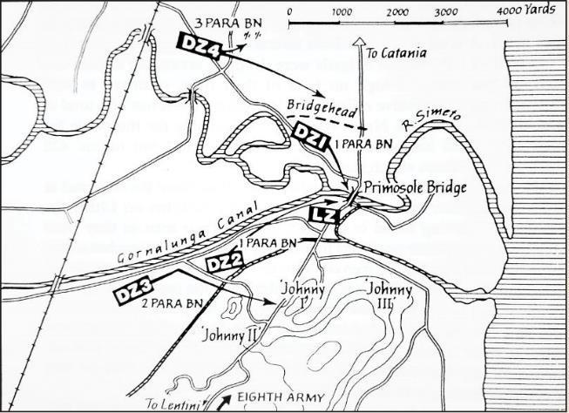
Drop Zones

Slide 50
July 14th 1943
Of those aircraft that reached Sicily 37 were shot down and the paratroops were widely scattered.
Initially the German paratroops thought that the paratroops and gliders were German reinforcements but soon realised their mistake

Slide 51
Alfred’s death ?
Is this is the point in the battle where Alfred was killed ?
The regiment war diary has not been digitised and can only be accessed by visiting the National Archives at Kew.
As an officer it might mention the circumstances of his death.

Slide 52
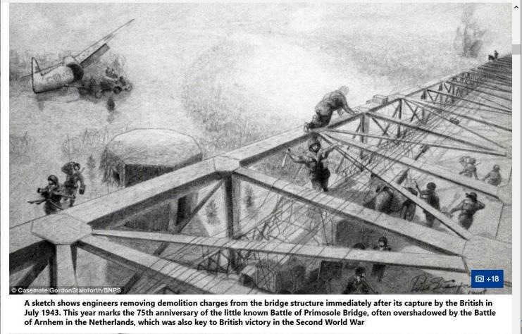
Demolition Charges Removed

Slide 53
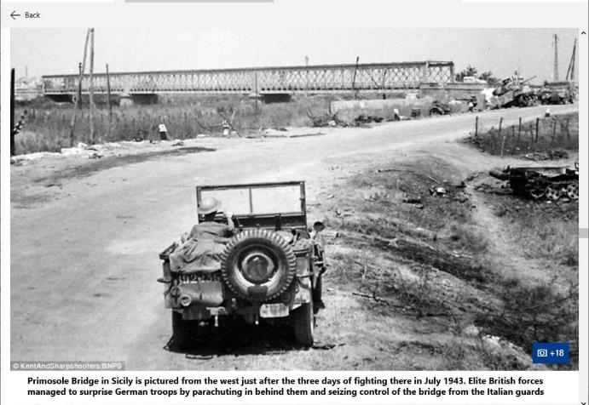
Bridge following 3 days fighting

Slide 54
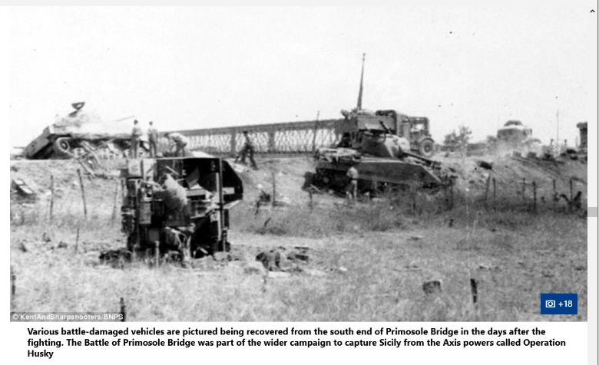
Battle damaged vehicles

Slide 55
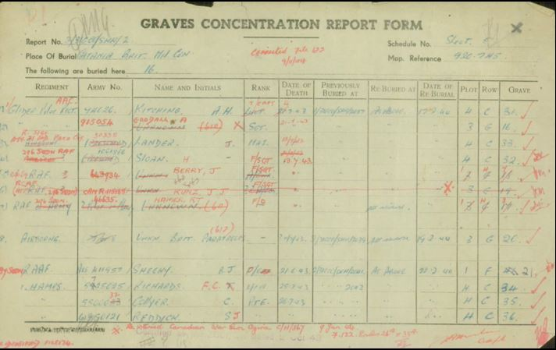
Grave Concentration Report

Slide 56
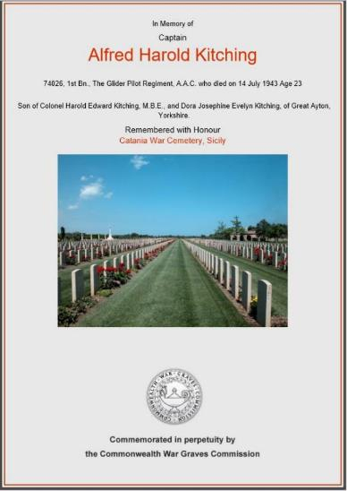
Catania War Cemetery

Slide 57
July 14th
The 1st Parachute Battalion were in control of the bridge.
At dawn the German paratroops attacked from the south and a German armoured thrust was made from the north.
The British retreated south of the bridge.
Of the 295 men defending the bridge 115 were now casualties.

Slide 58
July 15th
The Germans are now in control of the bridge.
Early in the morning the tanks of the 44th Royal Tank Regiment supported by the Durham Light Infantry crossed the bridge
(with heavy losses)
By the night of the 15th the bridge had been recaptured.

Slide 59
Aftermath
The operation was deemed successful although only 40% of the paratroops had landed in their assigned drop zones.
The capture of the bridge did not result in the rapid advance over the Catania plain as envisaged by Montgomery.
Many lessons learned for future airborne operations.

Slide 60
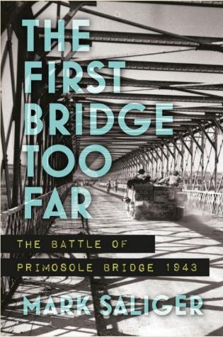
Book about the attack

Slide 61
Part 2
What evidence of wartime installations remain in Great Ayton

Slide 62
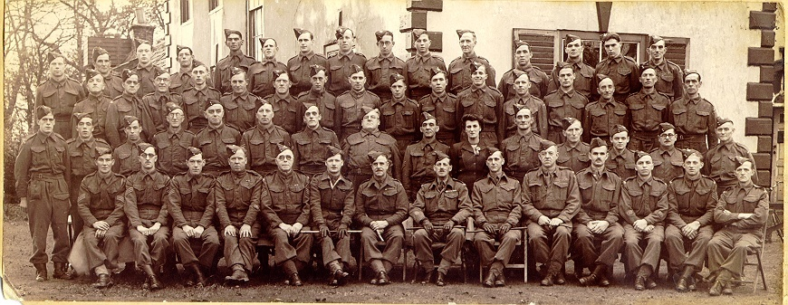
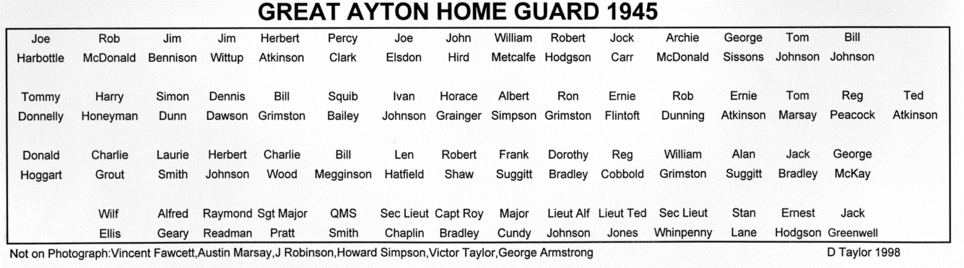
Home Guard
Notes:
Names added to the Home Guard Photo. Helped by Ivan Johnson & Robert Hodgson
Photograph found at Workingman’s Club
As Time passes it’s difficult to find people to put names to faces.

Slide 63
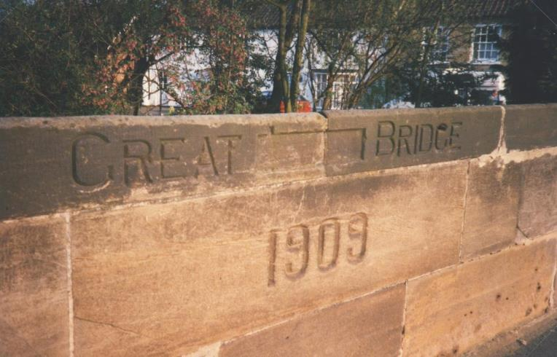
Home Guard and Anti-invasion measures
Removal of the word ‘AYTON’ from the carved name on the stone bridge.
Notes:
No GPS or Satnav in 1940. Villages prepare for Invasion : remove signposts, names on bridges etc.

Slide 64
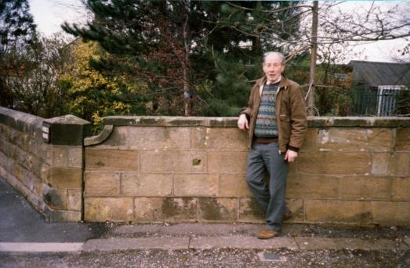
Home Guard and Anti-invasion measures
A rifle position in the sandstone wall at the entrance to Firbeck House in Easby Lane. The slot in the wall was made by Mr. Robert Pickersgill, shown in the photograph, whilst he was a member of the Local Defence Volunteers.

Slide 65
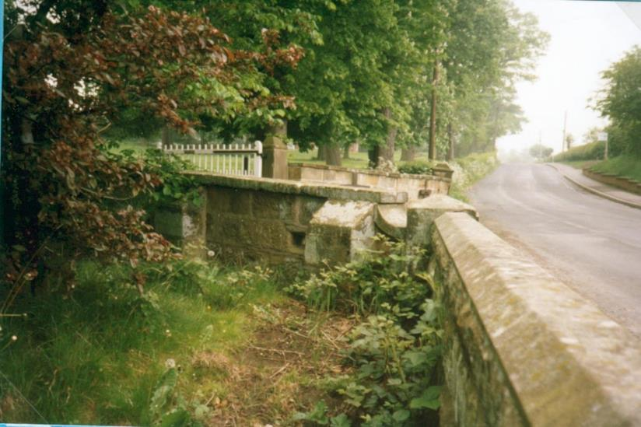
Home Guard and Anti-invasion Measures
Notes:
Rear of wall.In1940 the mill race ran through here and the rifle hole would have been at chest height.

Slide 66
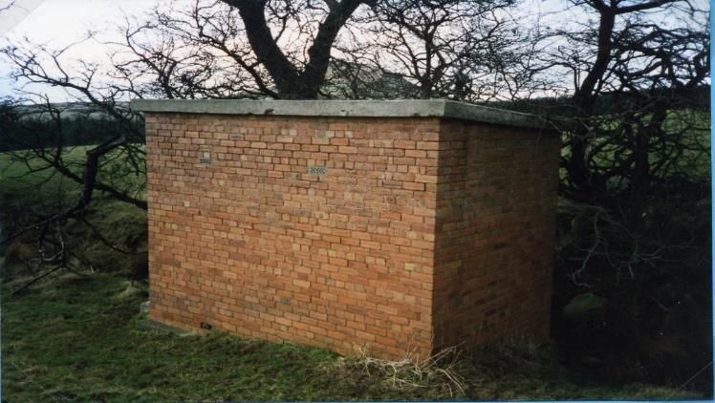
Home Guard and Anti-invasion measures
Home Guard ammunition store at
Ayton Banks Farm
Notes:
Buildings like this at Battersby,Leven Bank Yarm,Crathorne

Slide 67
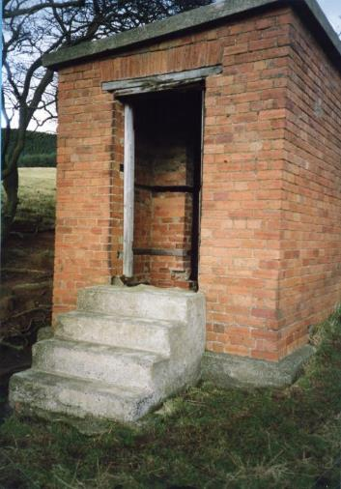
Home Guard and Anti-invasion Measures
Ammunition Store entrance

Slide 68

GREAT AYTON HOME GUARD
Notes:
Great Ayton Home Guard at the rear of Ayton Hall 1945

Slide 69
Auxiliary Units
‘Auxiliary Unit’ was the codename given to a force of civilian volunteers. They were to carry out sabotage, guerrilla warfare and spying from behind enemy lines
in the event of a successful German invasion of the British Isles during World War II.
Formed in 1940 there were 640+ Patrols with a total force of 4,200 men.

Slide 70
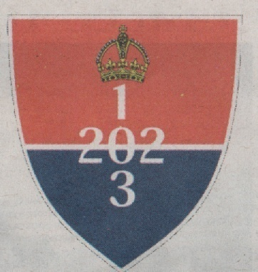
Auxiliary Unit Badge
Notes:
The badge shows the unit numbers,Scotland 201,Northern England 202,Rest of England 203.

Slide 71
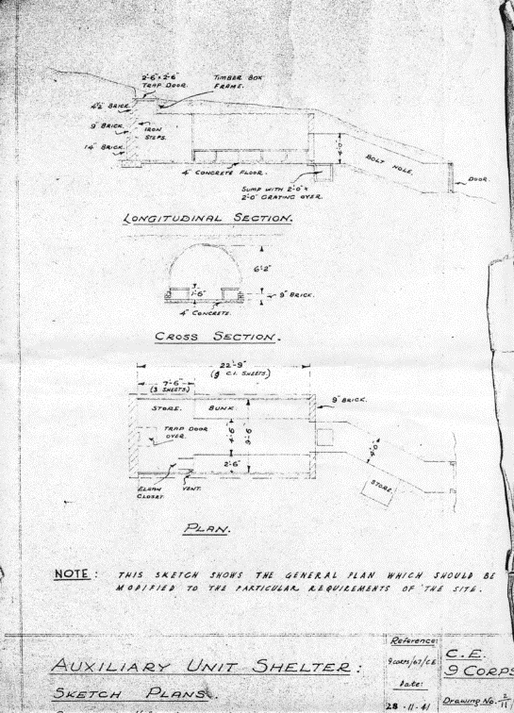
Auxiliary Units
Drawing from the
National Archives
at Kew of the
‘standard’ Auxiliary Unit Operational Base.

Slide 72
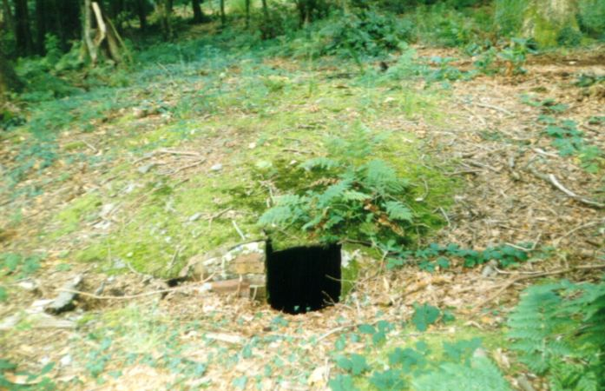
Auxiliary Unit Operational Base
Notes:
How most of the Operational bases looked from above ground.The entrance would have been disguised.

Slide 73
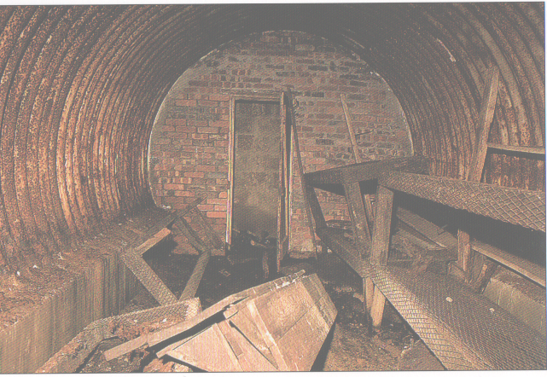
Auxiliary Unit Operational Base
Notes:
How most of the Operational bases looked from above ground.The entrance would have been disguised.Nissen hut underground

Slide 74
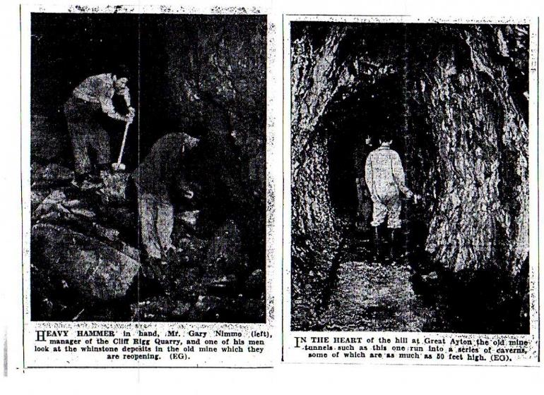
Evening Gazette 1960
Checking old mine workings
Notes:
Garry Nimmo opening up the mine.Describes a long tortuous route to the Operational Base.

Slide 75
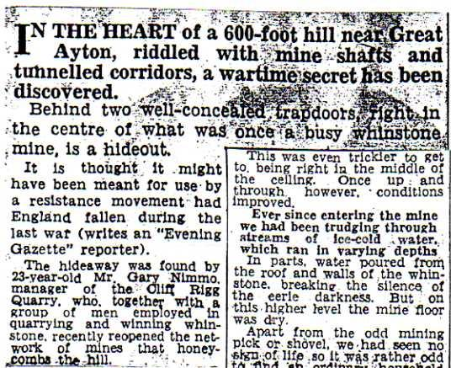
Notes:
Gazette article describes a long walk to the bunker .

Slide 76
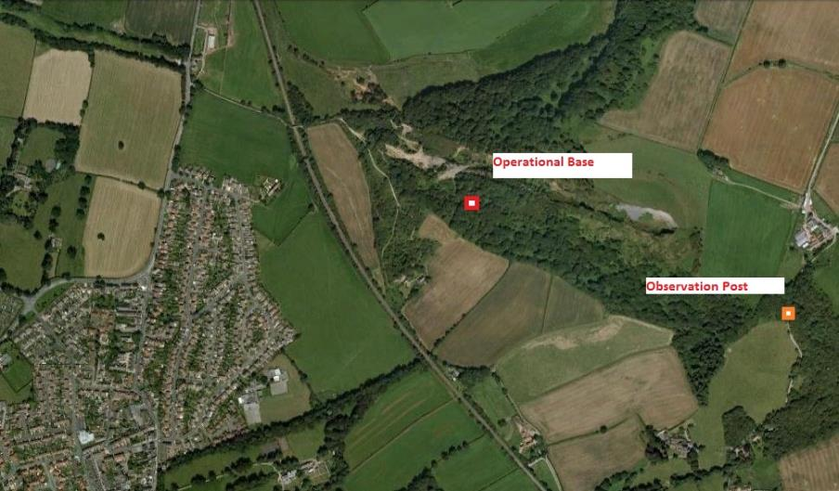
Great Ayton Auxiliary Unit Operational
Base
Notes:
Internal photographs of the bunks etc published at the time have still not been located.The hunt goes on!
Telephone link to observation post

Slide 77
Great Ayton Auxiliary Unit
Lieutenant J F Pain, Ryehill
Pvt F G Forster, Westbrook (Hay & Straw Merchant)
Pvt G W Brown, 12 Deuchar Terrace (Miner)
Pvt R Whitworth, Westbrook (Electrical Eng)
Pvt R S Williamson, High Green (Chemist)
Pvt C Raw, Craignair (Moodys Agric Supplies)
Notes:
All of these men would have gone to Coleshill House,near Swindon in Wiltshire to be trained.(Now owned by National Trust)

Slide 78

Auxiliary Units
The now-sealed entrance to the mineshaft containing the Auxiliary Unit Operational Base in Cliff Ridge Wood.

Slide 79

Auxiliary Units
Site of an Auxiliary Unit Observation Post close to Airyholme Farm.
Notes:
Charles Phalps as a child saw a soldier appear from the ground.Food in the bunker so it could have been another Operational Base

Slide 80

Auxiliary Units
Site of an Auxiliary Unit Observation Post close to Airyholme Farm.
Notes:
Door behind Gooseberry Bush

Slide 81

Auxiliary Unit – Observation Post
Notes:
The post lies above an old railway tunnel.Were they connected?Escape route.

Slide 82

Auxiliary Unit – Observation Post ?
Notes:
Observation Post probably demolished at the end of the war.

Slide 83

Auxiliary Uniform

Slide 84

TEESSIDE AA SITES
Tree Bridge
Notes:
AA Guns 3.72” & 4.5” Batteries.Also Z Batteries

Slide 85

Luftwaffe Photographs
Translation (part of)
b)The steep mountain pyramid of
Roseberry Topping,the striking NW
edge of the York Moors.
c)A monument on altitude 324,
situated on NW edge
d)Ironstone mines
e)The only water reservoir in the region (Lockwood beck)

Slide 86

Luftwaffe Photographs
Notes:
Is this taken from a postcard or did they photograph it ?Follow this route out to sea between b & c and you pass over the Ayton AA guns.

Slide 87

Tree Bridge Anti- Aircraft gun site
This was the site of four 4½ inch Heavy Anti-Aircraft (AA) Guns which formed part of a ring of AA sites around Teesside.
Notes:
Huts known as “squatters camp” when I was at school.Some children came to the British School.

Slide 88

4½ inch Anti-Aircraft guns
Notes:
Ammunition lockers around the guns.Operated at one time by the Home Guard

Slide 89


Shell case from Treebridge

Slide 90

Tree Bridge anti-aircraft gun site 2002
The only visible evidence remaining at the site is a block column with metal pin.
It is thought to be either an alignment post associated with the guns or a mounting post for a Lewis machine gun.

Slide 91

Same Site in 2005

Slide 92
Searchlight Position
In the Council minutes of October 1941:-
Petition from residents residing in the immediate vicinity of the searchlight unit
being erected in the field adjacent to Newton Road .
Site position to be reconsidered.

Slide 93

Searchlight Position

Slide 94

Searchlight
Notes:
Newton Road

Slide 95

Remains of Searchlight Cook-house range at the side of Newton Road
Notes:
Remains of a cookhouse

Slide 96
The Bombing of Great Ayton Recollection from Mrs Joan Taylor
“I saw that thing come down, what was it, a bomb or something. I think Vic was on nights. I was looking out of the house, across that area, in the middle of the night. There must have been an air raid warning. I was looking out of the bedroom window and saw it come down. It seemed as if it was on strings.” The raid took place on May 8th
1941.
Notes:
Raid Information from Air Raid Diary by Bill Norman: Luftwaffe attacks on Teesside 1940 to 1943.My mother thought the raid was in 1945 .
Major raids that night on Hartlepool and Middlesbrough.

Slide 97

It was thought that the stone bridge was the target for the landmine but it is more likely that the mine was being jettisoned after a raid on Middlesbrough. Landmines because they were on parachutes were susceptible to the direction of the wind. In this case the wind seems to have carried the mine away from the village
Notes:
Soldiers were on duty guarding the bridge.Lots of aircraft attacking Middlesbrough and Hartlepool on the night of the attack.

Slide 98

German parachute mine
Notes:
Mines came in various sizes.

Slide 99

German parachute mine in Hull, 1941

Slide 100

Target Bridge
Landmine Impact Point
Notes:
If the landmine had landed on the village it would have caused a lot of casualties

Slide 101

Landmine Crater 1946

Slide 102

Great Ayton Camp
This is the entrance to the camp as it is today.
Notes:
Route of Great Ayton Bypass.

Slide 103

Guisborough Road
Arthur Street
Addison Road
Langbaurgh Close
Allotments
Linden Avenue

Slide 104

Notes:
Camp was to house bombed out people from the expected bombing raids on Middlesbrough
Family connections :Mother unloaded asbestos roof sheets at station.
Sold lead washers of roof when the buildings were demolished.
Uncle Ken and the hand grenade.
Aircraft parts in one hut
Auntie Susy’s first UK home after service in Luftwaffe
Garage very large building.Big enough to take buses.
Aircraft parts in this hut

Slide 105

Maurice Stockdale with camp huts in the background

Slide 106

Perforated Steel Plate (PSP) from Ayton Camp

Slide 107
Air-raid Precautions
Village air-raid shelters
Ayton had 36 public air-raid shelters.
34 Shelters Each Holding 48 people = 1632
2 Shelters Each Holding 24 people = 48
Total Shelter Places = 1680
70% of Village Population provided for.
(Council Minutes November 1940)

Slide 108
Council List of Air Raid Shelters
1) Mill Terrace :Field NE of Tee
2) Green :In front of Overbrook
3) Sunnyfield :SE of Bridge
4) Bridge Street :Bridge Square
5) Levenside:In yard at back of Cottages
6) Church Street: Garden in front of Marwood Hall.
7) Land in front of Congregational Chapel
8) Land in front of Congregational Chapel
9) Waterfall Terrace Clearance Area
10) High Green West Side
11) Mill Cottage & Park Square Back Royal Oak
12) School Gardens
13) Romany Road :Land at corner
14) Mount Pleasant :Opposite Fir Tree Cottages
15) Cliffe Terrace:Field,Tile Sheds Farm
16) Eatons Row :Back of Cottages
17) Back of East View Terrace
18) Gribdale Terrace :Mount at other side of Terrace
19) California:In land near Moody’s Warehouse
20) Bradley’s Row :Front Street
21) Bradley’s Row :Front Street
22) Langbaraugh Corner
23) Langbaraugh Corner
24) Arthur Street : Yard at back
25) John Street :Moody’s Field
26) John Street :Clearance Area
27) Pearson Ville: Land at rear of The Gables
28) Cleveland Street :Land at the end of street
29) Monkabeque :Land at end of street
30) Deuchore Terrace : Rear
31) Addison Road :West of Council houses
32) Addison Road :Addison Road
33) Linden Road
34) Linden Terrace
35) Church Street :Rear
Note:Site 16 at rear of Eaton’s Row unsatisfactory due to flooding.

Slide 109

Plans for Shelters
Notes:
Plans found at Northallerton Council Archives 2010

Slide 110

Great Ayton Shelters
Notes:
Show location of surviving shelter

Slide 111

Great Ayton Shelters

Slide 112

Location of Surviving Shelter
Notes:
While on Google Earth spotted possible surviving shelter.

Slide 113

Only Surviving Surface Air Raid Shelter

Slide 114

Positions of Access Doors

Slide 115

The Grange Great Ayton

Slide 116

Air-raid shelter entrance at Ayton Grange

Slide 117

Inside the Grange air-raid shelter

Slide 118

War Weapons Week May4th 1941
Notes:
Home Guard bringing up the rear.Names of many of the people in the parade identified.

Slide 119

Great Ayton VJ Day Parade
Notes:
Home Guard bringing up the rear.Names of many of the people in the parade identified.

