Slide 1
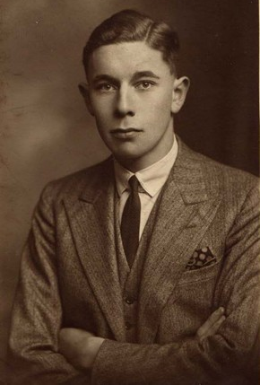
George Morley Fidler
Ian Pearce, Great Ayton History Society.

Slide 2
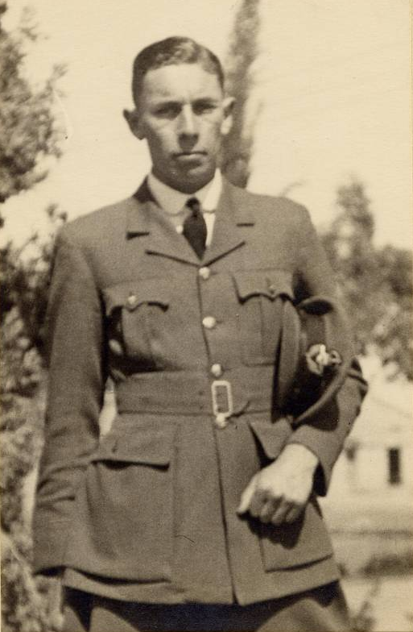
GEORGE MORLEY FIDLER
1912-1940
The life and death of a brave airman from Great Ayton

Slide 3
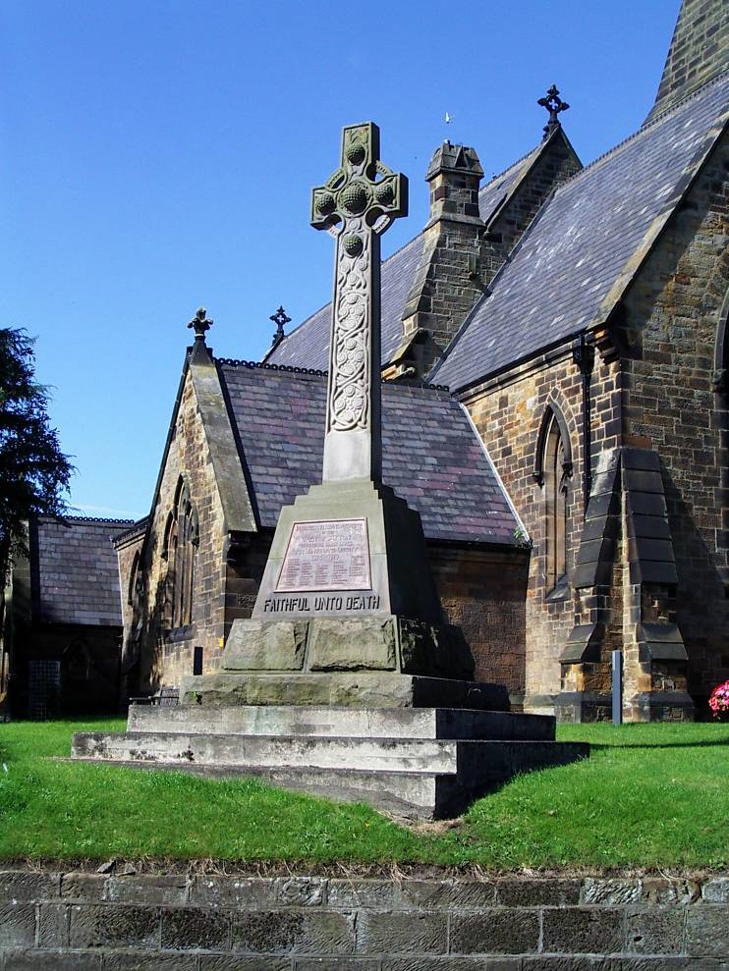
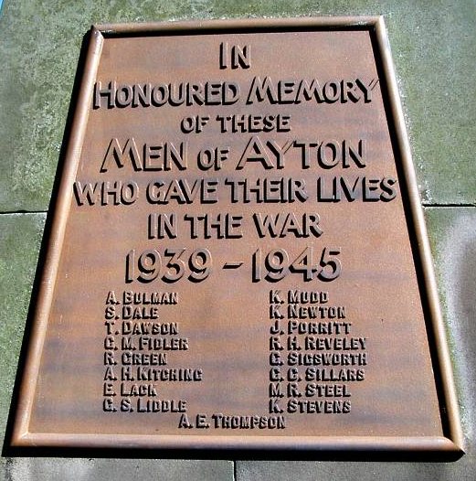
17 Great Ayton men lost their lives
in the Second World War.
One of them was G M Fidler.
Christ Church, Great Ayton

Slide 4
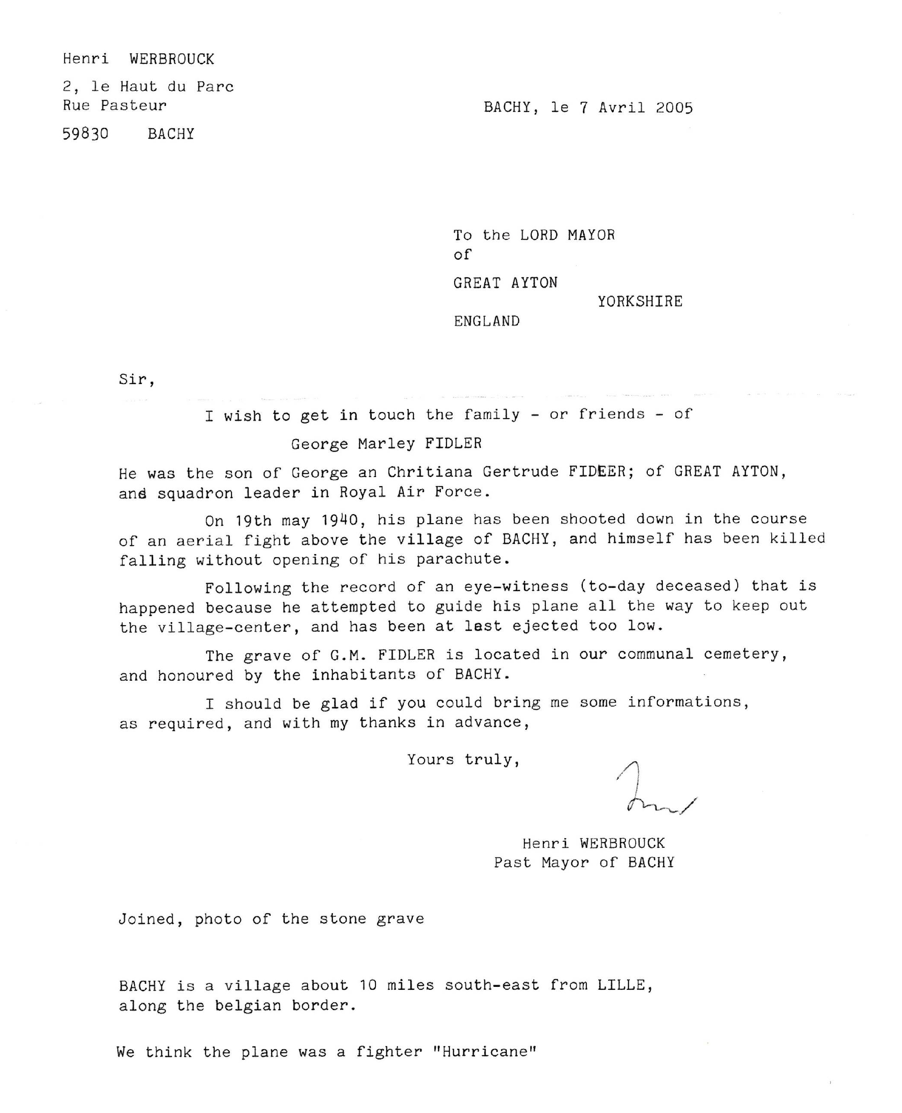
In 2005, Great Ayton Parish Council received a letter from Henri Werbrouk, the Mayor of Bachy, a small village near Lille in Northern France.
Was there was any information about Squadron Leader G M Fidler, the only British serviceman to be buried in their village cemetery?

Slide 5
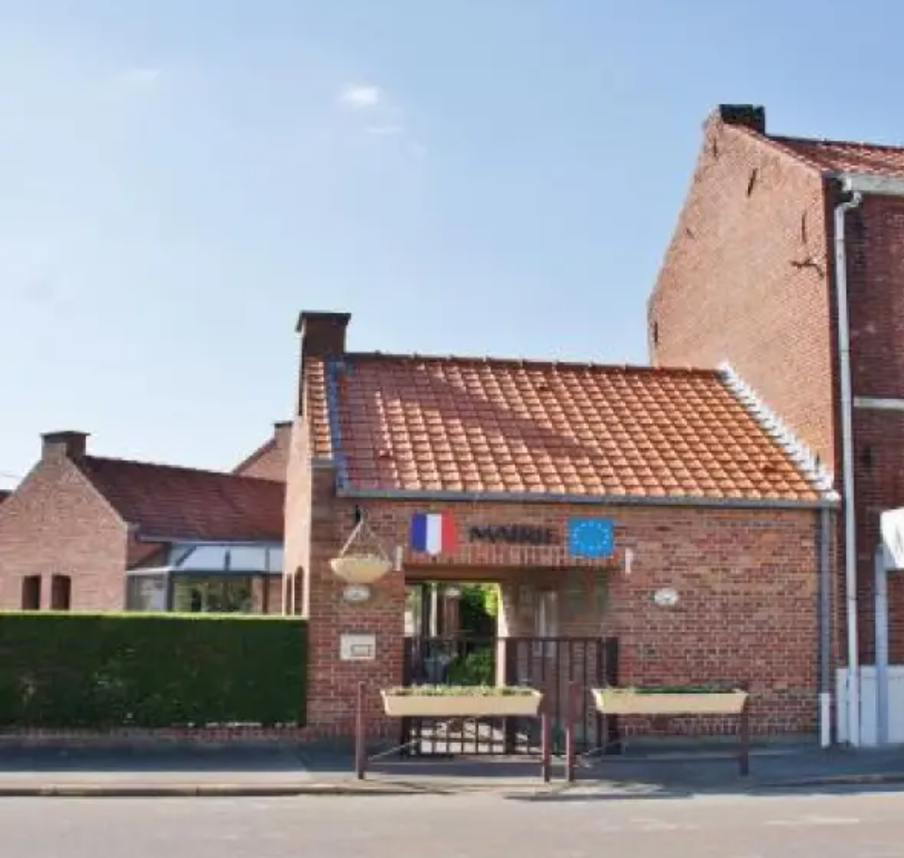
What was believed to be the tragic story of George Morley Fidler was put together from research in Great Ayton and a visit to Bachy in France in 2005.
Twenty-one years later, in 2026, unexpected discoveries led to a
different story.
Bachy Town Hall

Slide 6
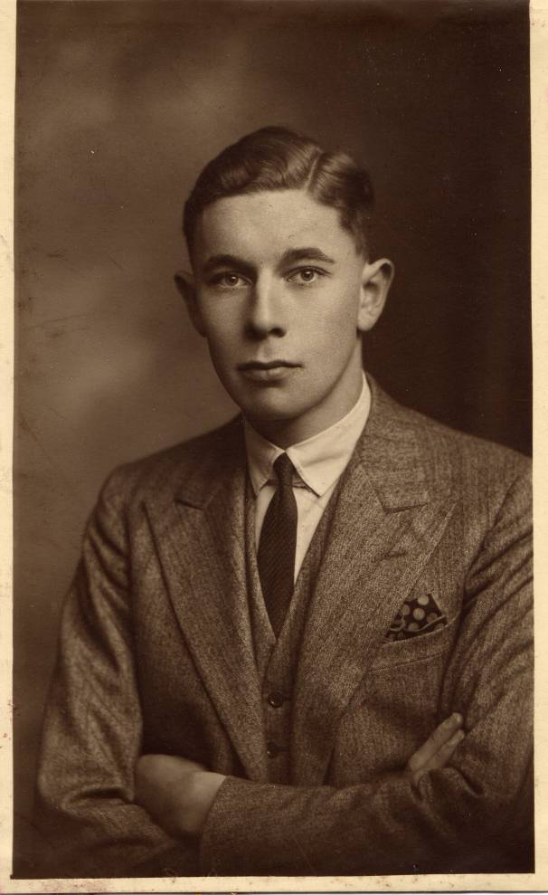
George Morley Fidler was born on 3 September 1912 at Roseberry House, Guisborough Road, Great Ayton.
His parents were George and Gertude Fidler.
Morley was educated at the Friends’ School in Great Ayton, and then at Middlesbrough High School.
His passion was for flying, and in 1934 he joined the Royal Air Force as an Acting Pilot Officer.

Slide 7
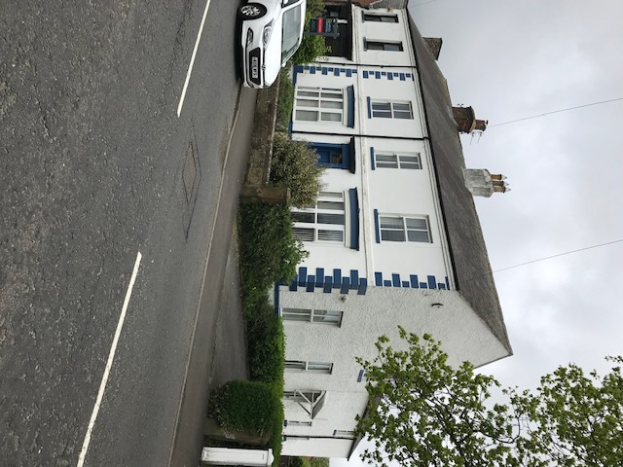
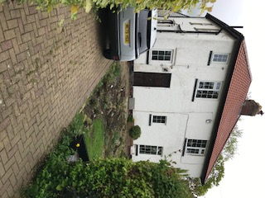
In 1928, Morley’s father had “Canobie” built at 45 Addison Road, Great Ayton.
The Fidlers had moved from Redcar to Roseberry House, Great Ayton.

Slide 8
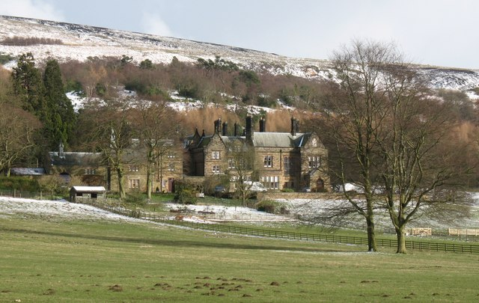
Morley had an elder brother and sister, twins Harold and Joan.
Joan became a radiographer.
During the war she worked at Kepwick Hall which was in use as a military hospital.
Kepwick Hall
Joan contracted a serious illness there and died in April 1940, just one month before Morley’s death.
Harold survived the war, but passed away in 1973 while sleeping in front of the kitchen range at 45 Addison Road.

Slide 9
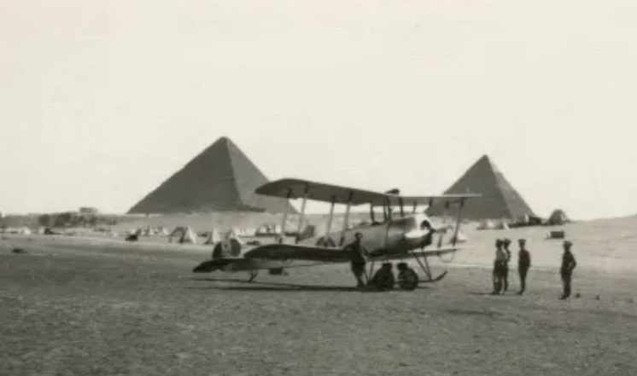
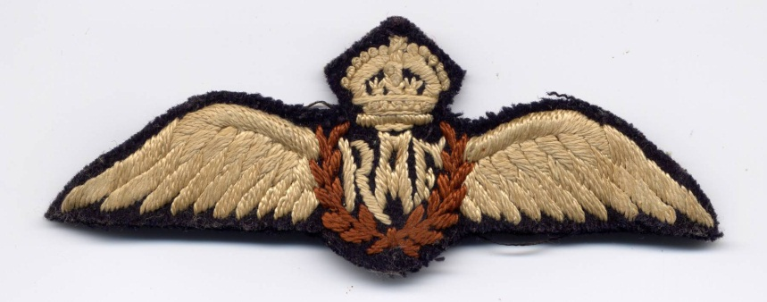
After two weeks’ basic training at Uxbridge, Morley was posted to Egypt, where he flew an Avro 504K.
Avro 504K in Egypt
He gained his wings in June 1935 assessed as “a sound and reliable pilot, excellent on ground subjects”.
Morley’s wings

Slide 10
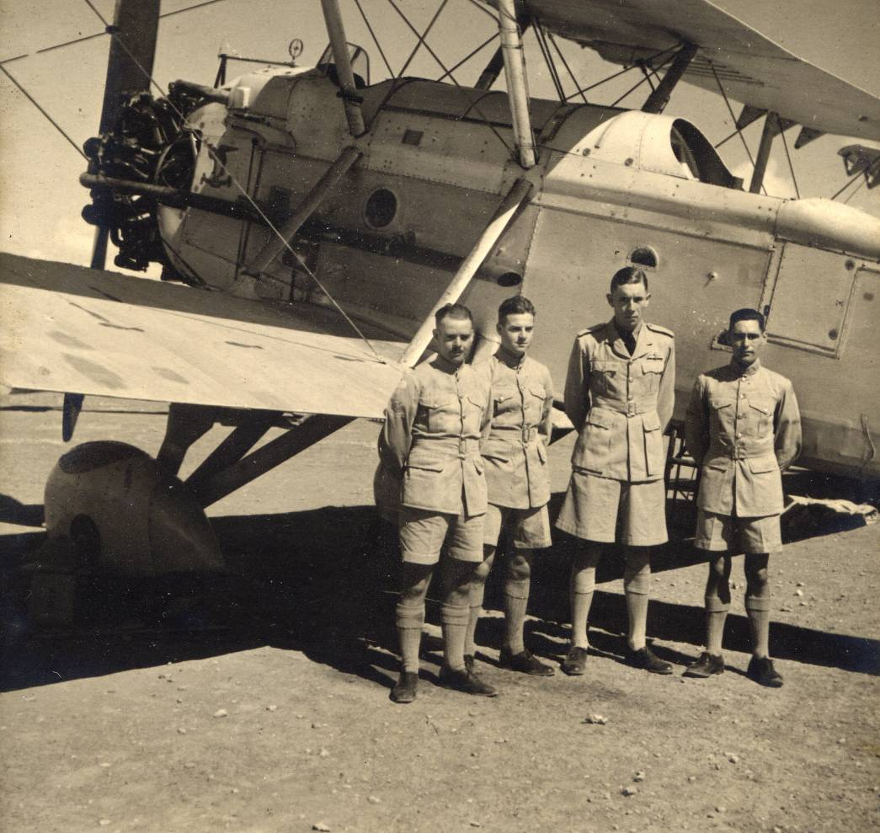
Morley, easily recognised by his height, standing by a Vickers Vincent in Egypt.

Slide 11
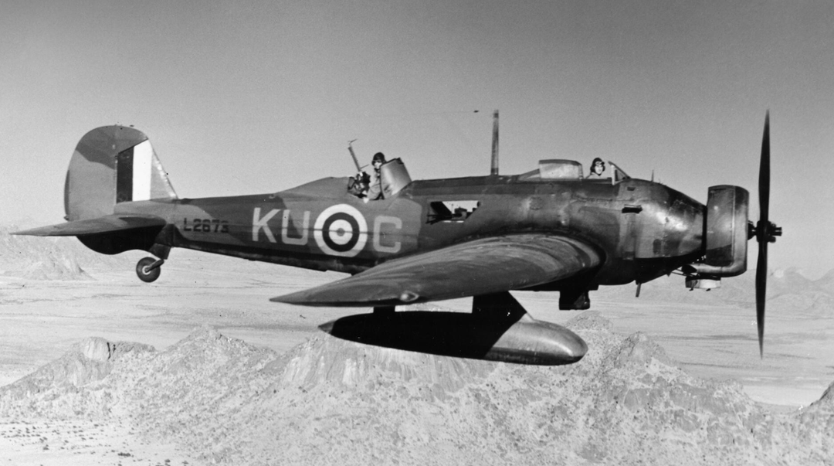
Vickers Wellesley
Morley was in Egypt for three years, with brief spells in Cyprus and India.
He was promoted to Flying Officer. By now he was flying Vickers Wellesleys.

Slide 12
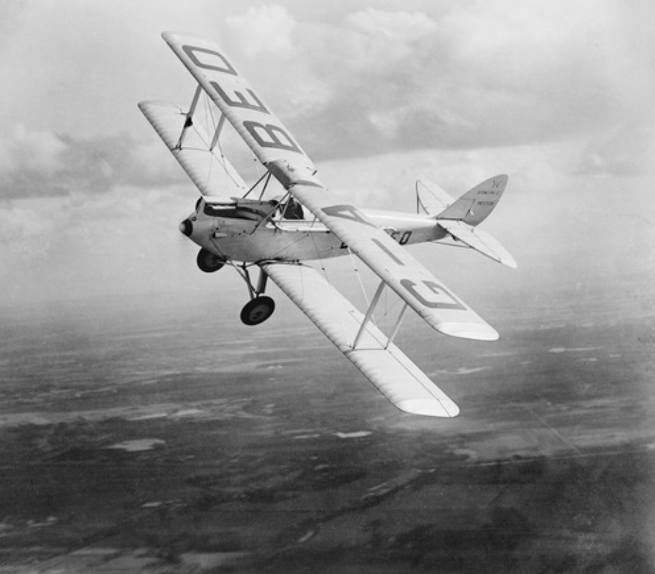

Tiger Moth biplane The Grange
Morley would fly up to Great Ayton on leave, looping-the-loop over “The Grange” and landing in a field behind Yarm Lane.

Slide 13
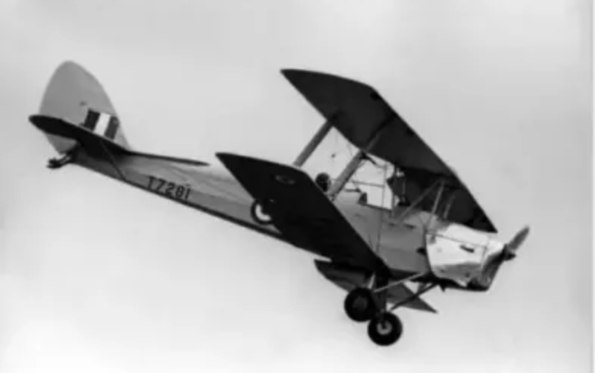
In 1938, Morley was assessed as “exceptional” and promoted to
Acting Flight Lieutenant.
In 1939, he was posted to Louth in Lincolnshire and promoted to
Flight Lieutenant.
Morley’s career then changed dramatically. War was declared in
September and he found himself in France, part of the Air Component
of the British Expeditionary Force.
He was flying Tiger Moths, behind the
front line, on administrative duties.

Slide 14
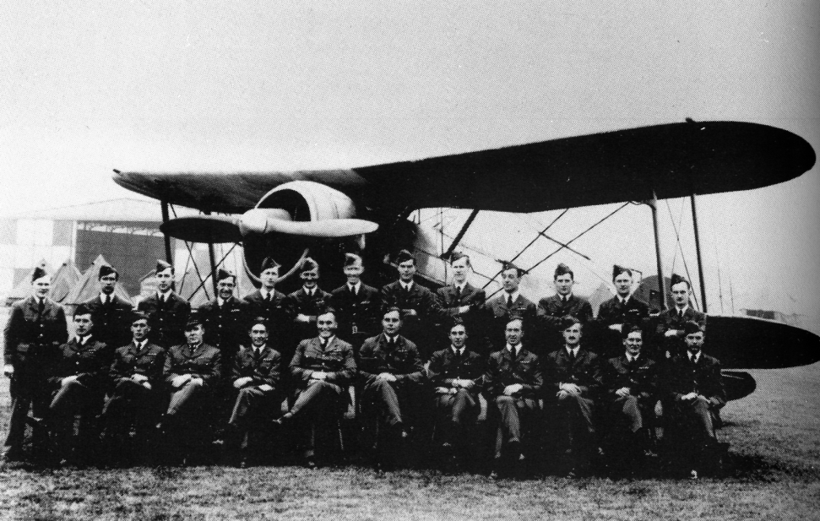
The pilots of 607 Squadron in front of a Gloster Gladiator in France.
In January 1940, Morley joined 607(F) Squadron, a volunteer squadron from Sunderland, on operational duties.
They were equipped with the elderly Gloster Gladiator aircraft.

Slide 15
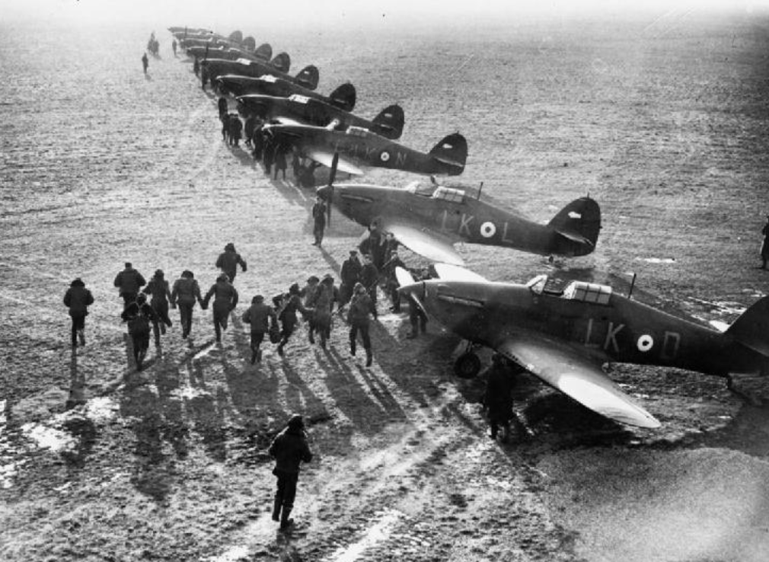
By March 1940, new Hawker Hurricanes were coming into service
with the RAF in France. They operated from grass airfields.

Slide 16
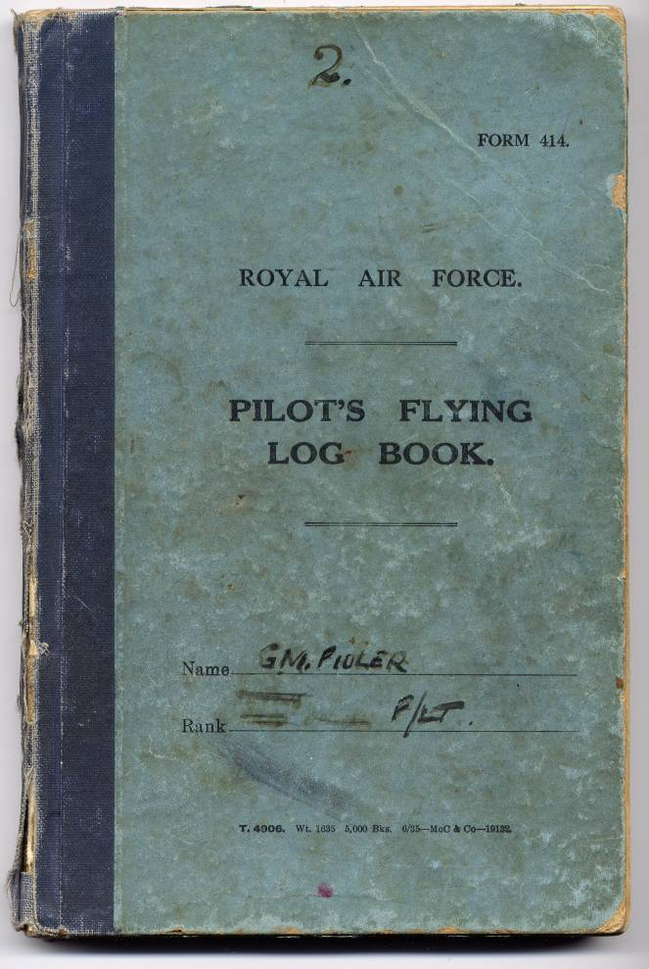
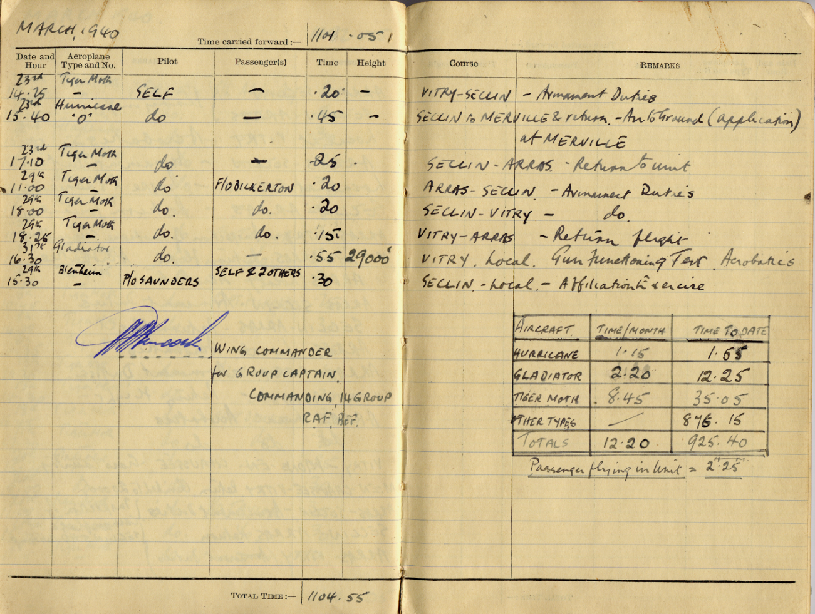
Morley Fidler’s Log Book for March 1940. Nearly all in Tiger Moth biplanes - only one flight in a Hurricane.

Slide 17
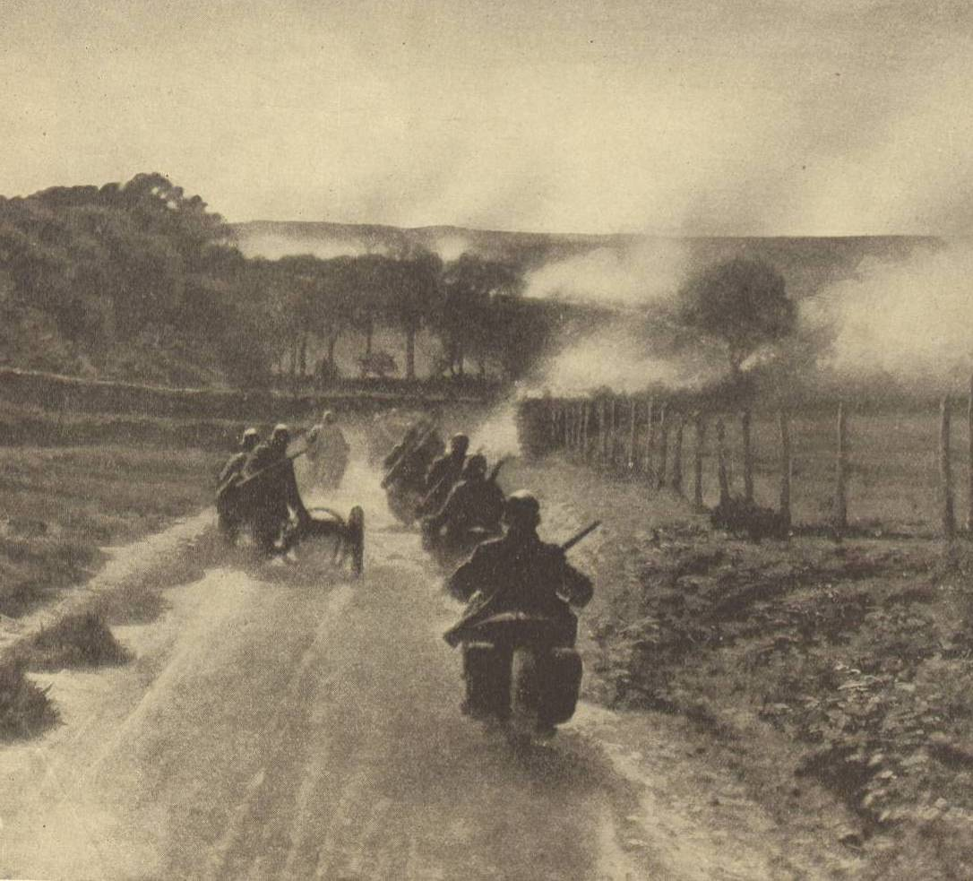
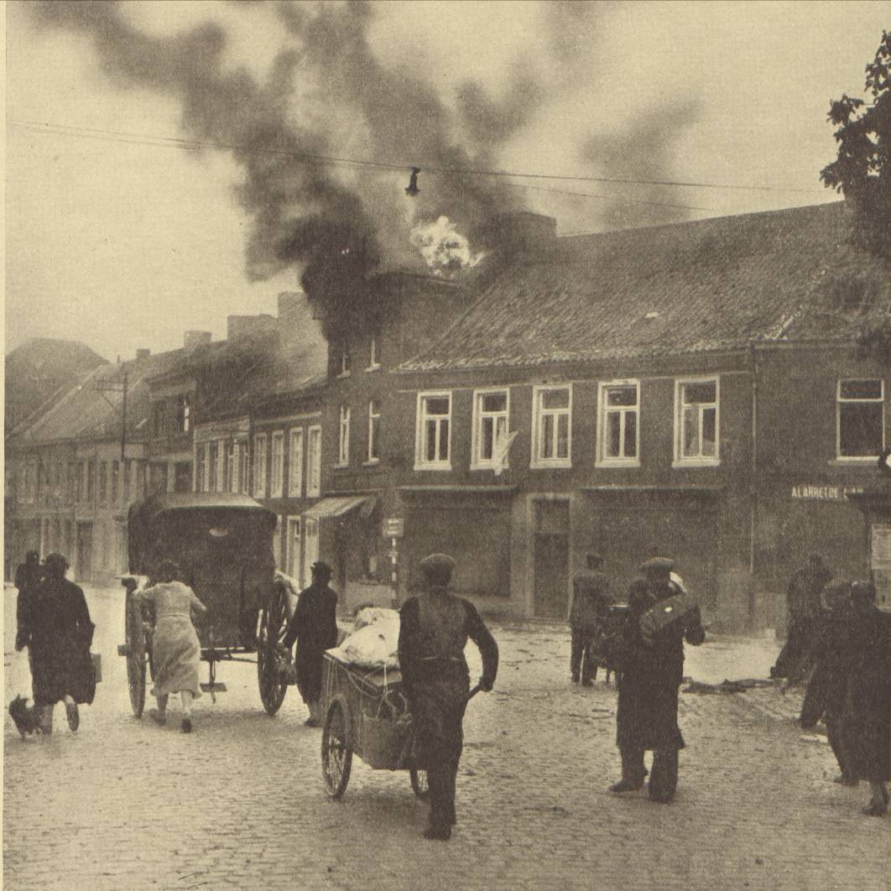
The German Blitzkrieg into Belgium, the Netherlands and France began on 10 May 1940. The German advance was unstoppable.
In the air, Messerschmitt Bf 109 fighters, with pilots experienced in the Spanish Civil War, soon gained the upper hand.

Slide 18
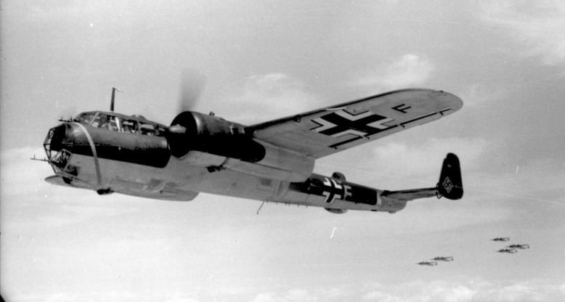
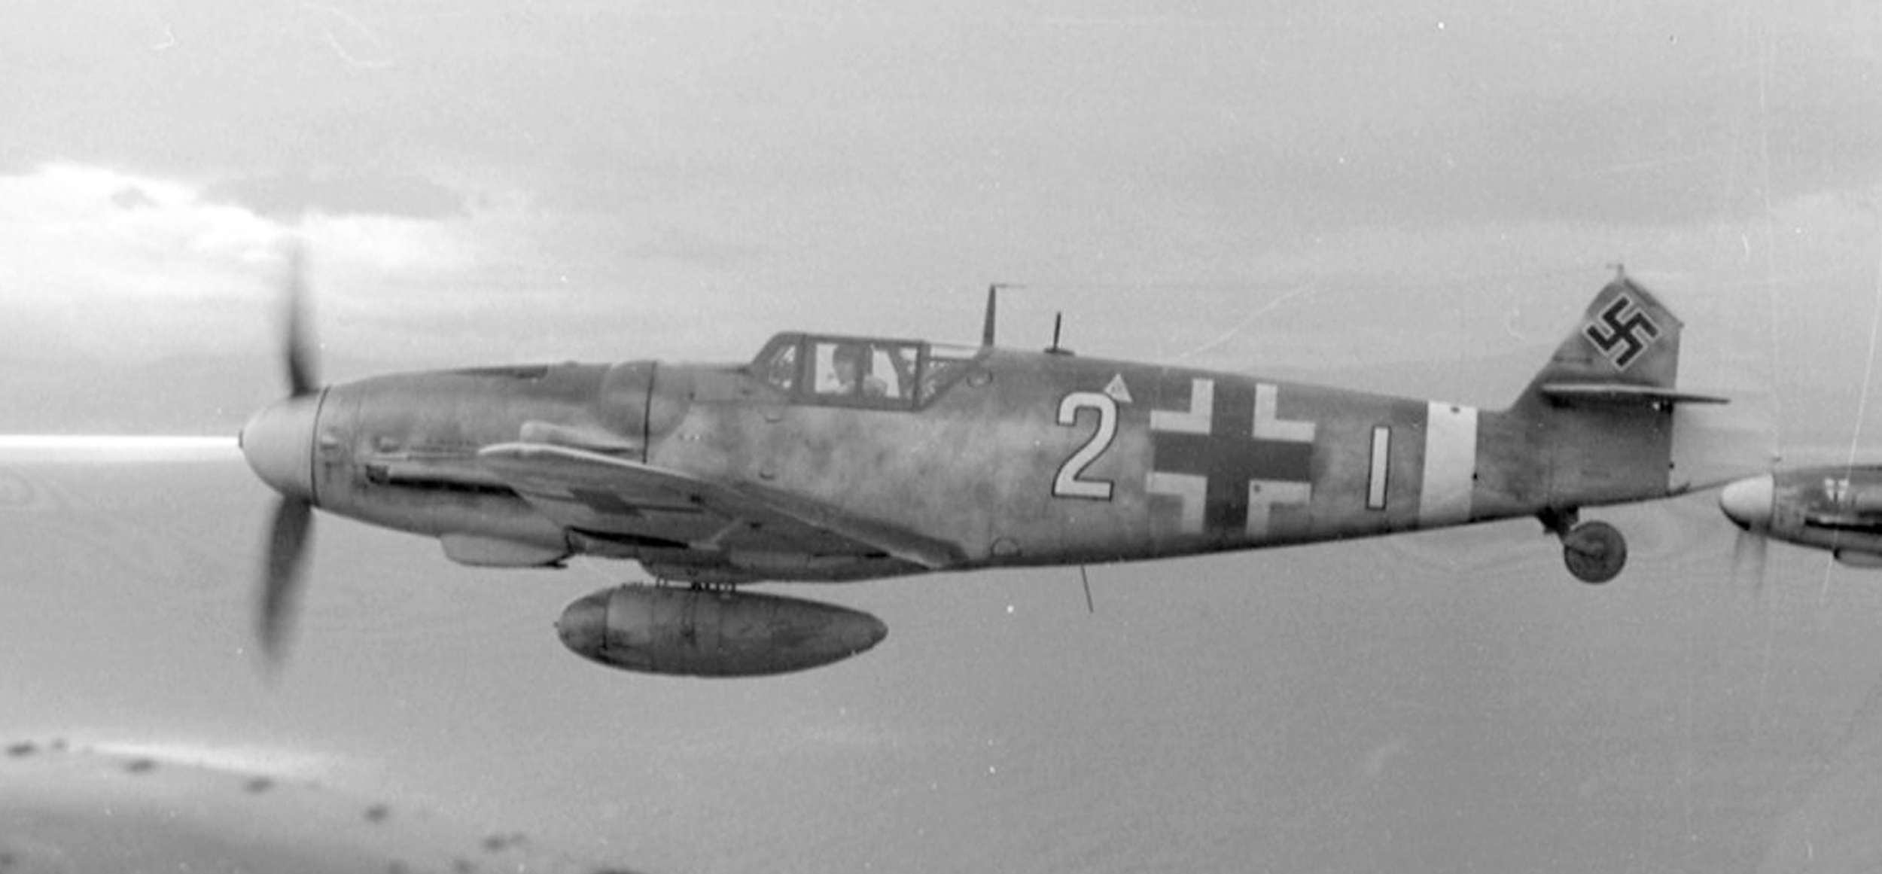
607 Squadron suddenly found itself in the middle of aerial combat.
During the first day of action, 607 Squadron claimed 18 enemy aircraft for the loss of 3 Hurricanes, but this early success was not to last for long.
Messerschmitt Bf 109 fighter
Dornier DO17 bomber

Slide 19
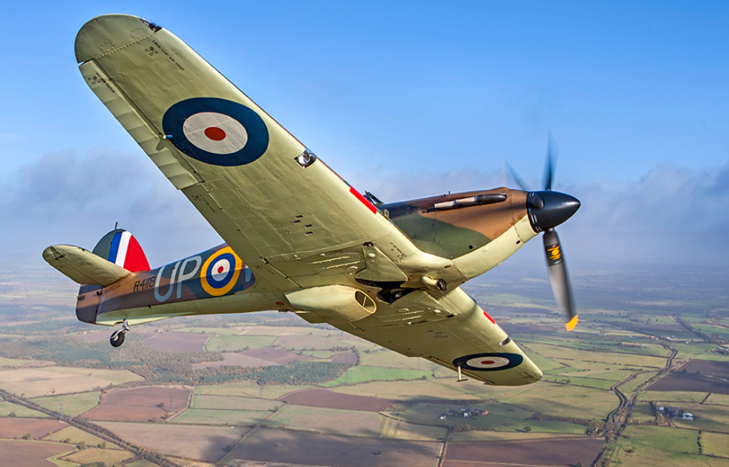
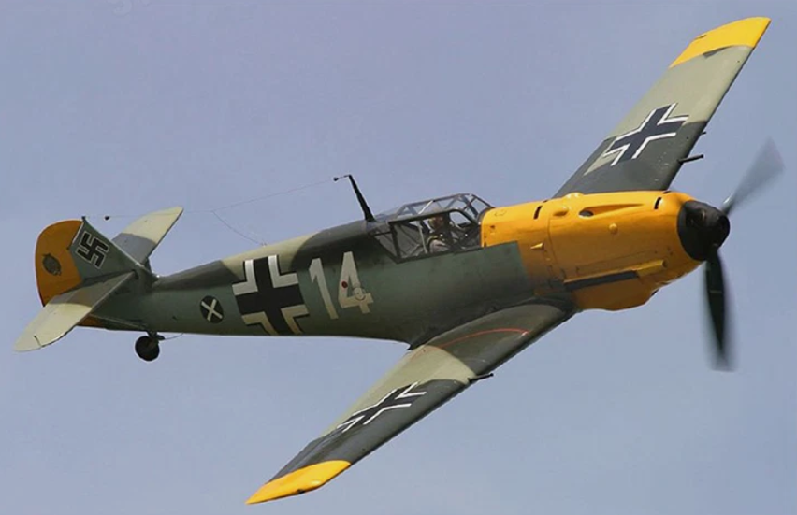
 |  |  | Hawker Hurricane Mk 1 | Messerschmitt Bf109E
 | Power | hp | 1,030 hp | 1,150 hp
 | Maximum weight | ton | 2.8 ton | 2.5 ton
 | Power to weight ratio | hp/ton | 371 hp/ton | 467 hp/ton (+25%)
 | Maximum speed | mph | 328 mph | 354 mph
 | Range | miles | 425 miles | 412 miles
 | Machine guns |  | 8 x 7mm guns in wings | 2 x 20mm guns in wings 2 x 8mm guns in nose
 | The Messerschmitt had superior performance, armaments about equal

Slide 20
Four momentous days in the life of George Morley Fidler
Day 1 - Thursday 16 May 1940
The Netherlands surrender.
In London the War Cabinet agrees to send more Hurricanes to France.
Squadron Leader “Lance” Smith, Commanding Officer of 607 Squadron, is shot down over Dinant and killed.
He is replaced by Morley Fidler, newly promoted to Squadron Leader.

Slide 21
Four momentous days in the life of George Morley Fidler
Day 2 - Friday 17 May 1940
Brussels and Reims are occupied.
Squadron Leader Morley Fidler arrives at Vitry-en-Artois, the grass airstrip used by 607 Squadron, in one of the additional Hurricanes.
607 Squadron Hurricanes are engaged in attacks on Dornier bombers.

Slide 22
Four momentous days in the life of George Morley Fidler
Day 3 - Saturday 18 May 1940
The rapid German advance continues.
More Hurricanes arrive at the Vitry-en-Artois airstrip.
As aircraft are being refuelled, the airstrip is attacked by
nine Heinkel bombers and about forty Messerschmitt fighters.
With their airfield in chaos, 607 Squadron hurriedly move
to Norrent-Fontès.

Slide 23
Four momentous days in the life of George Morley Fidler
Day 4 - Sunday 19 May 1940
17 Squadron and 607 Squadron Hurricanes patrol the skies over Cambrai.
Squadron Leader Fidler is flying with them in his Hurricane P3535.
At 1600 hours they encounter a Dornier bomber with an escort of Messerschmitt Bf 109 fighters.
In the ensuing air battle, Morley Fidler is shot down over Oisy-le-Verger.

Slide 24
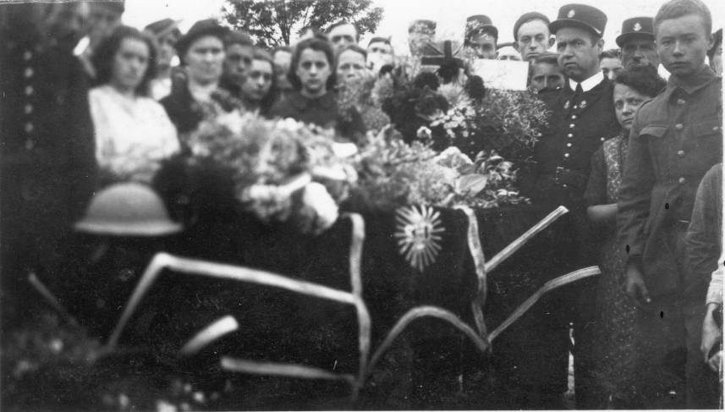
Was this Morley Fidler?
An eye-witness saw a stricken Hurricane flying low over the village of Bachy.
The pilot baled out but his parachute failed to open. He fell into a field on the outskirts of Bachy where he was hastily buried by a party of passing British Grenadiers.
After the Germans left, the pilot’s
body was lifted from the field and
placed in the cemetery at Bachy.
At the service the priest was
concerned that he did not know
the religion of the deceased airman.

Slide 25
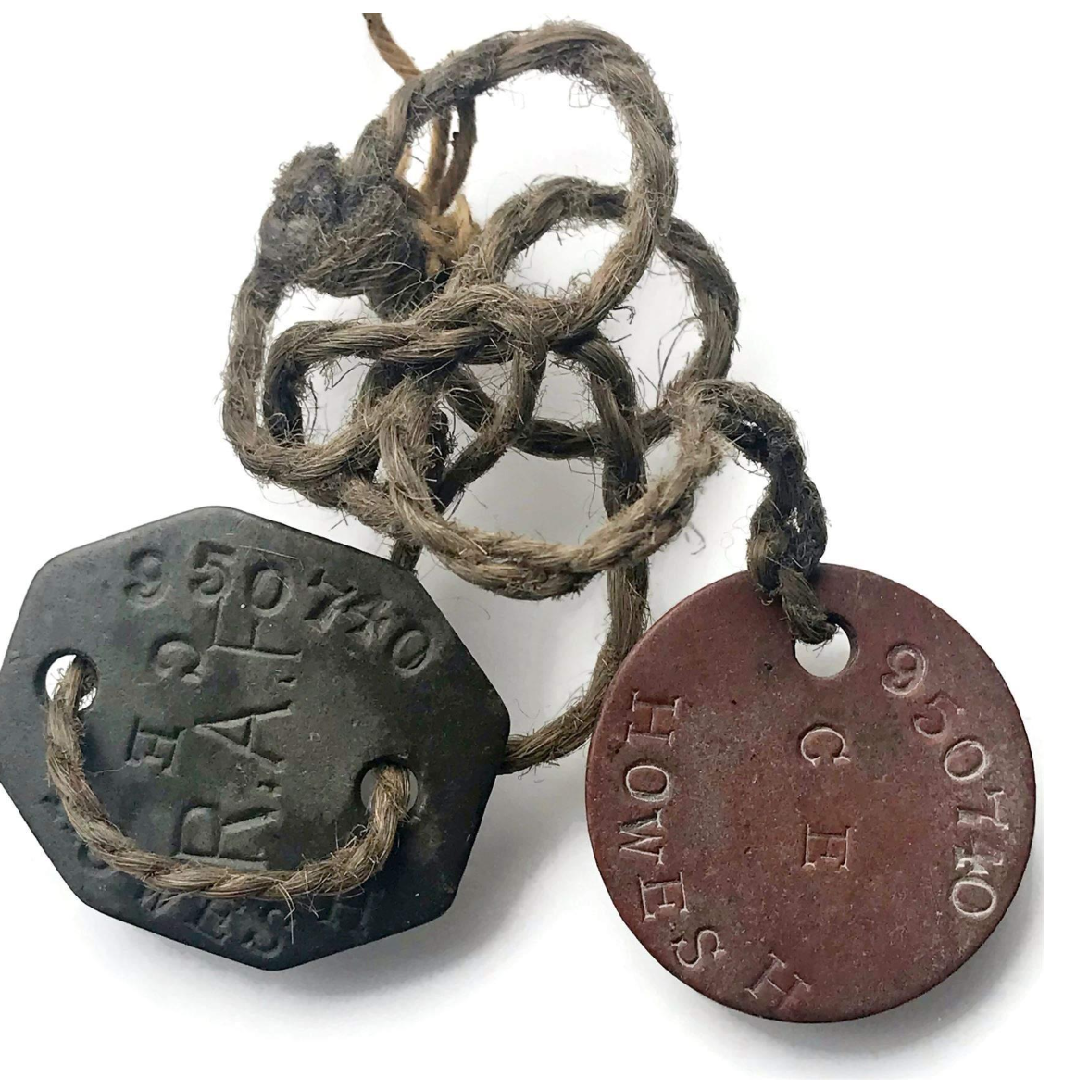
The residents of Bachy believed that the pilot buried in their communal cemetery was Squadron Leader Morley Fidler.
It is now known that he was not Morley Fidler.
It has always been a mystery how the people
of Bachy identified their pilot as Morley Fidler.
The only means of identifying a pilot would have been the “dog-tag” worn around the pilot’s neck.
But RAF dog-tags were made of fibre and would rot away in the ground.

Slide 26
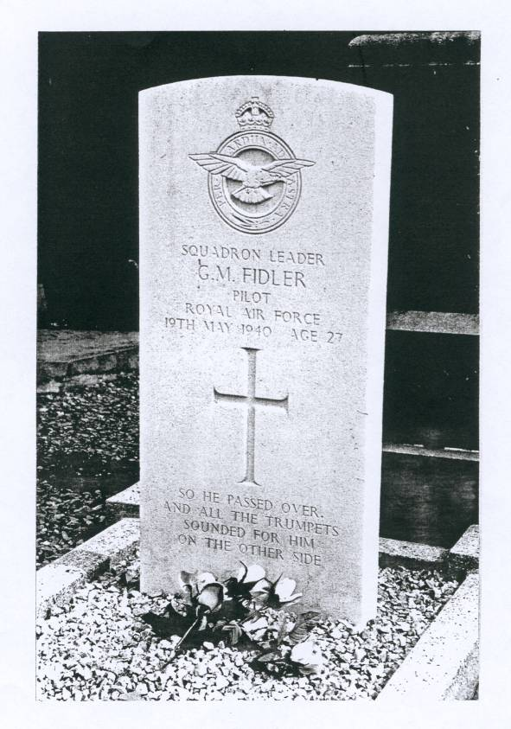
A possible explanation for the confusion is that the Missing Research and Enquiry Service made a mistake in assuming the pilot at Bachy was Squadron Leader Fidler.
It was another, unknown, Hurricane pilot who had been shot down at Bachy.

Slide 27
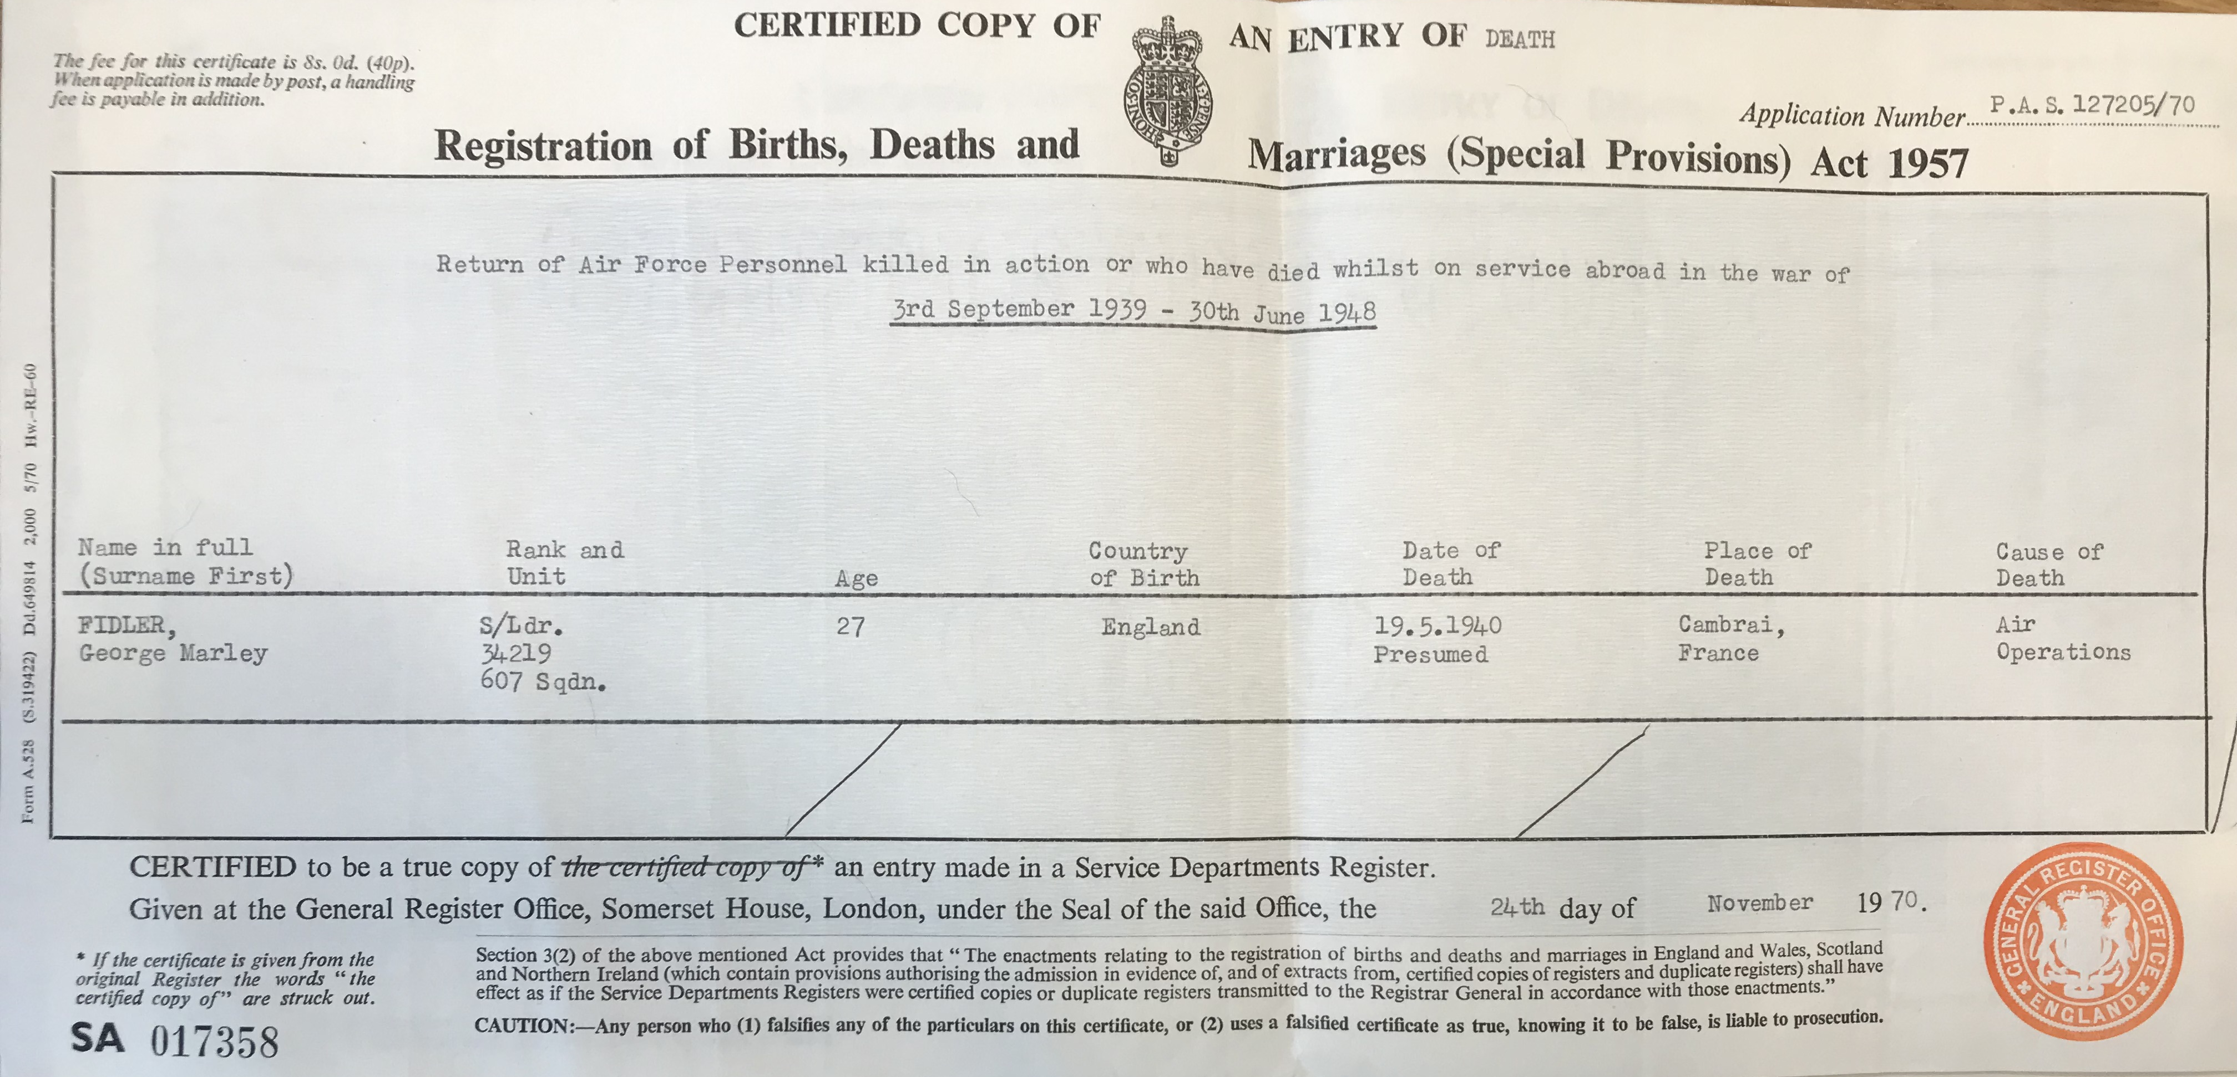
Return of Air Force Personnel killed in action or who have died whilst on service abroad in the war of 3rd September 1939 - 30th June 1948
S/Ldr.34219, 607 Sqdn., Age 27
Date of death 19.5.1940 Presumed, Place of death: Cambrai, France
Cause of death: Air Operations

Slide 28
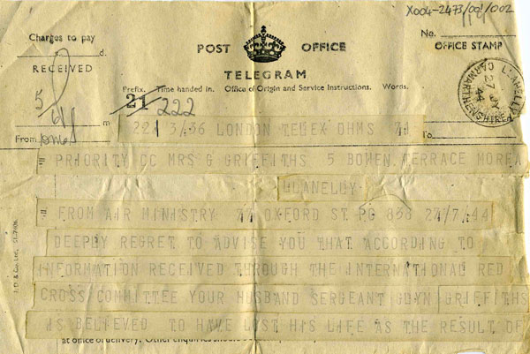
Ivy Hynes remembered doing domestic work for Mrs Fidler, who was
already mourning the death of her daughter the previous month.
“One morning the doorbell rang quite early and I went to answer it. It was
a lady with a yellow telegram. You knew it wasn’t good news. I took the telegram and wondered what to do with it. Mrs Fidler was still very sad from Joan’s death.”
“Then I remembered that Nurse Norton lived just along the road. She went to the Fidlers’ home regularly and knew them well. I took the telegram to her house and told her what had happened. She came back to Mrs Fidler’s with me and broke the news of Morley’s death to her.
She was distraught.”

Slide 29
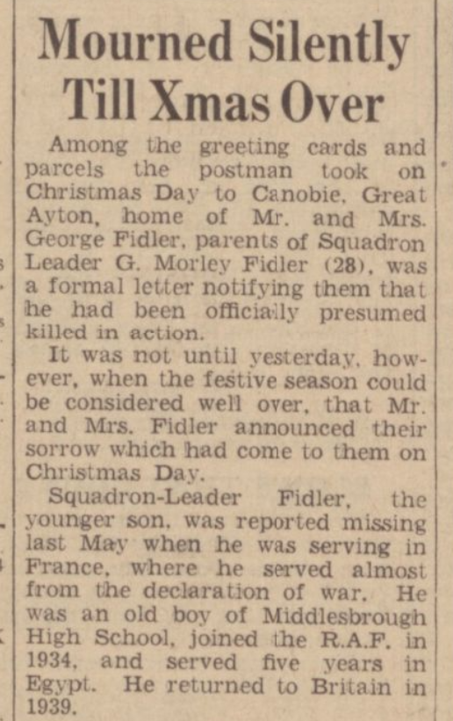
Newcastle Journal and North Mail
9 January 1941, page 3

Slide 30
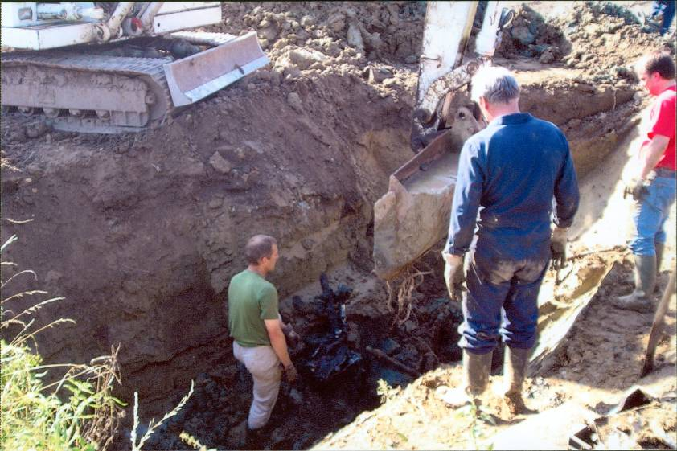
In 2006, a group of Franco-Belgian amateur historians started excavating
a site at Oisy-le-Verger where a Hurricane, believed to be that of Morley Fidler, had been found.
But if Morley Fidler had fallen to the ground at Bachy, how could his Hurricane be found 20 miles away?

Slide 31
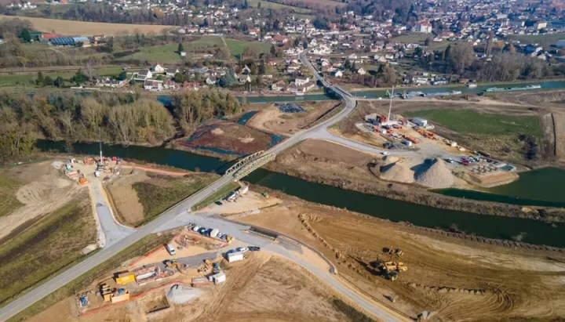
Parts of a Hurricane had been found at Oisy-le-Verger, 20 miles from Bachy.
These parts carried the serial number of Fidler’s aircraft, and local people who saw the plane crash said that it carried a yellow star on its tail, denoting the Squadron Leader.
Recent excavations for the Seine-Nord canal have revealed a complete Hurricane with the decomposed body of the pilot still seated in the cockpit.
This was George Morley Fidler.

Slide 32
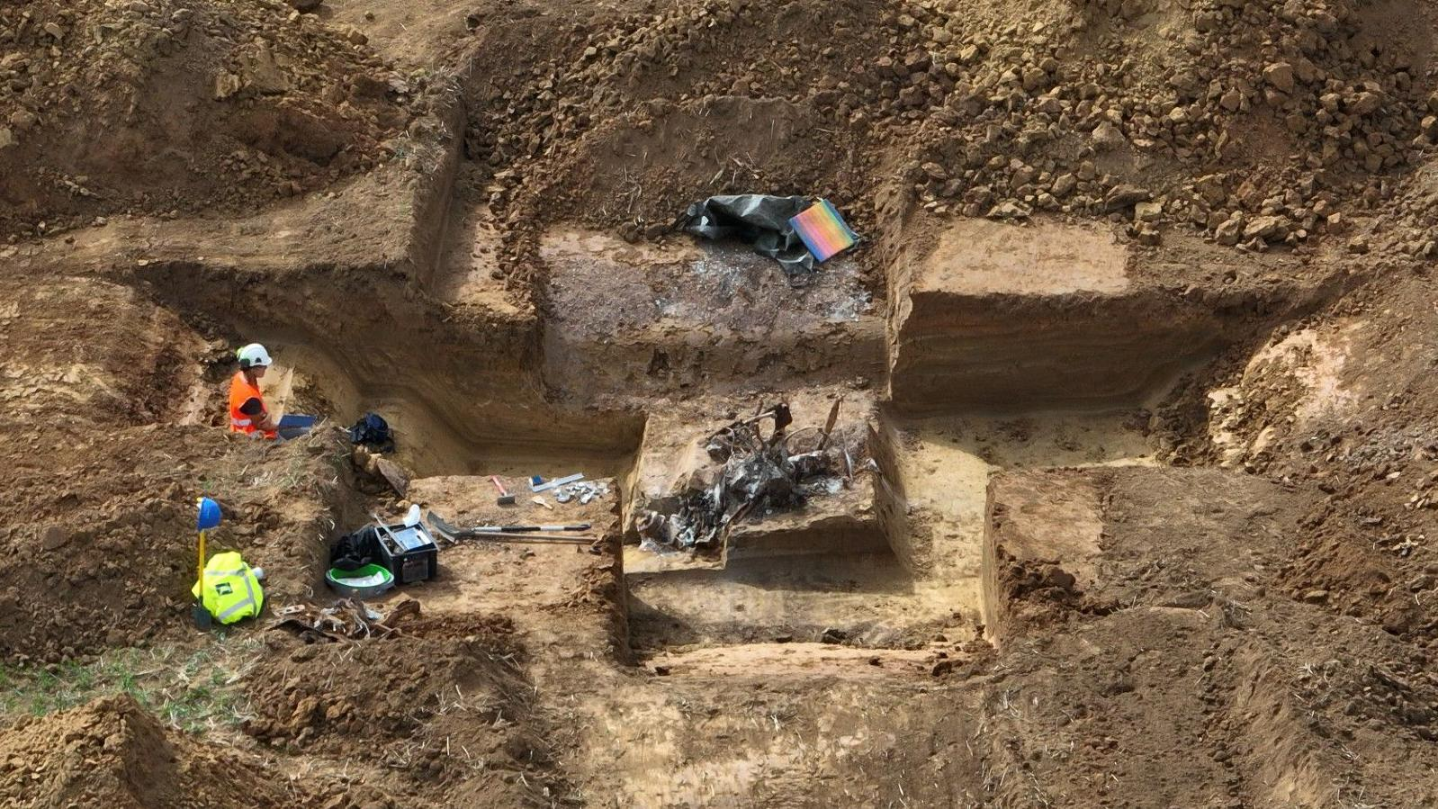
In 2022, the remains of a Hurricane, with its pilot still in his seat, was found.

Slide 33
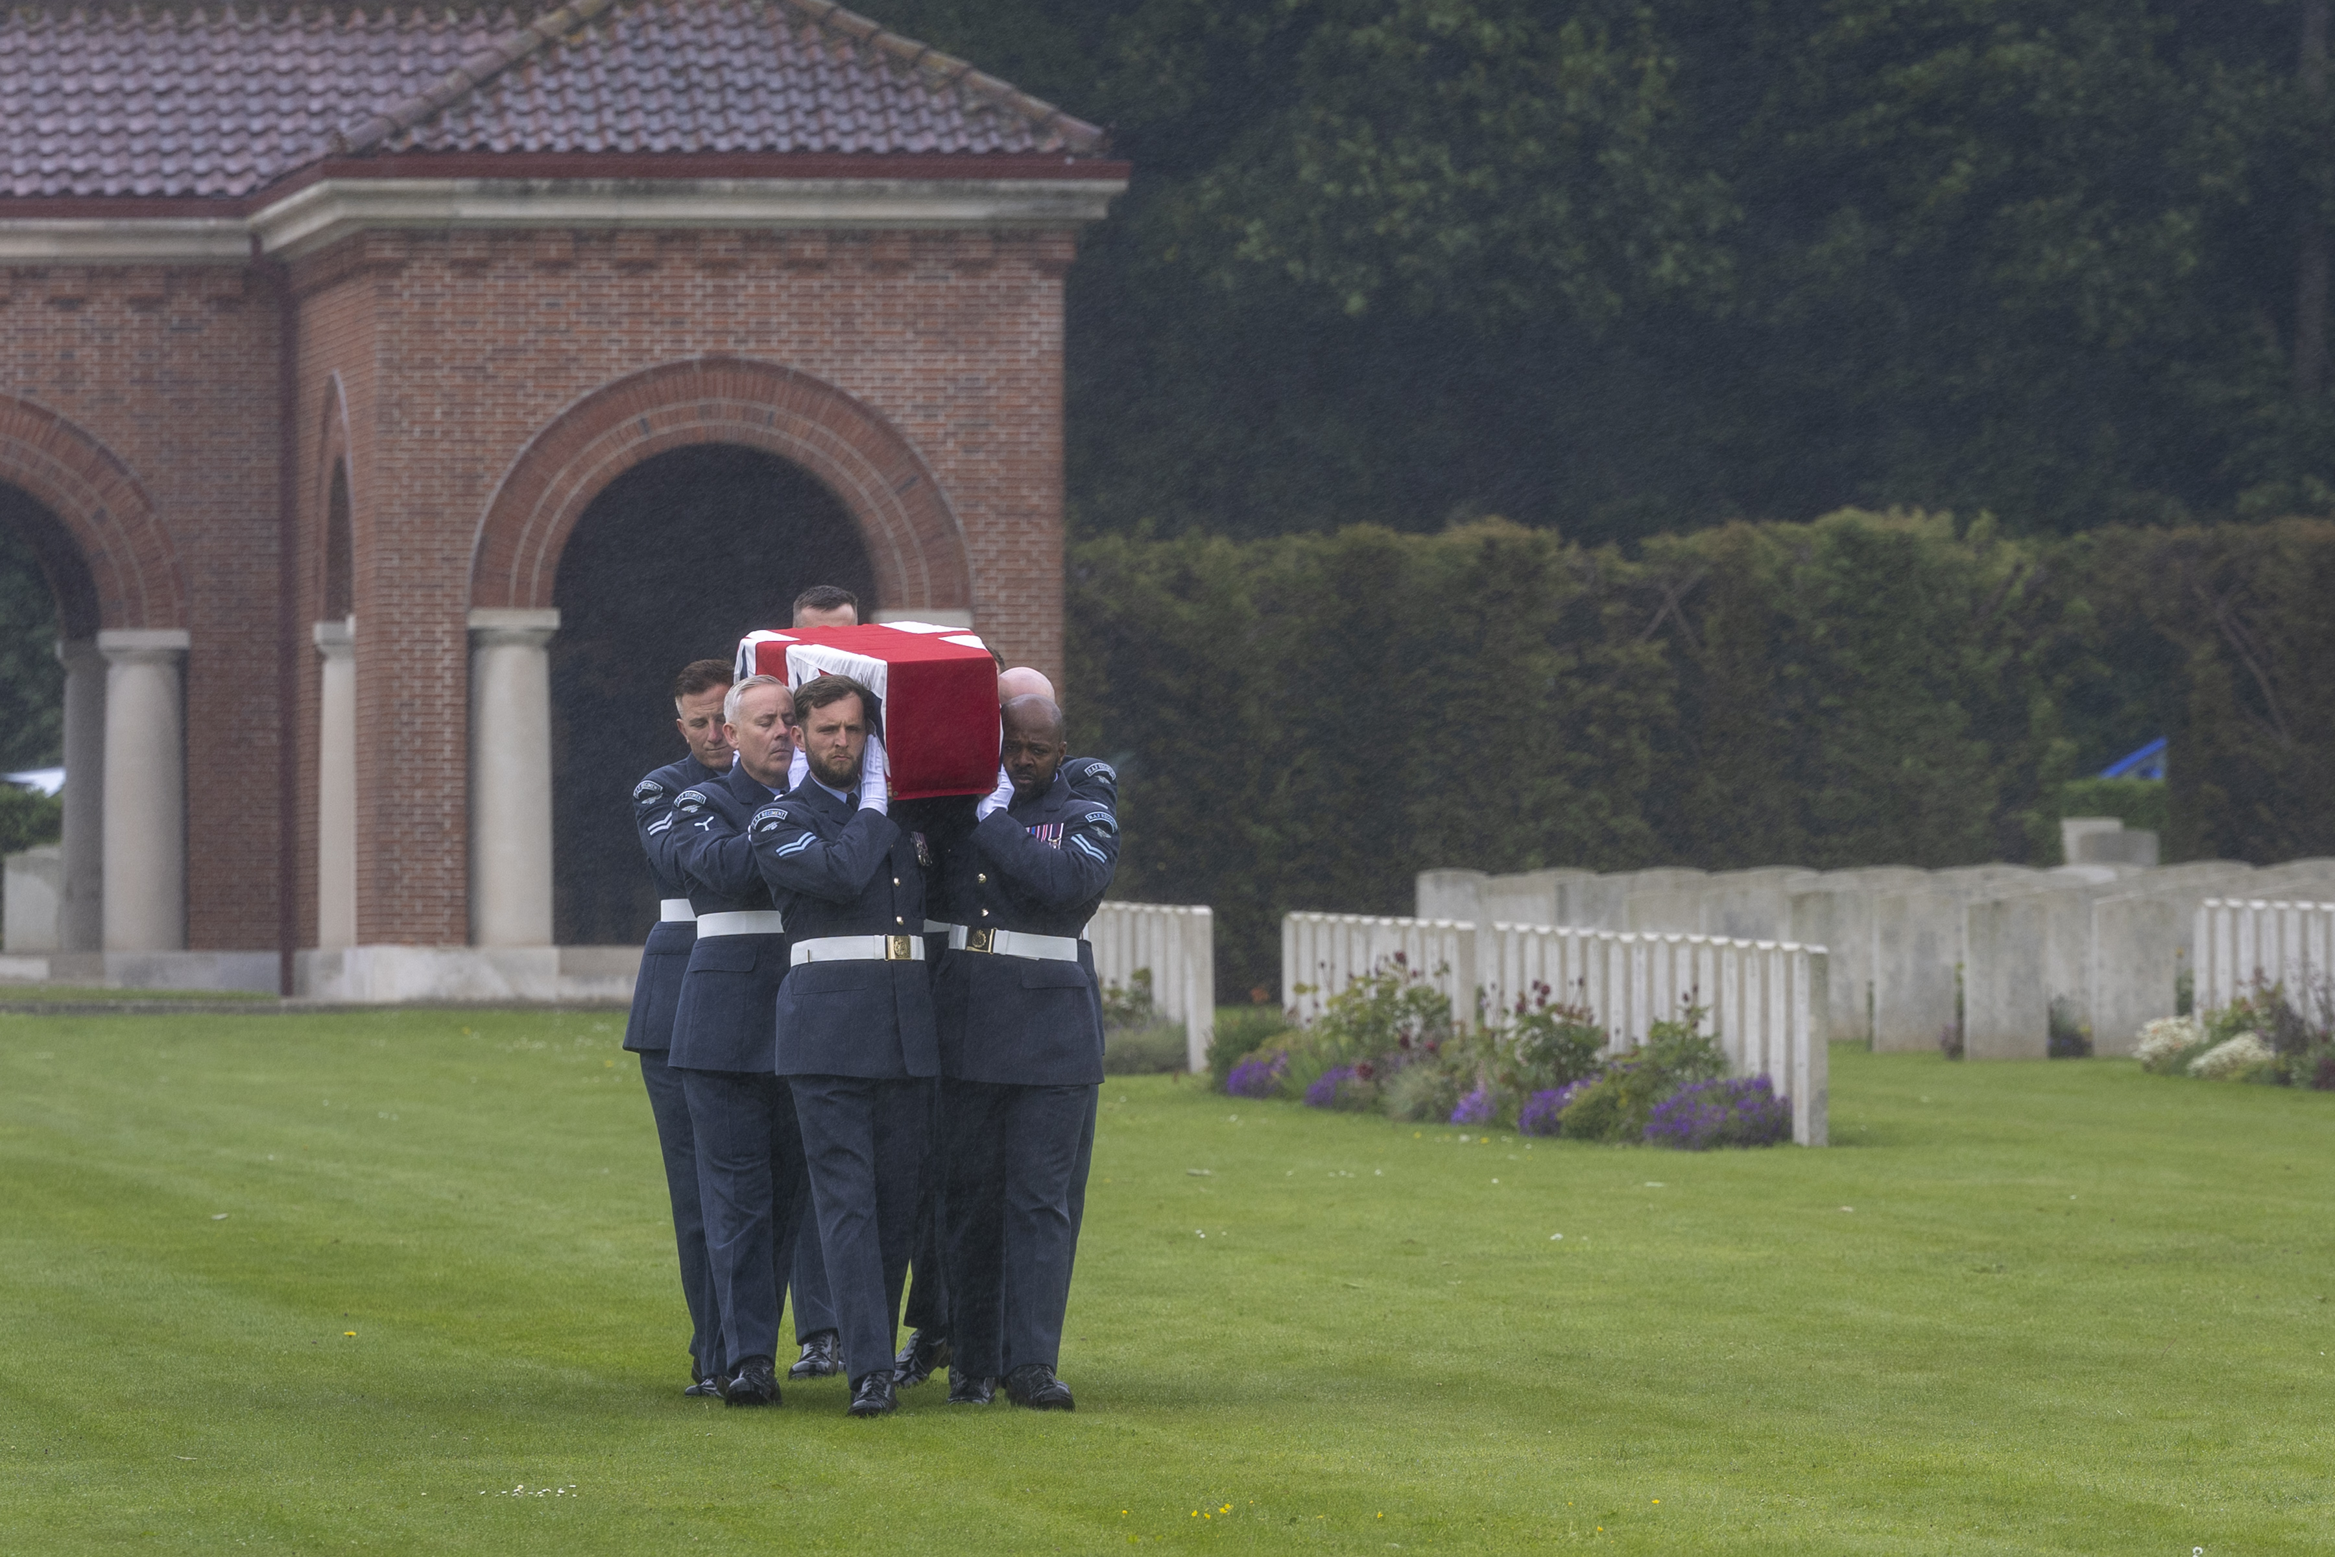
Burial of Squadron Leader George Morley Fidler
London Cemetery and Extension, Longueval, France
19 May 2026

Slide 34
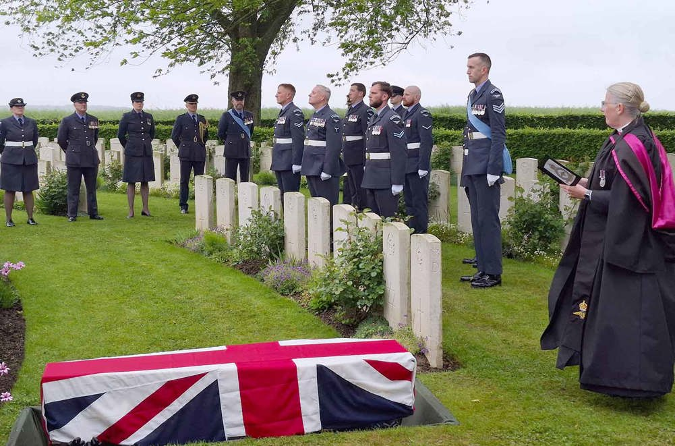

Slide 35
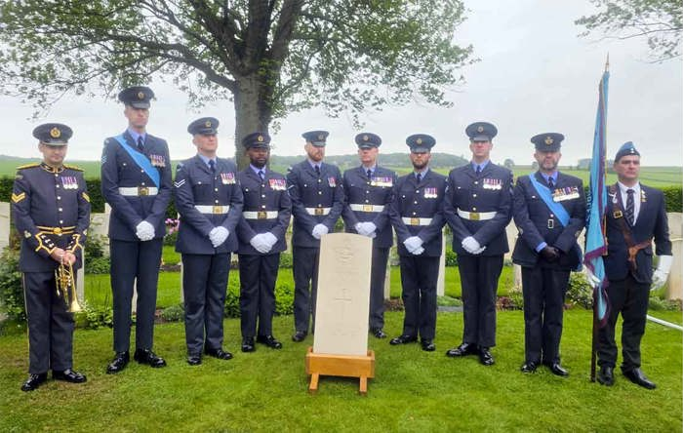
The CWGC headstone ready to be relocated above Morley’s grave

Slide 36
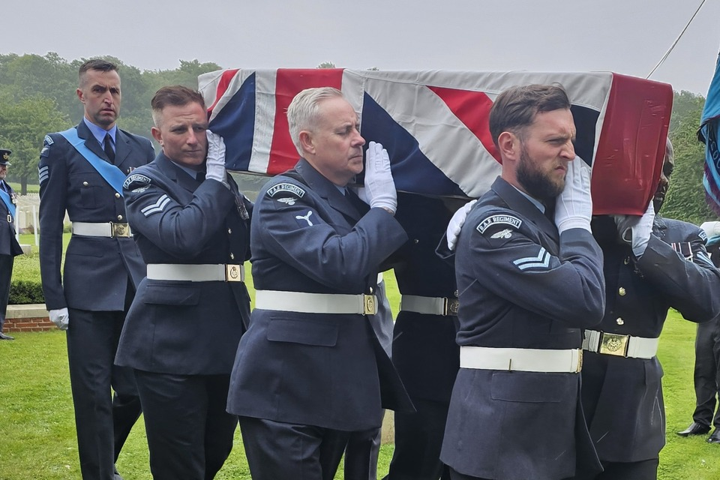
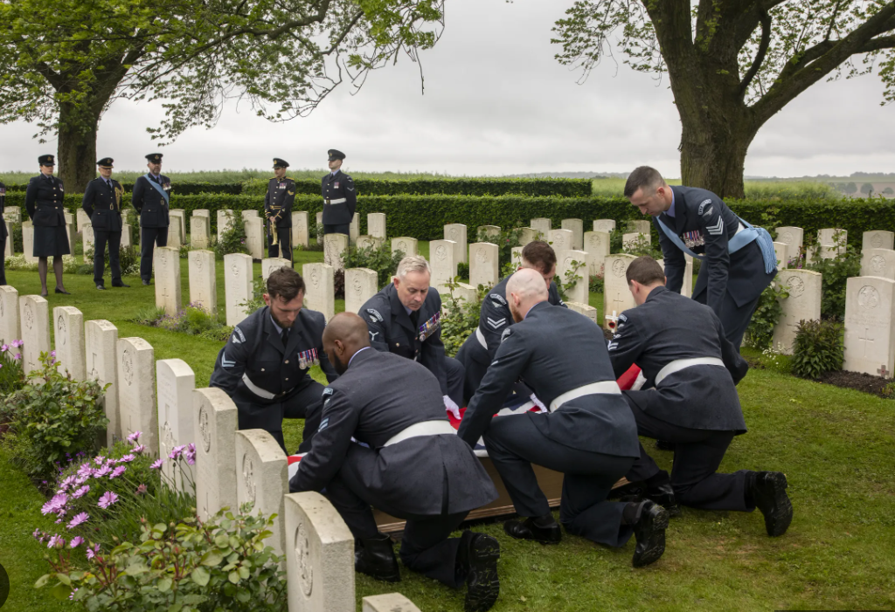
The burial

Slide 37
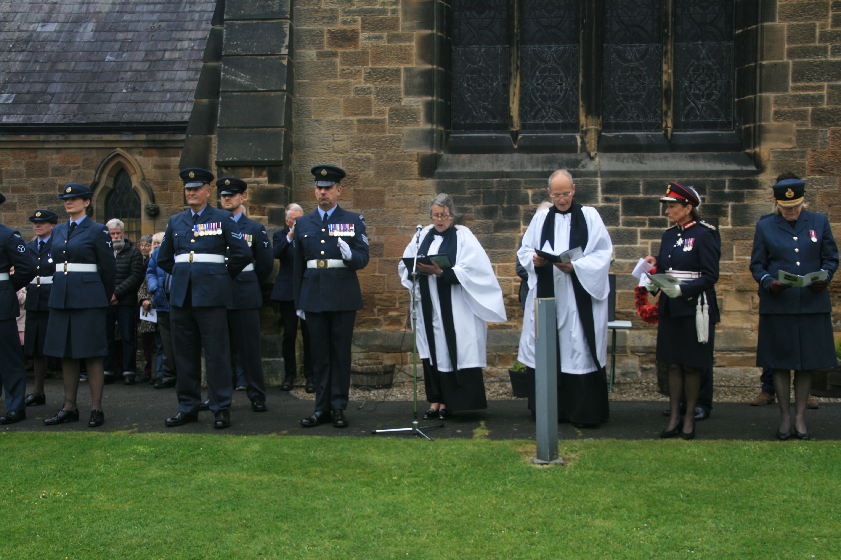
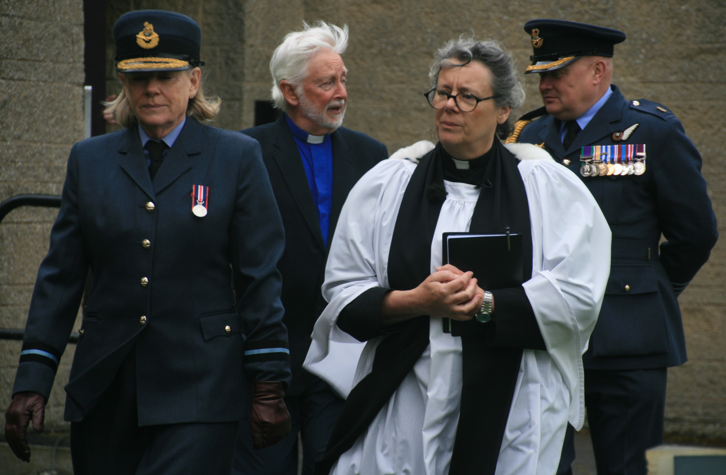
At the same time as Morley Fidler was buried, a service taken by the Rev Sarah Cliff, was held at Christ Church in Great Ayton.

Slide 38
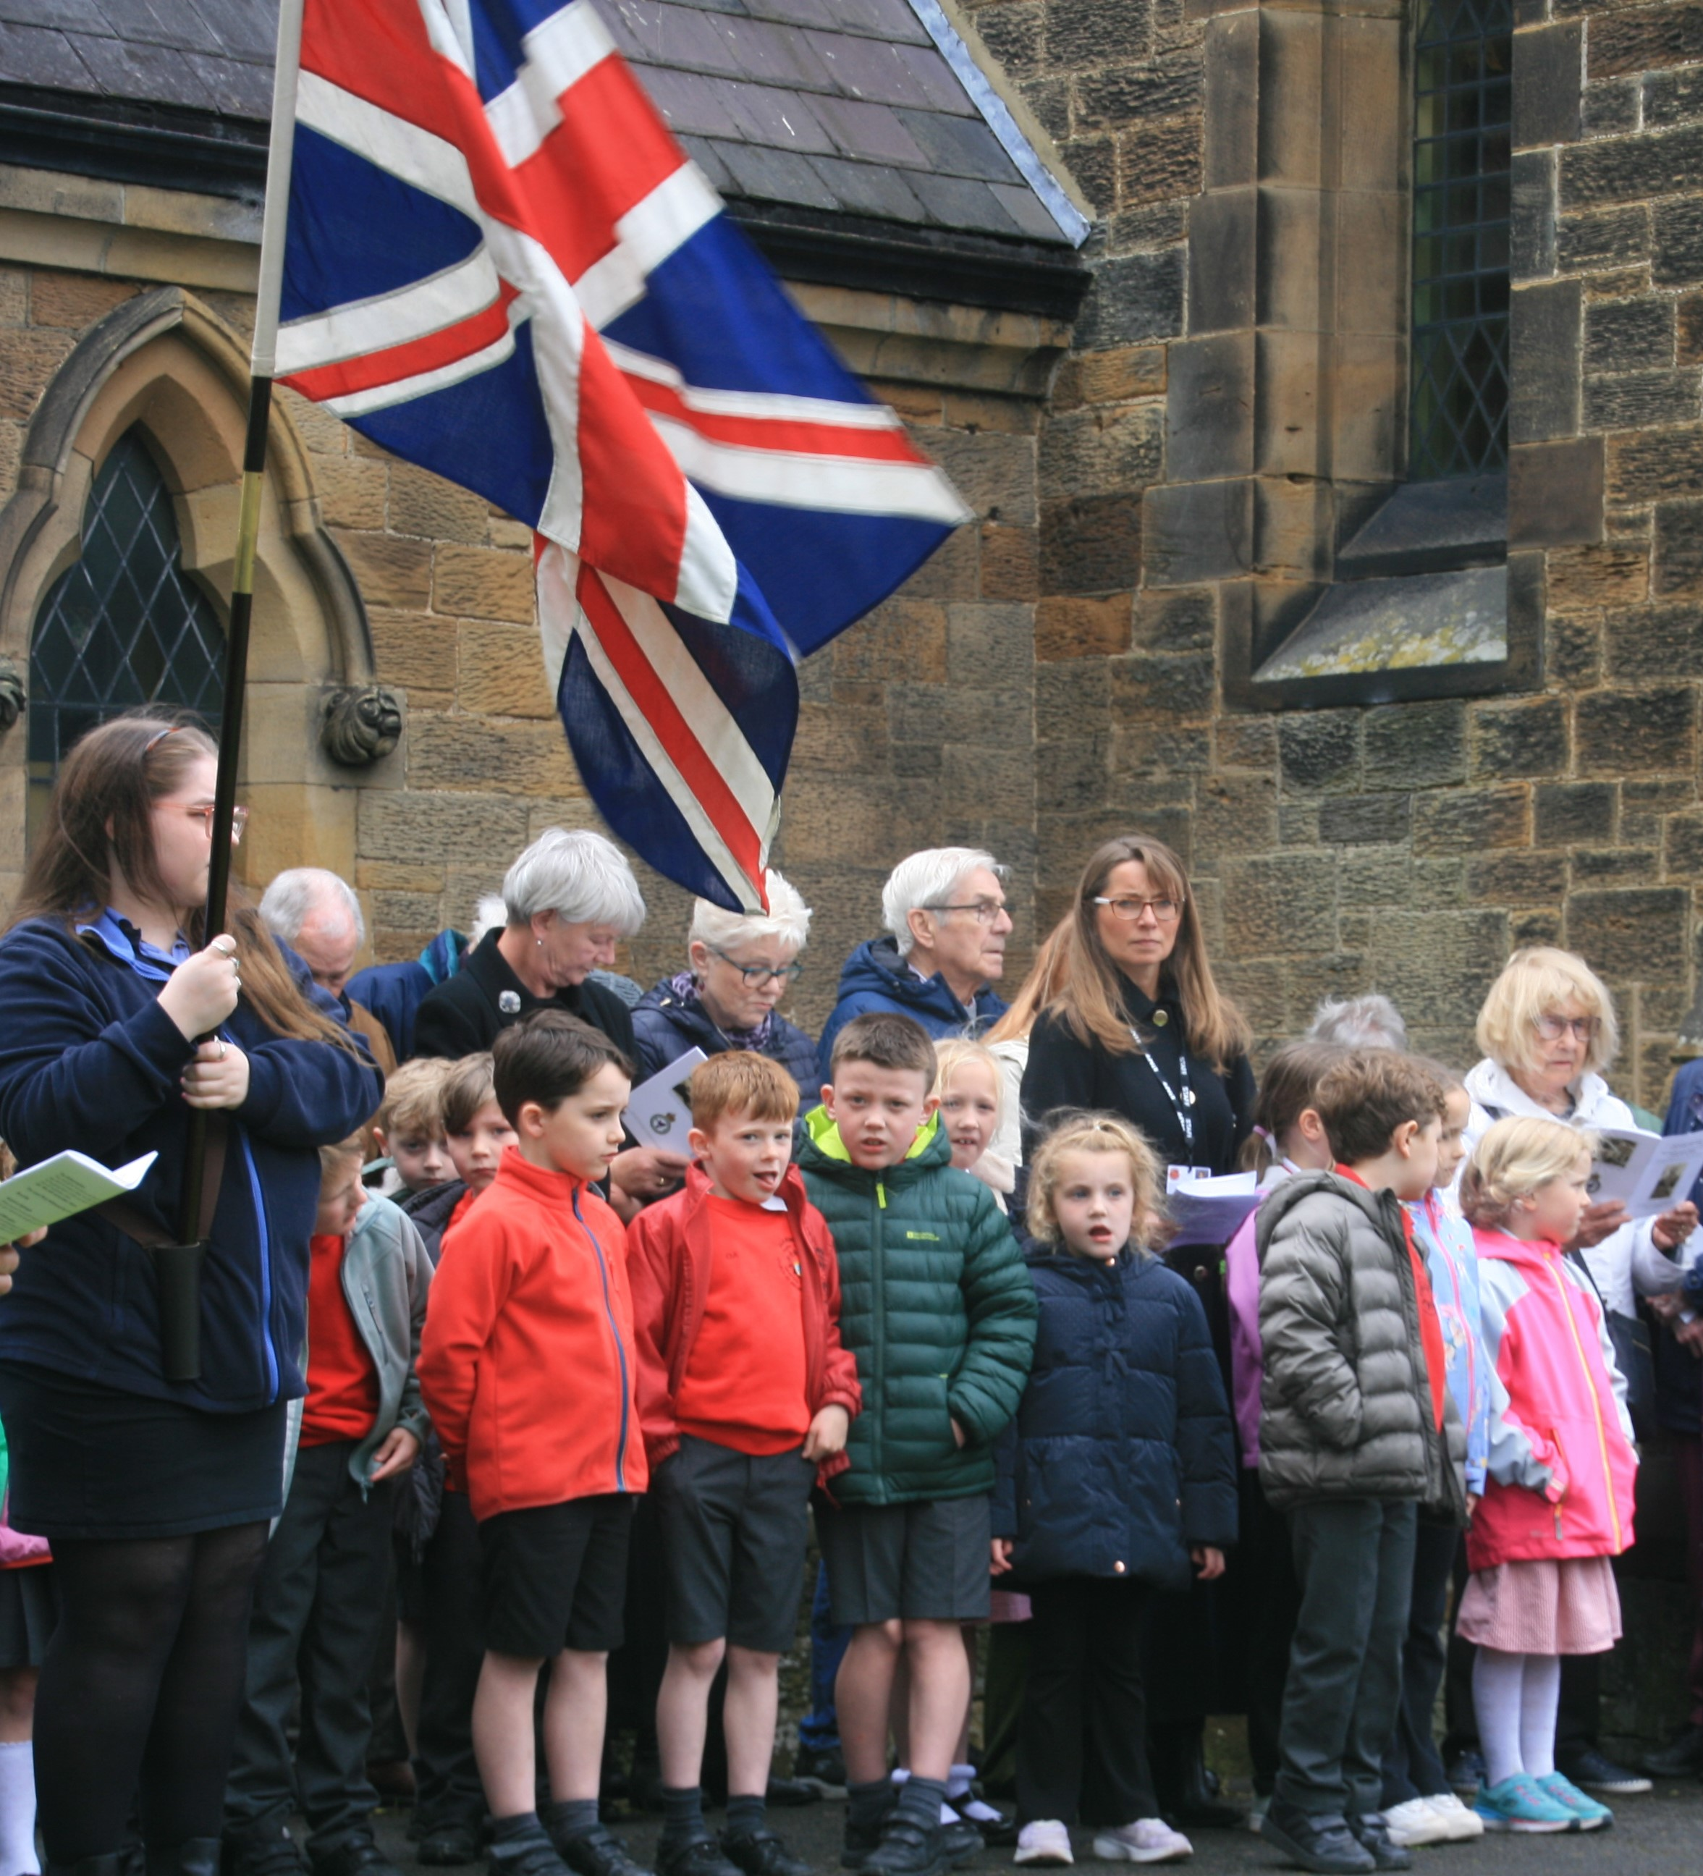
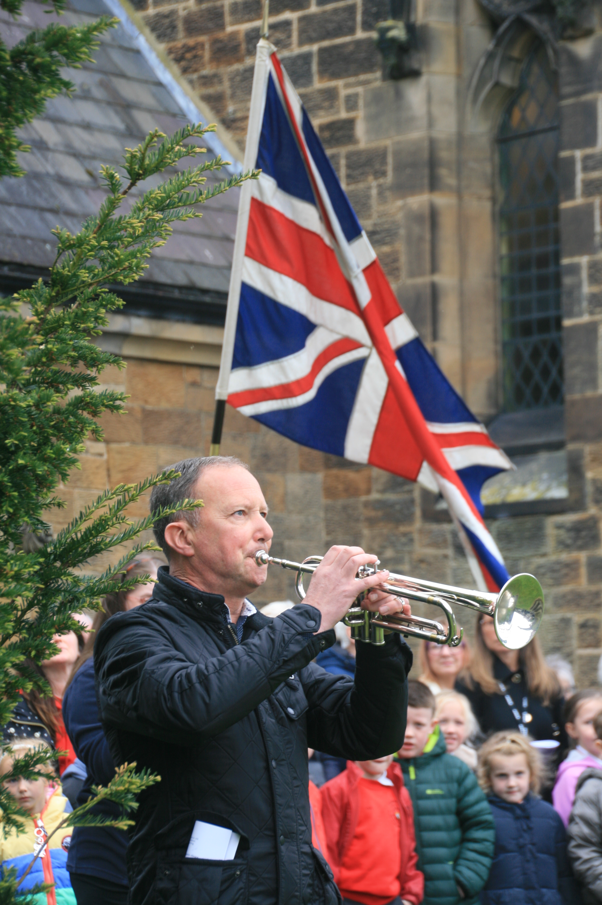

Slide 39
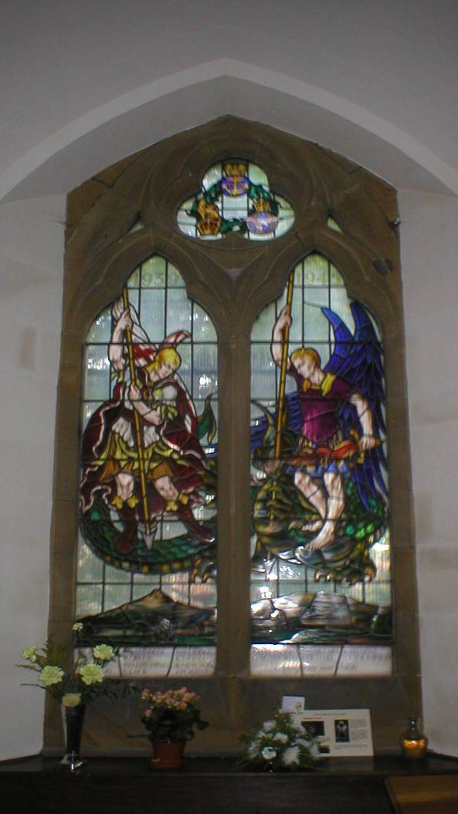
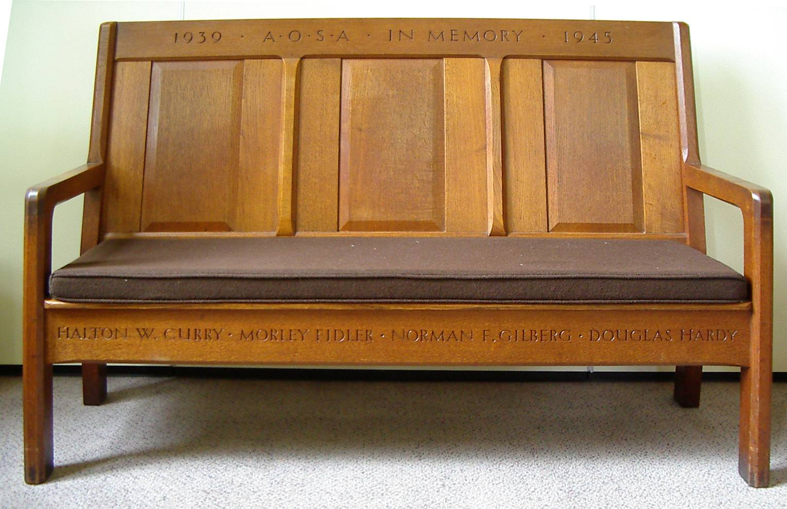
Locally, there are four memorials to Morley Fidler:
Christ Church War Memorial
Stained-glass window in Christ Church
- Carved bench in the Friends’ Meeting House
- Middlesbrough High School Memorial Plaque

Slide 40
Morley Fidler’s original Commonwealth War Graves Commission headstone at Bachy, inscribed, at the request of Mrs Fidler,
“So he passed over, and all the trumpets sounded for him on the other side”.
Later, the inhabitants of Bachy added another headstone with the words “Hommage ému de la population de Bachy au vaillant aviateur”.
It has now been replaced by a headstone to an unknown airman.

Slide 41
When Morley Fidler used to come back to Great Ayton, looping-the-loop in his Tiger Moth, he was a celebrity.
When Morley Fidler did not come back to Great Ayton, he was a hero.

Slide 42
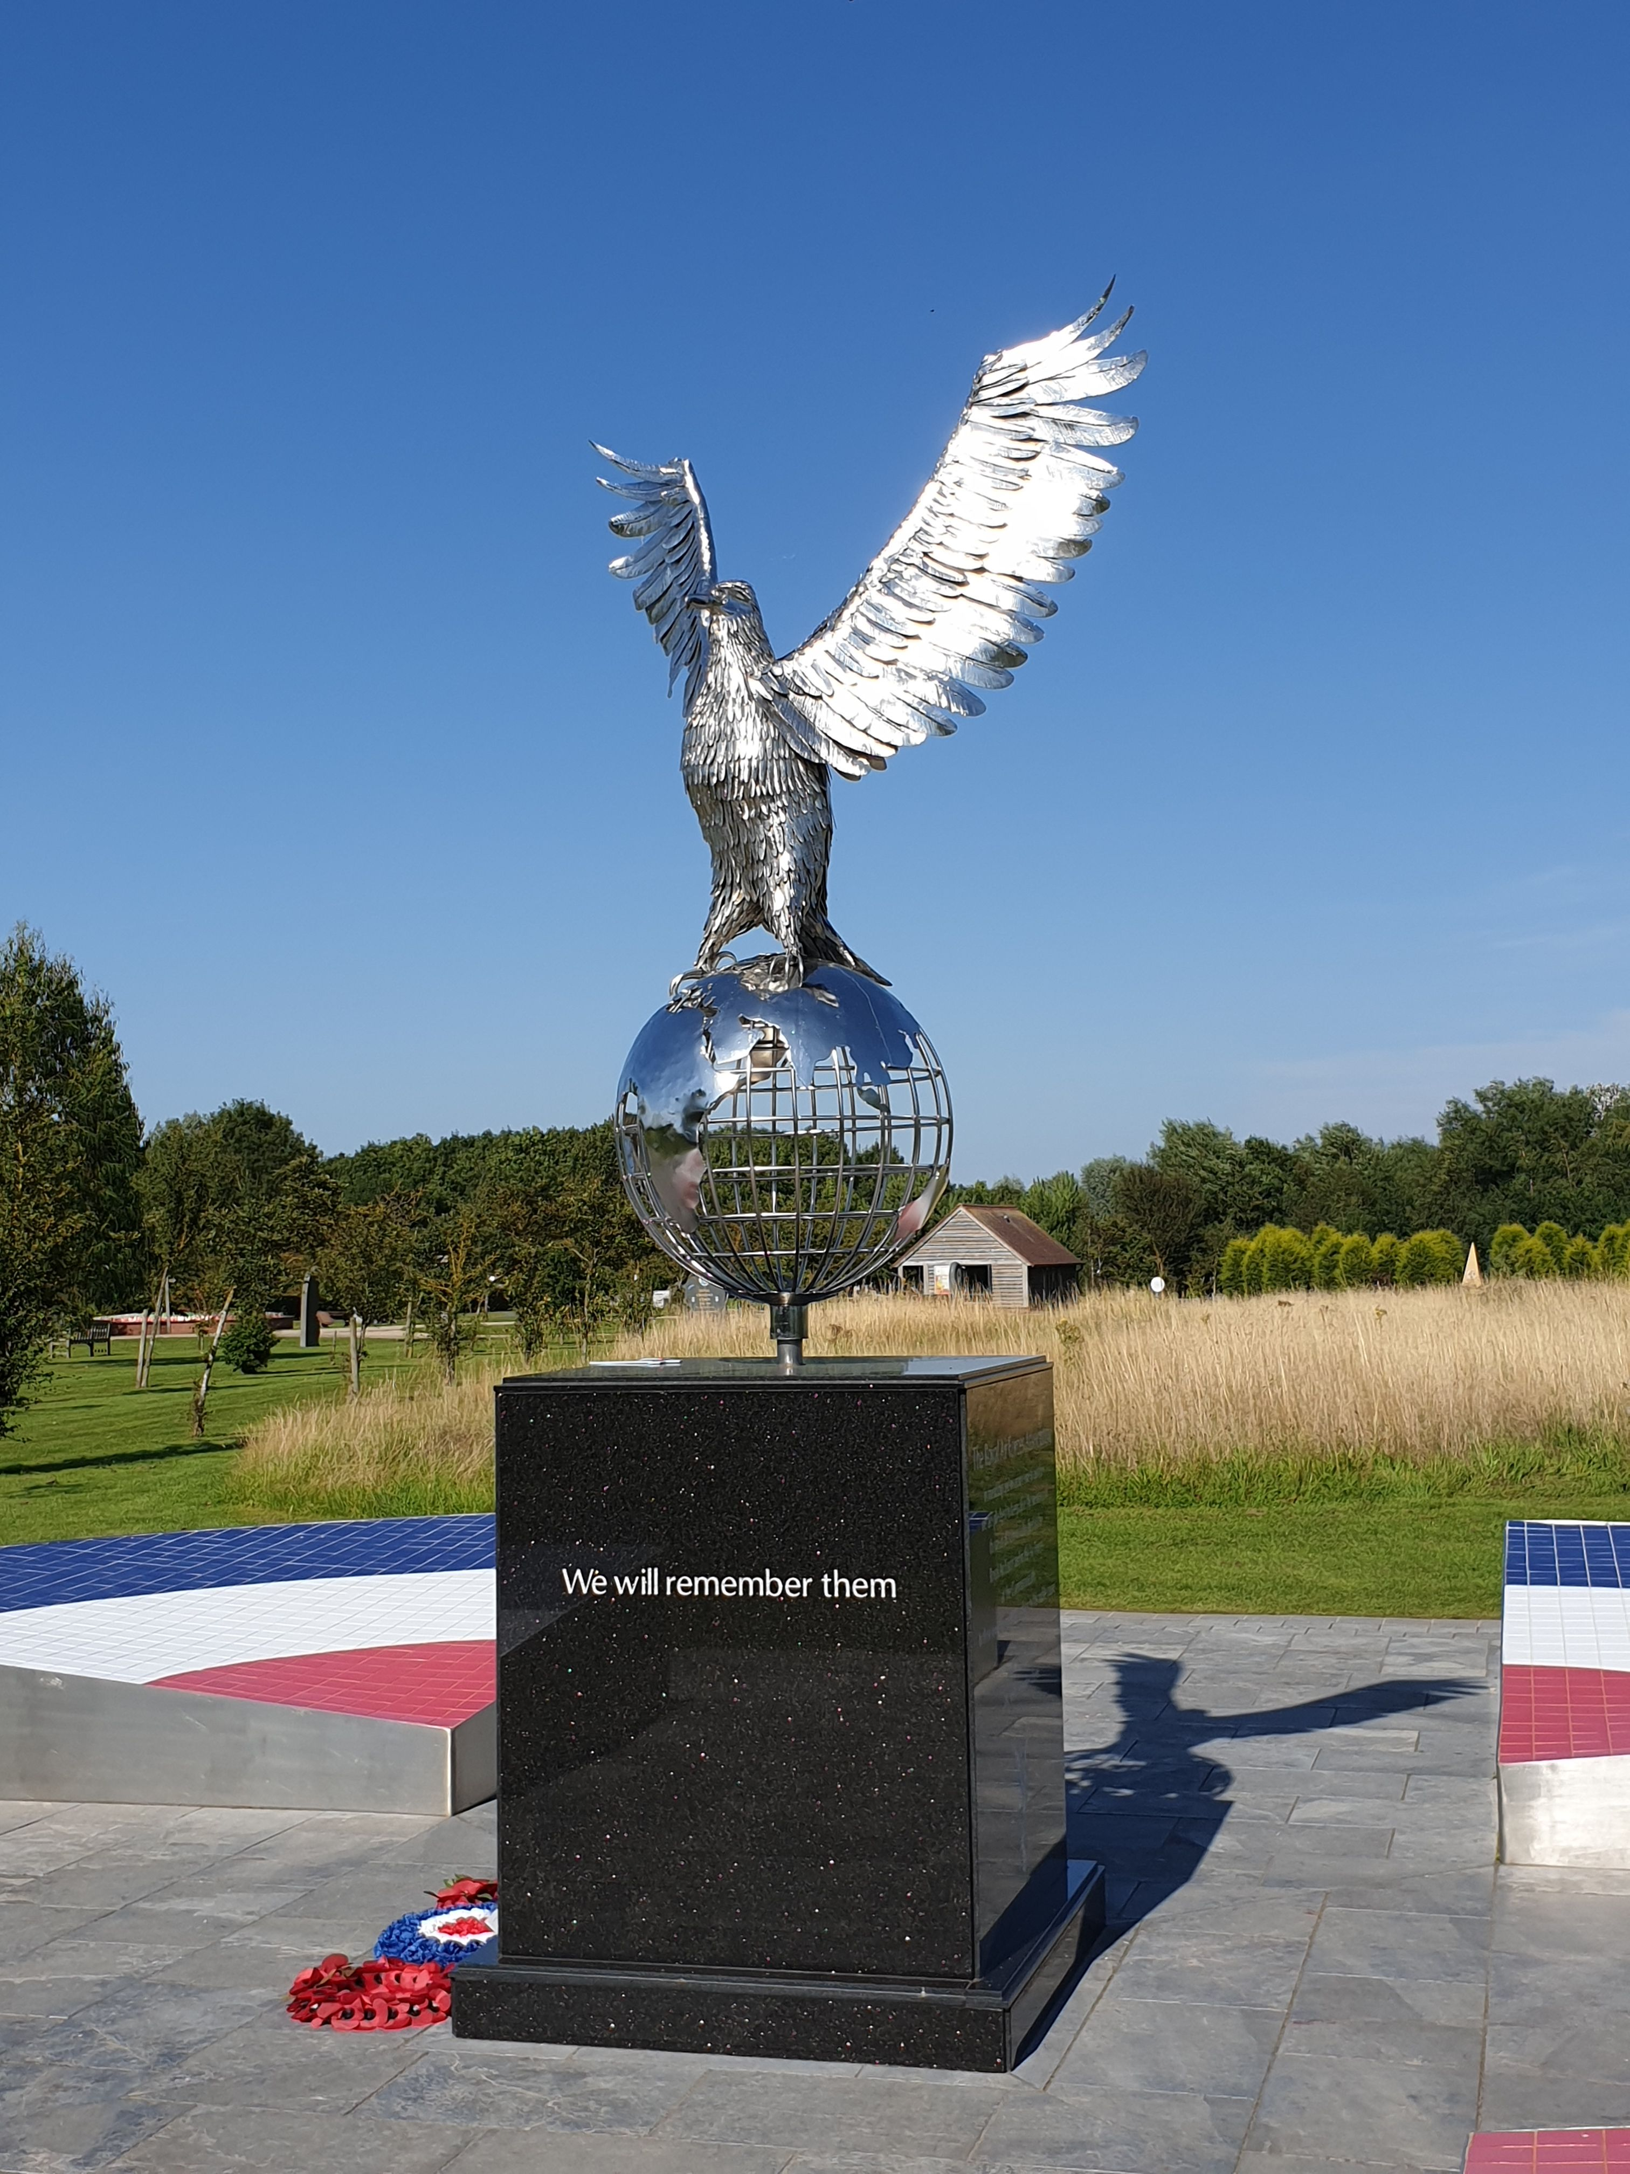
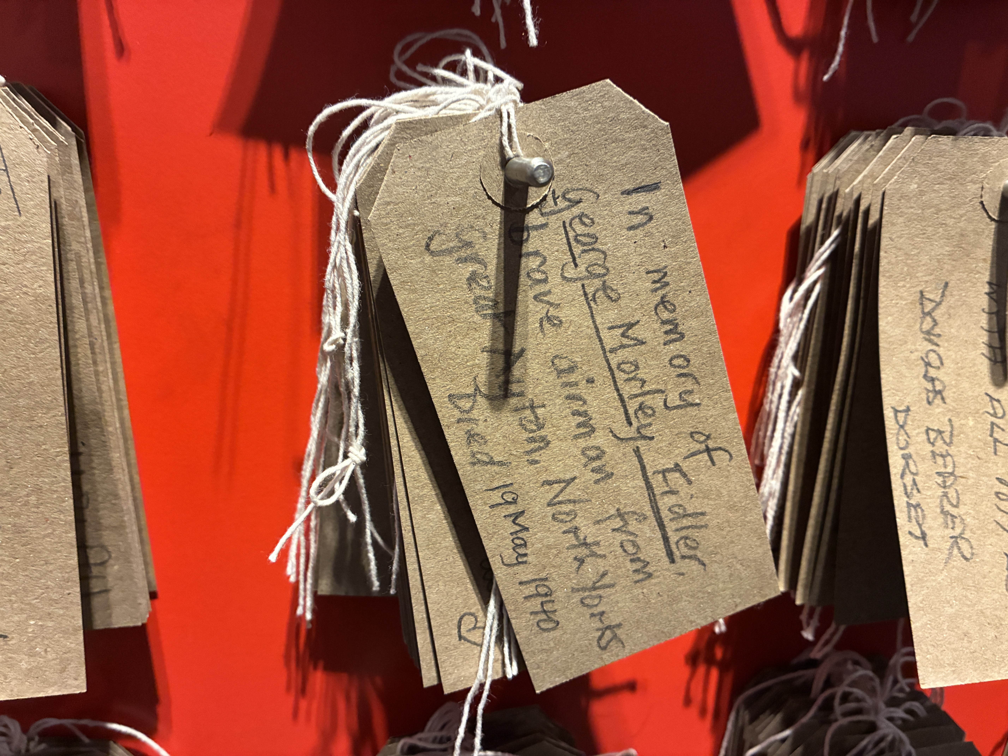
Six days ago, I wrote a card of remembrance for Morley Fidler at the National Memorial Arboretum.
The RAF Memorial

Slide 43
Joan Fidler Sister 1940
George Morley Fidler 1940
George Fidler Father 1942
Christiana Gertrude Fidler Mother 1965
Harold Fidler Brother 1973
While she was alive, Mrs Fidler saw the death
of two of her three children and her husband

Slide 44
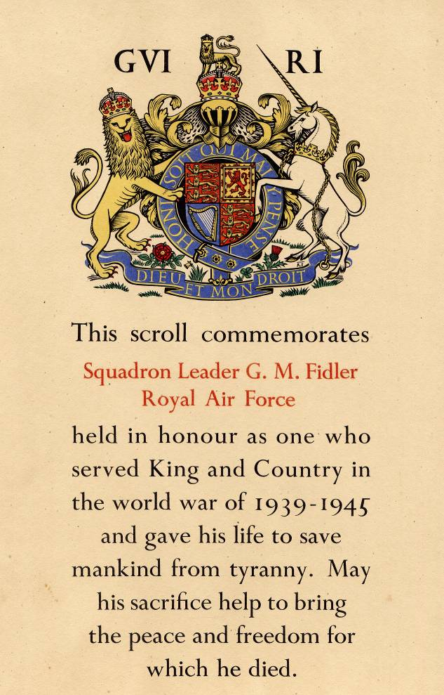
This has been based on researches by Ian Pearce and David Taylor in 2005-6, and by Nicola Nash of the MoD in 2026.
Acknowledgements are due:
Monsieur Henri Werbrouck, Bachy.
Bob Walters and Ivy Hynes of Great Ayton.
Members of the 607 Squadron Association.
RAF Personnel Management Agency, Innsworth.
National Archives, Kew.
Twelve days in May, the air battle for Northern France and the Low Countries
Brian Cull, Bruce Lander and Heinrich Weiss
Grub Street, 1999.
Twenty-one Squadrons, the history of the Royal Auxiliary Air Force 1925-1957
Leslie Hunt
Garnstone Press Ltd, 1972.

